Slide 1
Creating Space for Multi-Modal Text Sets
Set Created By: Christina Bustos

Slide 2
How will multimodal text sets transform our learning?
Guiding Question

Slide 3
What is a Multimodal Text Set?
A multi-modal text set helps us as learners to develop a well rounded understanding based on a topic.
These sets include access to books, audio or video read alouds, podcasts, interviews or other recorded interactions with an author or authors as well as websites, articles, timelines and song.
All of these materials are to help build our knowledge around the topic in an effort to see multiple sides to the story.

Slide 4
Here is NCTE's Declaration around Multimodal literacies:
Integration of multiple modes of communication and expression can enhance or transform the meaning of the work beyond illustration or decoration. What this means for teaching:
It is the interplay of meaning-making systems (alphabetic, oral, visual, etc.) that teachers and students should strive to study and produce. “Multiple ways of knowing” (Short & Harste) also include art, music, movement, and drama, which should not be considered curricular luxuries.
All modes of communication are codependent. Each affects the nature of the content of the other and the overall rhetorical impact of the communication event itself.
Young children practice multimodal literacies naturally and spontaneously. They easily combine and move between drama, art, text, music, speech, sound, physical movement, animation/gaming, etc.What this means for teaching:
Children who grow up in impoverished or repressed literacy environments may not experience this important early literacy foundation.
The over-emphasis on testing and teaching to the test may deprive many students of the kinds of multimodal experiences they most need.
An exclusive emphasis on digital literacies is not what most advocates of technology-rich composition advocate. Such an emphasis would limit students’ access to other modes of expression.

Slide 5
Why use text sets in the classroom?
Student Impact:
A collection around a theme, topic, event or any other collection adds to students understanding of the content being taught in your classroom.
These different sets allows for all learners to participate in the learning in multiple and varied ways, but specifically giving them choice and independence.
Teacher Impact:
A place to curate the a collection around a theme or topic that allows us to continue to provide resources that will sustain.
An opportunity to create a structure you can reproduce as you create more in depth sets to support student learning.

Slide 6
The Different Modes of Literacy Sharing
Fiction & Nonfiction
Novels & Picture Books
Videos
Timelines
Audio Books
Oral History
Podcasts
Music
Spoken Word

Slide 7
Novels & Picture Books
This should be where you start your units! Then as you look at the themes of the main texts you include it would be important to curate a set that supports the themes you are identifying as important.
Be mindful of the number of themes that you have to work with each text there may be potential for more text sets as you move forward.

Slide 8
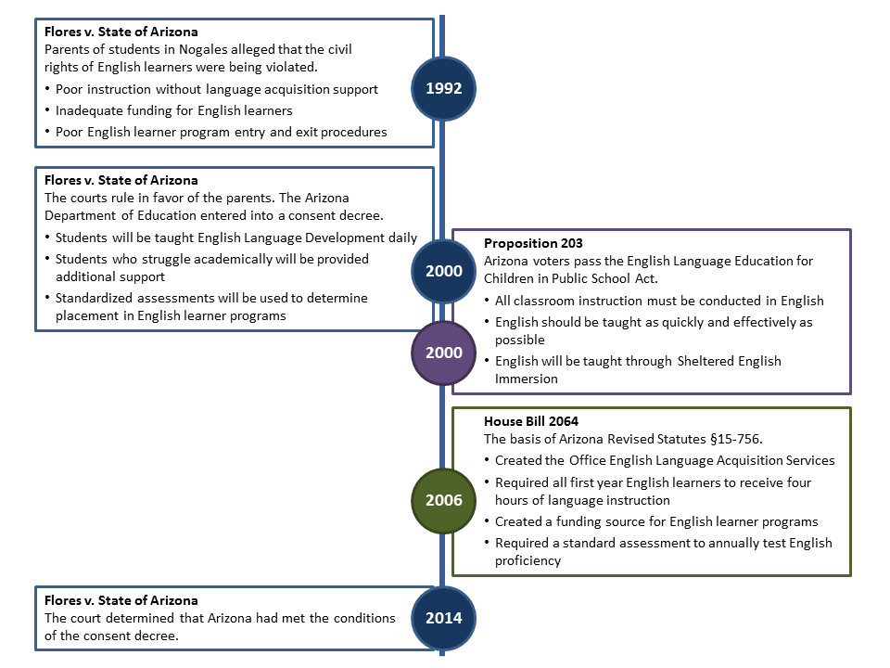
Timelines
Teaching with Timelines says, “Timelines help students understand the chronology of historic events, and help students situate newly encountered events and figures in relation to those they’ve already studied”.
The article suggests that it’s important that the student construct it themselves to put the information into perspective.
Digital Timelines Teaching Resources from Vanderbilt University

Slide 9
Videos
The purpose of adding video content is to enhance the understanding of the learning from the text, in a visual and auditory way.
Videos should be used strategically if it’s a documentary. Perhaps with something like Edpuzzle or Canvas studio where you can ask questions along the way.
Also another route is creating interactive notes that the students can watch a part, discuss and write you could use padlet, jamboard or even a Google Doc or Slides.

Slide 10
Music
There are many reasons to use music as a teaching tool. One of the primary ways is as a primary or secondary source to convey the sentiment of the time, or perhaps to represent a period of time. Here are a few examples to give ideas as to how to incorporate music into your classroom.
3 Ways to Use Music in the Classroom From Edutopia
Music as a Teaching Tool From Edutopia
Music in the Classroom from Scholastic
Music and Literacy NCTE Blog
Mind Meets Music Teaching Early Childhood Literacy Through Music

Slide 11
What is Oral History, Spoken Word, Audiobook and Podcast?
Oral History is the collection and study of historical information using sound recordings of interviews with people having personal knowledge of past events.
Spoken word is poetry that is performed for an audience. It uses the affordances of spoken language such as word play and intonation, to explore ideas and experiences and communicate them to others, according to Literacy today QC.
An Audio book is a book read on "tape" or recorded digitally. In truth, that sounds pretty boring as I write it, but the important part is that Audiobooks are no longer those drawn out boring readers with newscaster voices. They are vibrant actors who are chosen to read books based on the characters that they create with their voices!
A podcast, according to Merriam Webster is, " a program (as of music or talk) made available in digital format for automatic download over the Internet". What I have found from my own research is that it's similar to the art of storytelling it could be about anything but always around a predetermined topic. So, you can find a variety of different podcasters, or people who record podcasts, on topics. Often times they invite others to have discussions around something.

Slide 12
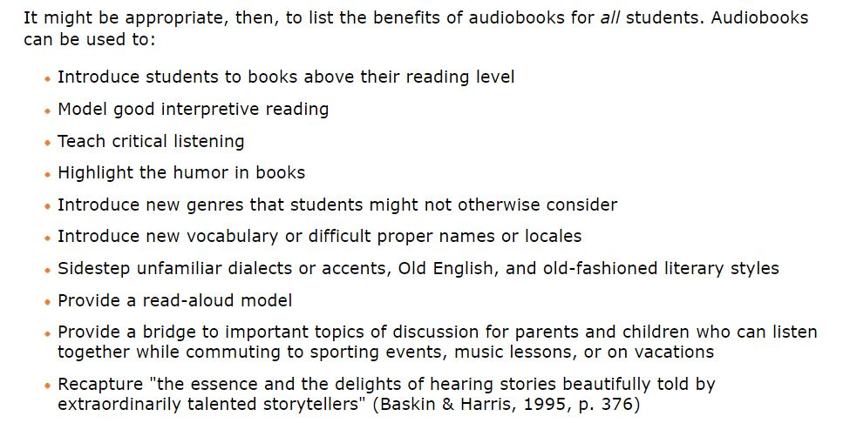
Audio Books
To Your Brain, Listening to a Book is Pretty Much the Same as Reading it.
Is Listening to Audiobooks Cheating?

Slide 13
Audio Book Resources
https://www.readingrockets.org/article/benefits-audiobooks-all-readers
https://www.readingrockets.org/article/listen-and-learn-audio-books
https://www.readingrockets.org/news/how-audiobooks-can-help-kids-who-struggle-reading
https://www.readingrockets.org/article/audiobooks-ideas-teachers
https://www.westerndownslibraries.com/the-benefits-of-listening-to-audiobooks-are-extensive/

Slide 14
Oral History
Oral History as an Innovative Language Teaching Technique for Spanish Heritage Language Learners
The Challenges of Oral History in the 21st Century: Diversity, Inequality and Identity Construction Using Online Video Oral Histories in University Courses across the Curriculum
Click Above
Patricia Preciado Martin discusses how she started writing around culture and community.

Slide 15
Oral History Resources
Smithsonian Institutes Introduction to Oral History
StoryCorps Podcast From Common Sense Education
https://www.loc.gov/classroom-materials/oral-history-and-social-history/
https://edsitement.neh.gov/teachers-guides/oral-history-educational-experience
Voice of Witness:Bringing the Power of Oral History to the Classroom from Cult of Pedagogy

Slide 16
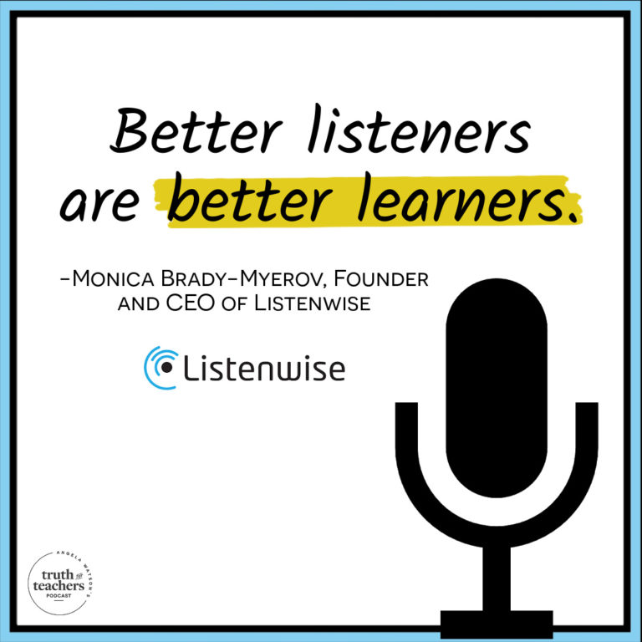
Podcasts
Click on the picture to access the podcast with Angela Watson’s The Cornerstone for Teachers.
Common Sense Education, How Podcasts Improve Literacy in the Classroom
How to Use Podcasts in the classroom

Slide 17
Podcast Resources
19-great-learning-podcasts-for-the-classroom Common Sense Education
Great Podcast Examples for Teachers and Students Common Sense Education
Best Podcast Apps and Websites for Students Common Sense Education

Slide 18
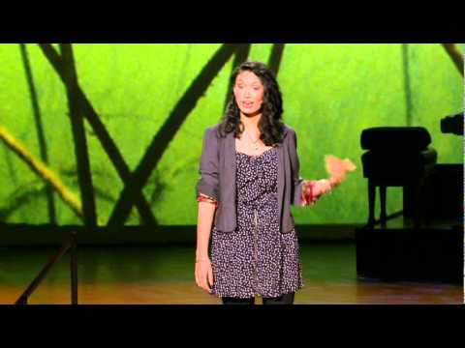
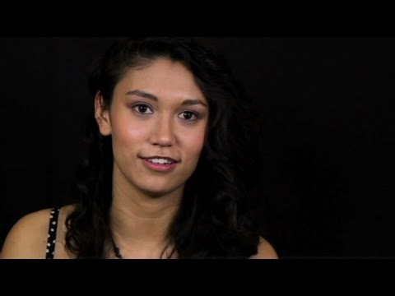
Spoken Word
Poetry and Spoken Word connections
With spoken word and hip-hop, a new generation of poets has taken the stage
Sarah Kay shares a spoken word story and then explains how the impact on her classroom.
Definition and Roots in Poetry

Slide 19
Spoken Word Resources
Facing History and Ourselves, How to Bring Spoken Word to the Classroom
Read Write Think, Crossing Boundaries Through, Bilingual Spoken Word Poetry
Edutopia, 5-Minute Film Festival: The Power of Spoken Word Poetry
Literacy Today QC, Creating Spoken Word Poetry

