Slide 1
African American Voices
What are the prominent events and characters in African American History in Minnesota from 1930-current day?
How do books historically represent the events happening in a community?
How does culture and literature reflect a history of a community?
Kari Matthies

Slide 2
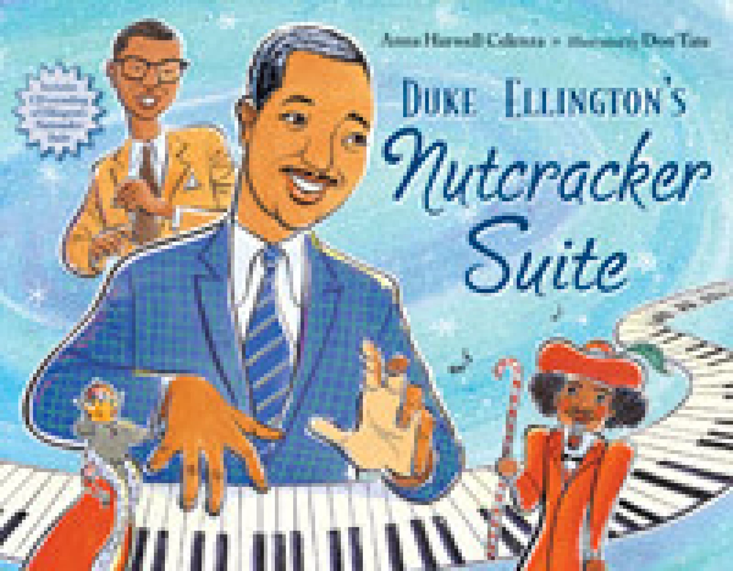
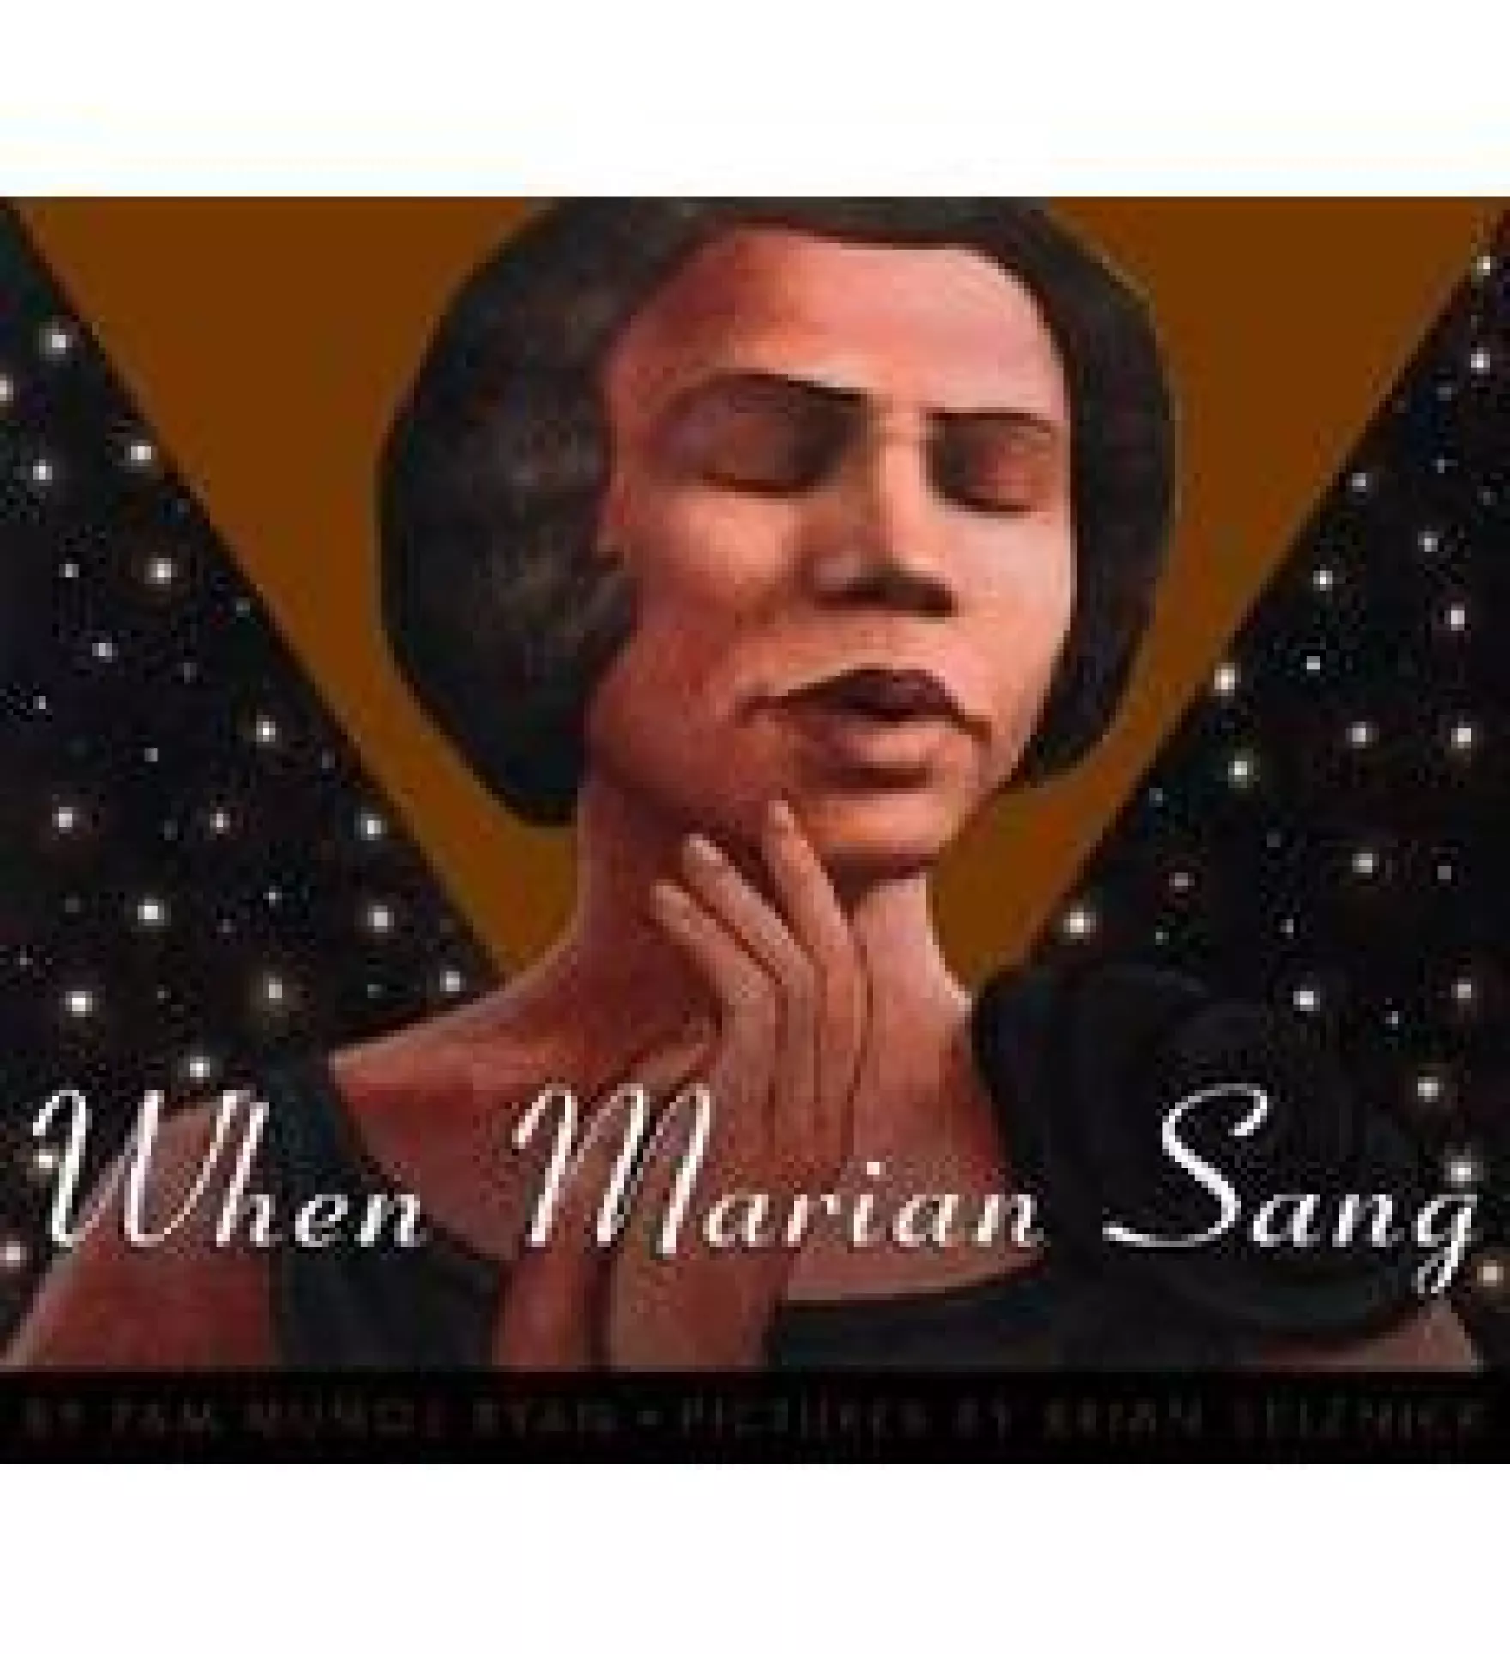
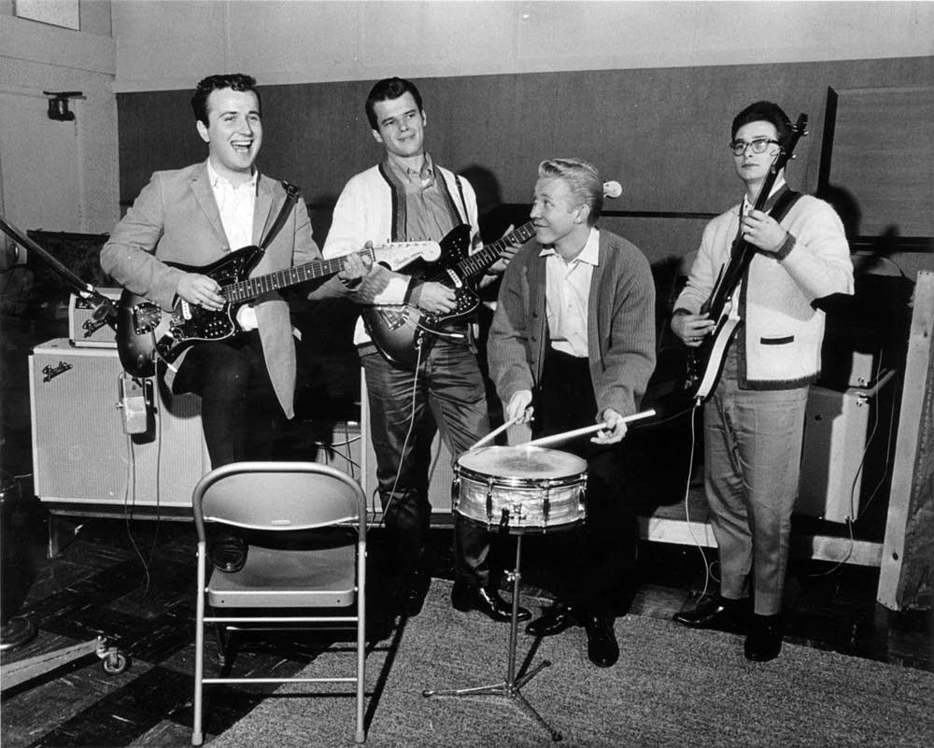
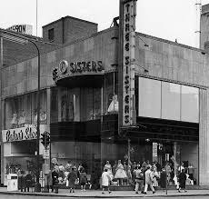
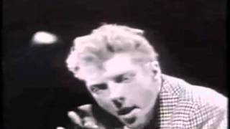
How Duke Ellington, Bill Strayhorn, Irving Townsend and Slim Gaillard turned Tchaikovsky’s famous ballet The Nutcracker into a jazz masterpiece.
Ryan's text tells the story of Anderson's childhood in south Philadelphia, where her supportive church family fostered her early confidence in her gift, and of her later life navigating the roadblocks of racial prejudice she encountered at every stage of her career.
Before 1960

Slide 3
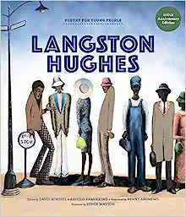
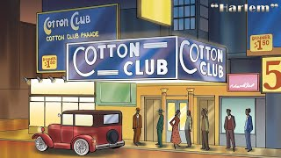
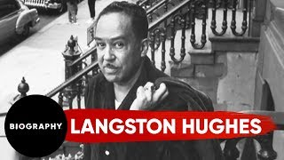
A Coretta Scott King Honor Award recipient, Poetry for Young People: Langston Hughes includes 26 of the poet’s most influential pieces, including: “Mother to Son”; “My People”; “Words Like Freedom”; “I, Too”; and “The Negro Speaks of Rivers”—Hughes’s first published piece, which was originally released in June 1921. This collection is curated and annotated by Arnold Rampersad and David Roessel, two leading poetry experts. It also features gallery-quality art by Benny Andrews and a new foreword by Renée Watson, a Newbery Honor Award recipient and founder of the I, Too Arts Collective.
Before 1960

Slide 4
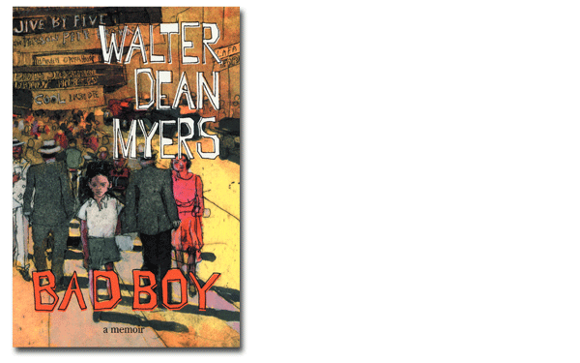
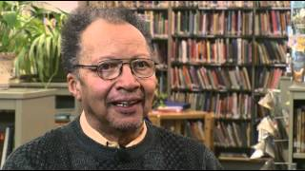
“In truth, everything in my life in 1951 that was personal and had value was white,” Walter Dean Myers later wrote in his memoir “Bad Boy.” It wasn’t until he reached adulthood and read “Sonny’s Blues,” by James Baldwin, a fellow Harlemite, that he felt he had permission to offer the world a narrative with blackness at its core. By then, after a stint in the Army, he was writing seriously. In 1968, his picture-book manuscript for “Where Does the Day Go” won a contest for black writers by the Council on Interracial Books for Children. It was published the following year. Eventually he would write more than a hundred books for young people: lyrical picture books and gritty novels, poetry and short stories, history, biography, memoir, books that earned him nearly every major award children’s publishing had to offer.
Before 1960

Slide 5
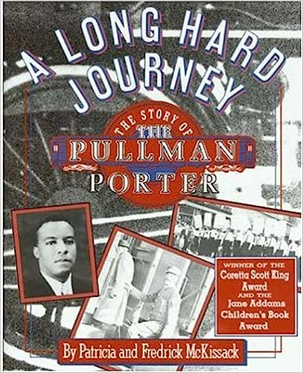
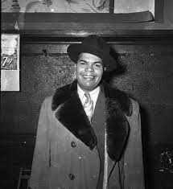
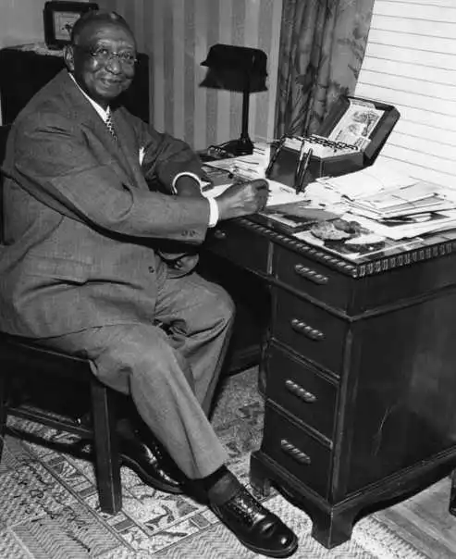
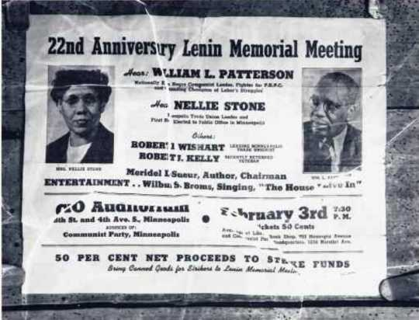
A chronicle of the first black-controlled union, made up of Pullman porters, who after years of unfair labor practices staged a battle against a corporate giant resulting in a "David and Goliath" ending.
Blacks who worked for the railroad as porters organized St. Paul Lodge No. 5 of the United Brotherhood of Railway Porters of North America in 1887. In 1925, A. Philip Randolph organized a national union, the Brotherhood of Sleeping Car Porters; Frank Boyd, who had worked as a Pullman porter since 1907, organized meetings for the Brotherhood in St. Paul. Boyd was fired for union organizing. In 1976, the City of St. Paul dedicated a park in his name.
The St. Paul Urban League was founded in 1923 to address Black unemployment and race discrimination. In 1935, the National Labor Relations Act (NLRA) encouraged workers to organize unions, but most labor unions barred Blacks from membership. Despite this prohibition, Anthony Cassius and Nellie Stone Johnson became prominent labor organizers in Minnesota. Cassius organized the all-Black waiters union at the Curtis Hotel in Minneapolis in 1935 after learning that white waiters made more money than Black waiters. The Hotel and Restaurant Workers Union did not accept Black members, so Cassius organized Local 614 of the Hotel and Restaurant Waiters Union.
Cassius sued the hotel and won a $13,000 wage increase and $3,500 in back pay for Black waiters in 1940. Johnson helped organize Local 665 of the Hotel and Restaurant Workers Union at the Minneapolis Athletic Club. She later became the first Black elected official when she was elected to the Minneapolis Library Board in 1945, and she helped create the Democratic–Farmer–Labor Party (DFL). A school in Minneapolis is named after Johnson.
Before 1960

Slide 6
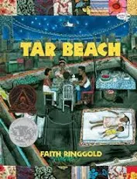
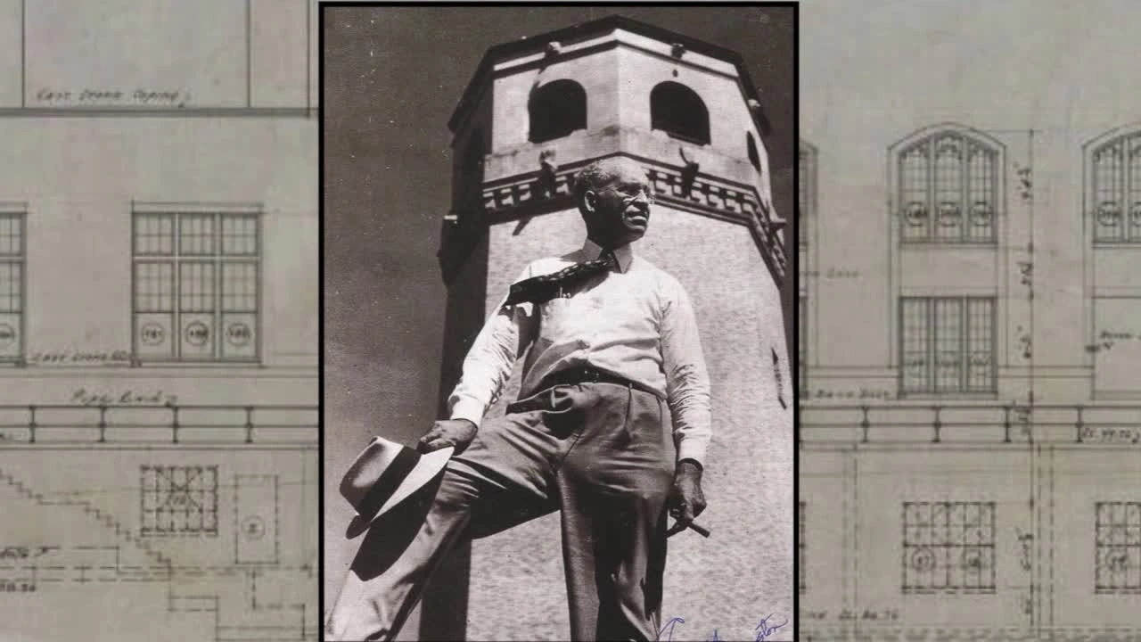
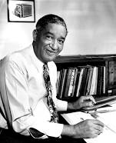
Cassie Louise Lightfoot has a dream: to be free to go wherever she wants for the rest of her life. One night, up on “tar beach,” the rooftop of her family’s Harlem apartment building, her dreams come true. The stars lift her up, and she flies over the city, claiming the buildings and the city as her own.
As Cassie learns, anyone can fly. “All you need is somewhere to go you can’t get to any other way. The next thing you know, you’re flying among the stars.”
African Americans contributed to and achieved success in medicine, education, law, business, politics, and the arts. Some Minnesota trailblazers were Dr. Robert S. Brown, the first Black doctor; Richard Green, the first Black superintendent of Minneapolis Public Schools; and Clarence “Cap” Wigington, the first Black municipal architect. Frederick Jones was the first Black inducted into the National Inventors Hall of Fame. He created the Thermo King portable refrigeration unit, which allowed delivery trucks to keep goods cool. Archie Givens, a business owner and real estate developer, was the first Black millionaire in Minnesota. He and his wife, Phebe, established the Archie Givens Sr. Collection of African American Literature at the University of Minnesota, which consists of over 10,000 books, magazines, and pamphlets by or about African Americans.
Before 1960

Slide 7
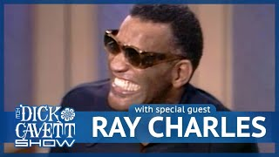
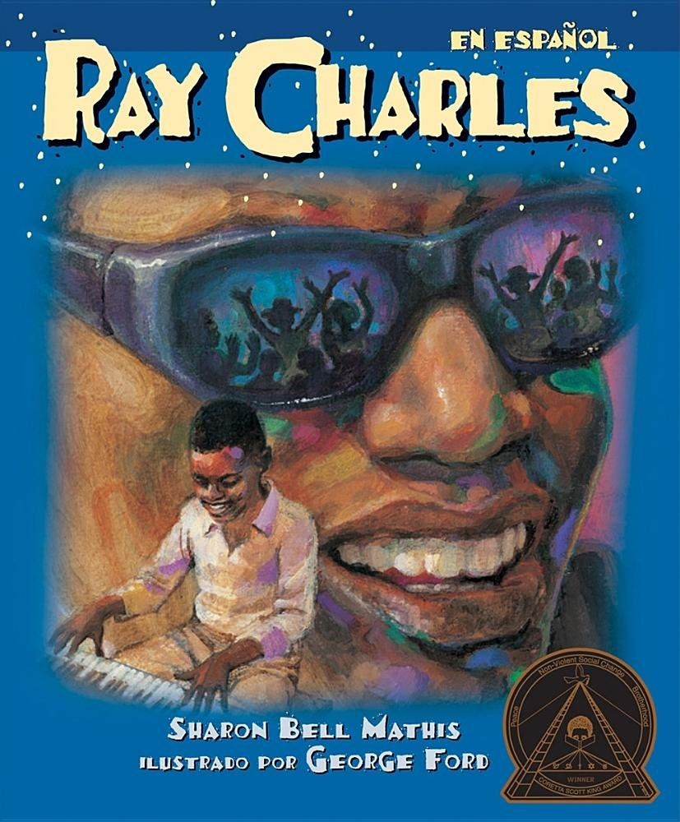
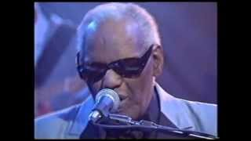
Before 1960
Narrates the life of Ray Charles from his childhood, when he became blind and learned how to read and write music in Braille, to his extraordinary success as a jazz and blues musician.
1960-1970

Slide 8
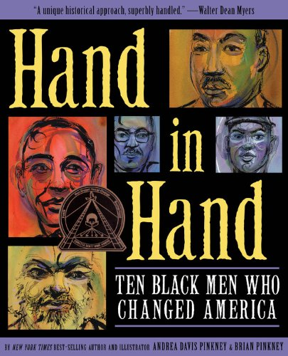
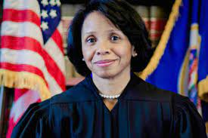
Blacks excelled in the field of law. Fredrick McGhee was Minnesota’s first Black lawyer; Lena Smith the first Black female lawyer; L. Howard Bennett the first Black municipal judge; and Stephen Maxwell the first Black district court judge. Pamela Alexander was the first Black female prosecutor and first Black female judge in Hennepin County. In addition, Alan Page was the first Black judge on the Minnesota Supreme Court; Michael J. Davis was the first Black federal judge in Minnesota; and Wilhelmina Wright was the first Black female federal judge in Minnesota.
Hand in Hand presents the stories of ten men from different eras in American history, organized chronologically to provide a scope from slavery to the modern day. The stories are accessible, fully-drawn narratives offering the subjects' childhood influences, the time and place in which they lived, their accomplishments and motivations, and the legacies they left for future generations as links in the "freedom chain." This book will be the definitive family volume on the subject, punctuated with dynamic full color portraits and spot illustrations by two-time Caldecott Honor winner and multiple Coretta Scott King Book Award recipient Brian Pinkney. Backmatter includes a civil rights timeline, sources, and further reading.
1960-Present

Slide 9
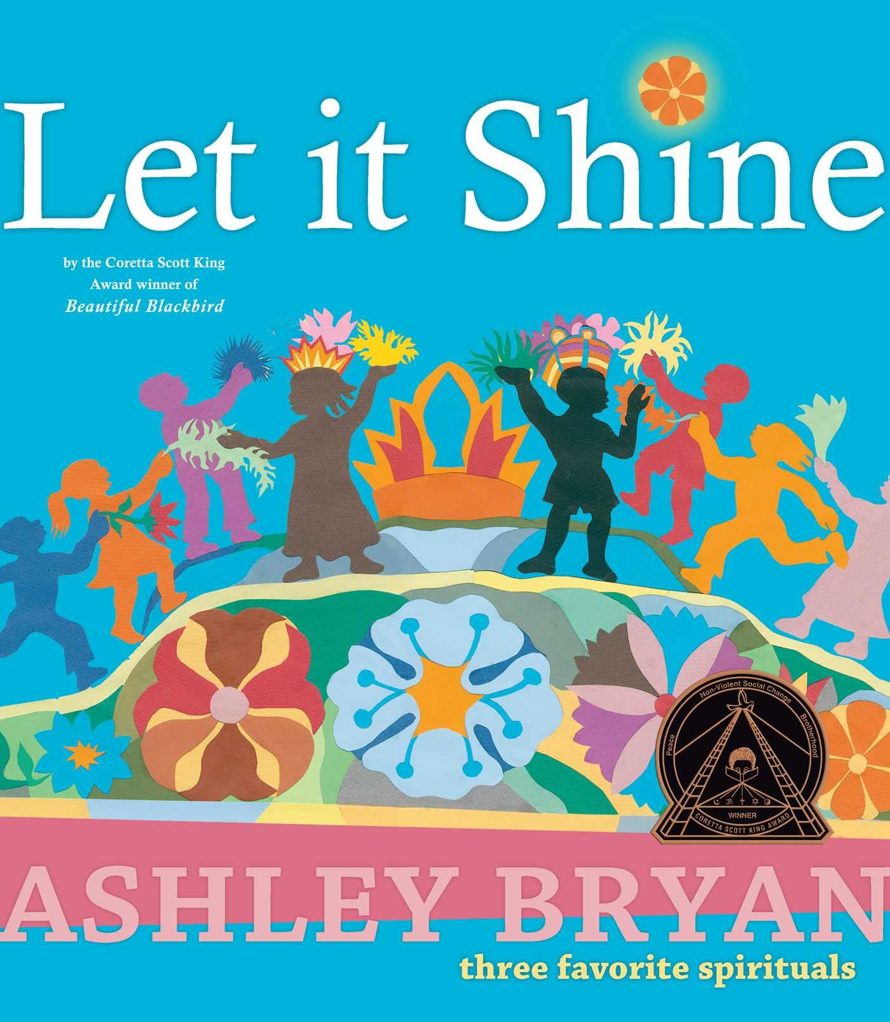
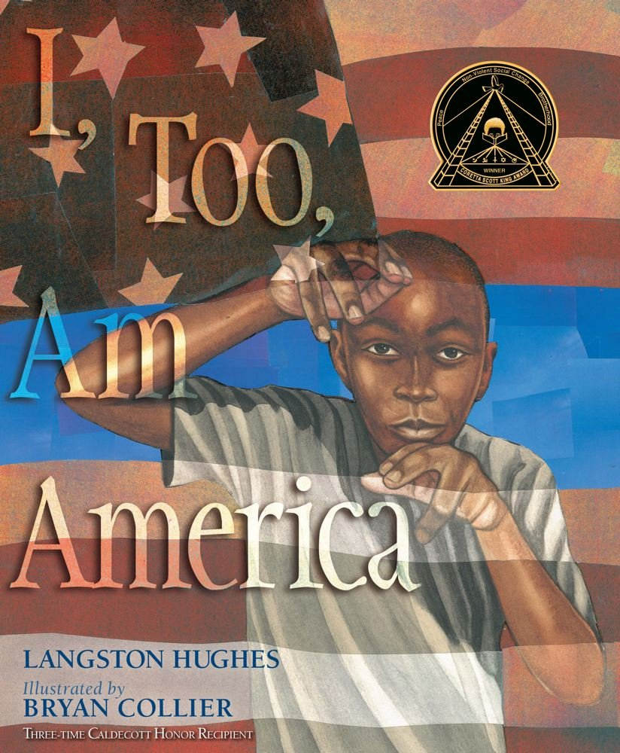
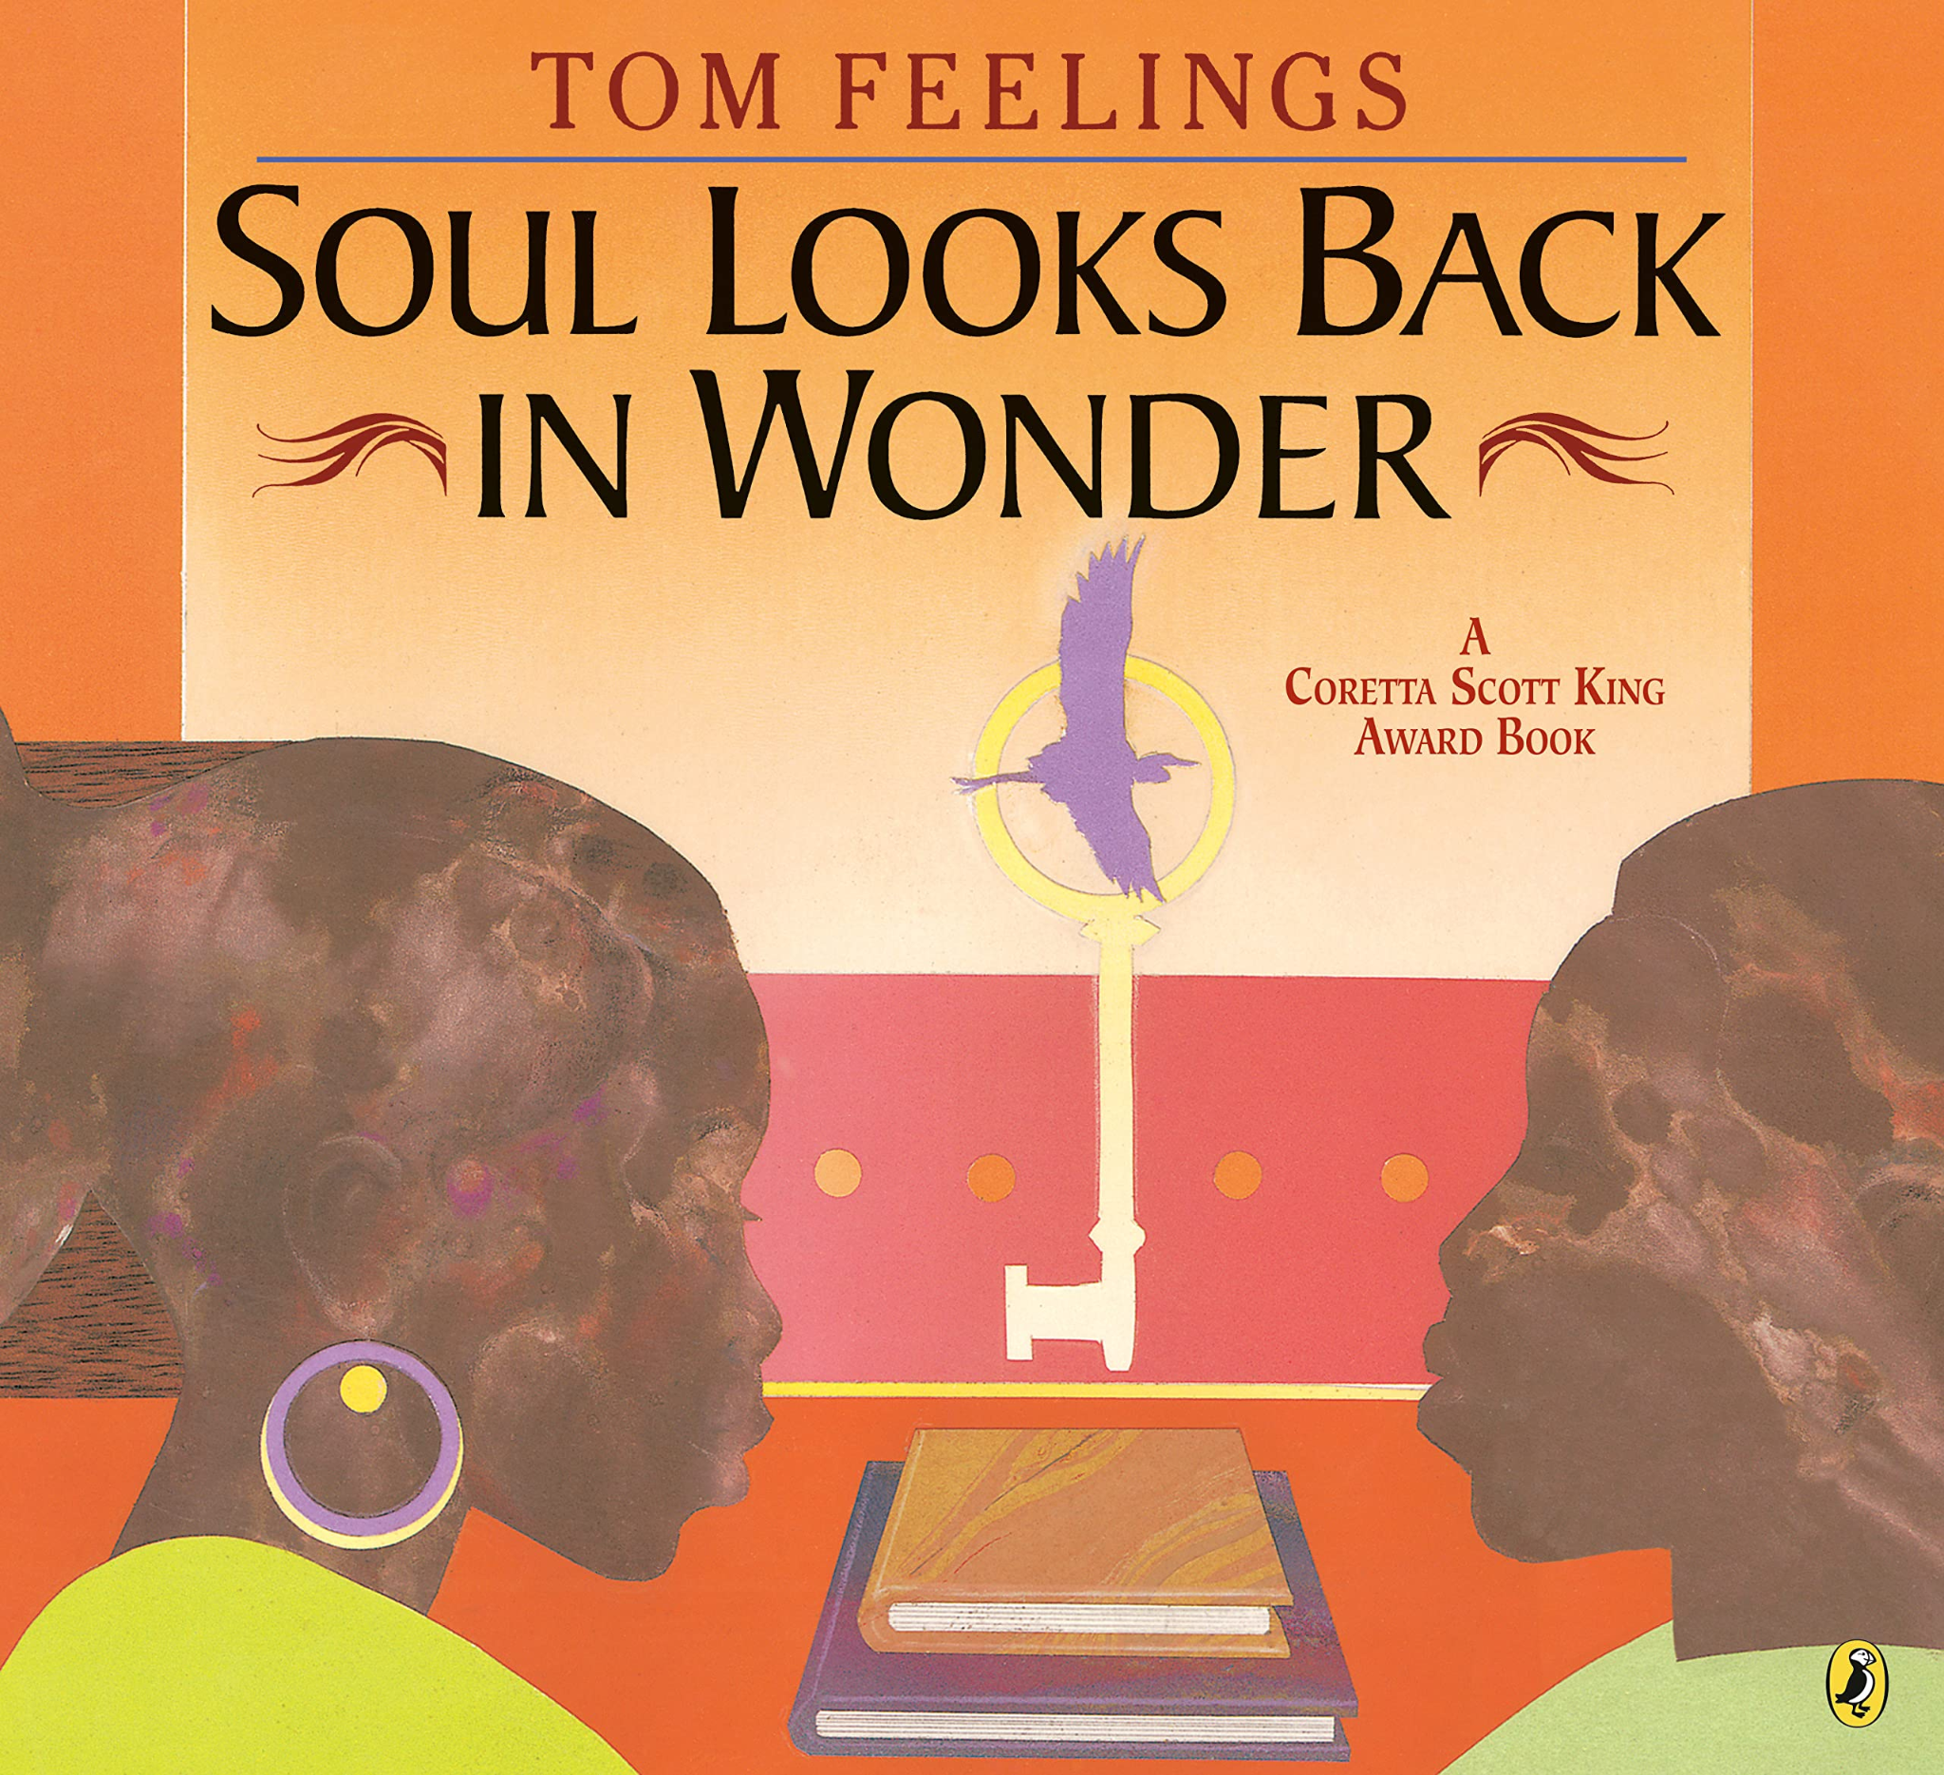
I, too, sing America.
I am the darker brother.
They send me to eat in the kitchen
When company comes,
But I laugh,
And eat well,
And grow strong.
Langston Hughes was a courageous voice of his time, and his authentic call for equality still rings true today. Beautiful paintings from Barack Obama illustrator Bryan Collier accompany and reinvent the celebrated lines of the poem "I, Too," creating a breathtaking reminder to all Americans that we are united despite our differences.
This picture book of Langston Hughes’s celebrated poem, "I, Too, Am America," is also a Common Core Text Exemplar for Poetry.
1960 to present
This little light of mine,
I’m gonna let it shine.
Let it shine,
let it shine,
let it shine.
Come, sing, and celebrate the power of the beloved songs “This Little Light of Mine,” “Oh, When the Saints Go Marching In,” and “He’s Got the Whole World in His Hands” through kaleidoscopic illustrations of color and cut paper.
In this compelling collection of words and pictures, the voices of thirteen major poets, including Maya Angelou, Langston Hughes, and Walter Dean Myers, rise in response to the dazzling vistas and emotionally vivid portraits of award-winning artist Tom Feelings. A unique and moving collaboration that celebrates the sustaining spirit of African creativity.

Slide 10
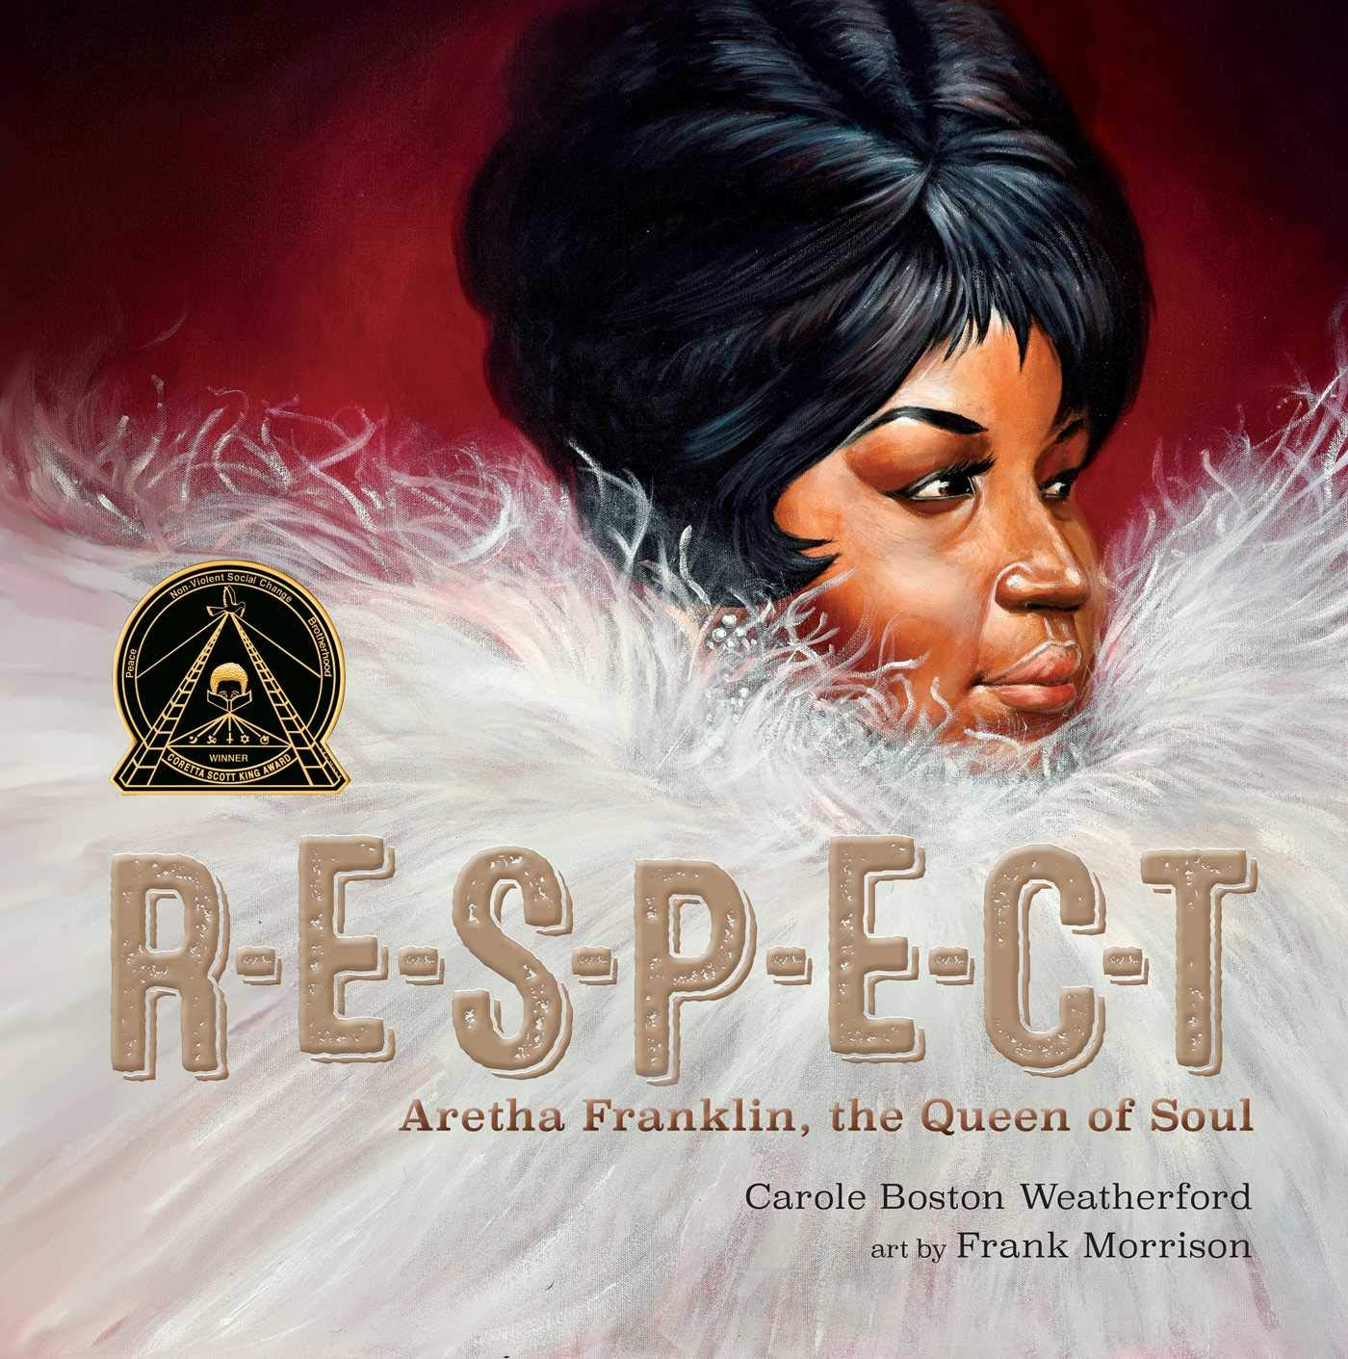
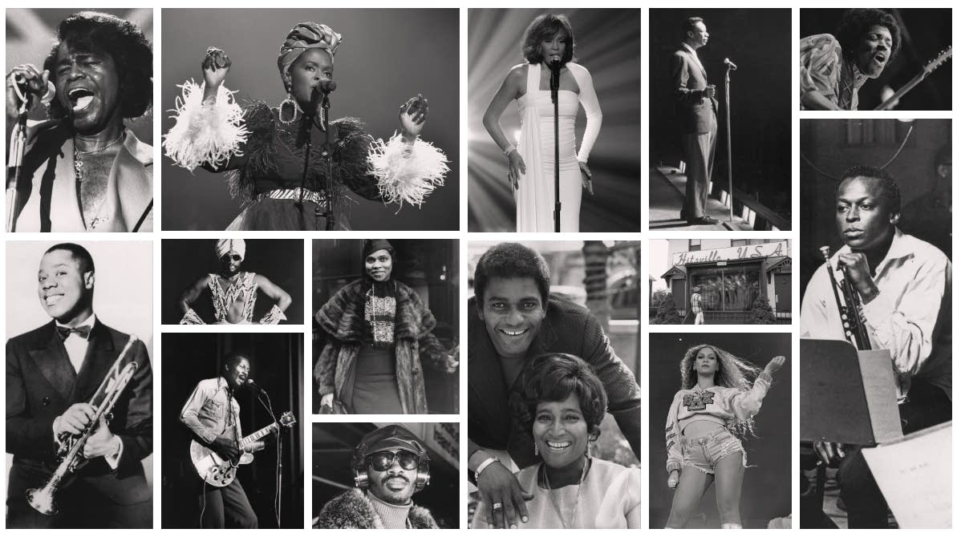
Aretha Franklin was born to sing. The daughter of a pastor and a gospel singer, her musical talent was clear from her earliest days in her father’s Detroit church where her soaring voice spanned more than three octaves.
Her string of hit songs earned her the title “the Queen of Soul,” multiple Grammy Awards, and a place in the Rock & Roll Hall of Fame. But Aretha didn’t just raise her voice in song, she also spoke out against injustice and fought for civil rights.
1960-1970

Slide 11
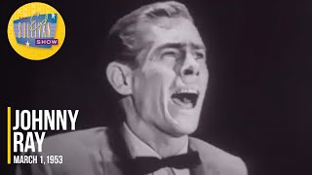
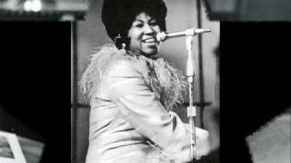
In 1967, during the “long hot summer,” hundreds of race riots erupted across the country. Racial tensions exploded along Plymouth Avenue in North Minneapolis when Blacks demonstrated against discrimination and police brutality. The Minnesota National Guard was dispatched to Plymouth Avenue for over a week.
Employment discrimination was pervasive in Minnesota. While some Blacks worked in skilled trade jobs as stonecutters and bricklayers, many white employers refused to hire Blacks. This limited their opportunities to unskilled jobs as laborers, waiters, cooks, and porters in the late nineteenth and early twentieth centuries.
1960-1970

Slide 12
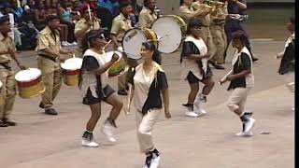
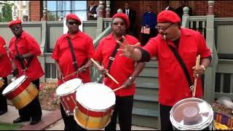
The Sabathanites Drum Corps was founded in 1964 as a youth organization affiliated with Sabathani Baptist Church, located at 3805 Third Avenue, in Minneapolis. Its pastor at that time, Rev. Stanley R. King, advocated for the church’s involvement in the community all week long—not just on Sundays. Thus, the Sabathanites Drum Corps was formed to give the youth in the neighborhood something to do and keep them out of trouble.The Sabathanites were popular, and whenever they performed, they generated large crowds. On July 19, 1967, they performed in the Aquatennial Torchlight Parade in downtown Minneapolis. Hundreds of people marched and danced along with the group. The police—on high alert because of rumors of possible “riots”—overreacted and beat many people in the crowd, including some drummers. Later, violence broke out in North Minneapolis along Plymouth Avenue, where demonstrators set fires, threw rocks, and damaged properties.
1960 to present

Slide 13
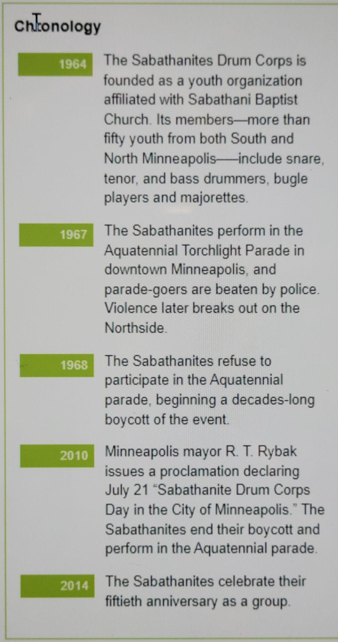
The Sabathanites denounced the police action and refused to perform in the Aquatennial parade—a protest that lasted forty-three years. On July 21, 2010, Minneapolis Mayor R. T. Rybak welcomed the group back to the Aquatennial parade and issued a proclamation declaring the day to be “Sabathanite Drum Corps Day in the City of Minneapolis.” Mayor Rybak encouraged Minneapolis residents to reflect on the Sabathanites’ history, perseverance, and strength, and called on all parade-goers to “get their groove on” to their music. The Sabathanites said they felt vindicated because they had not caused a riot in 1967 and were not doing anything wrong—just performing. The Sabathanites marched in the Aquatennial parade that night in honor of a long-time member who had recently passed away, and to inspire young people in the community.
https://www.facebook.com/groups/aaidctn/
1960 to present

Slide 14
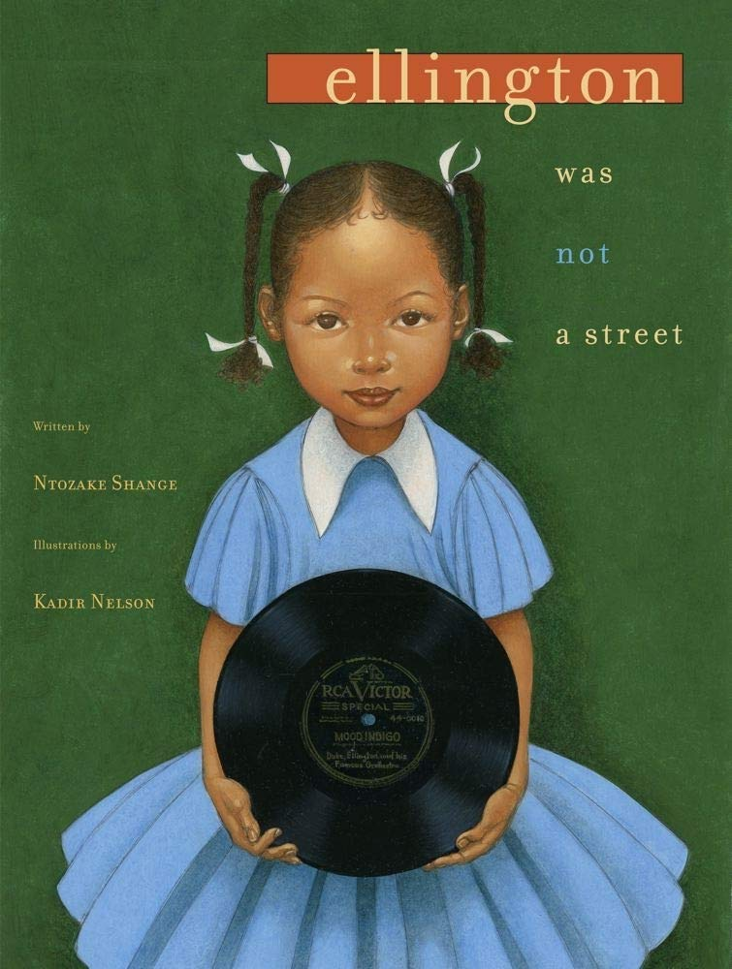
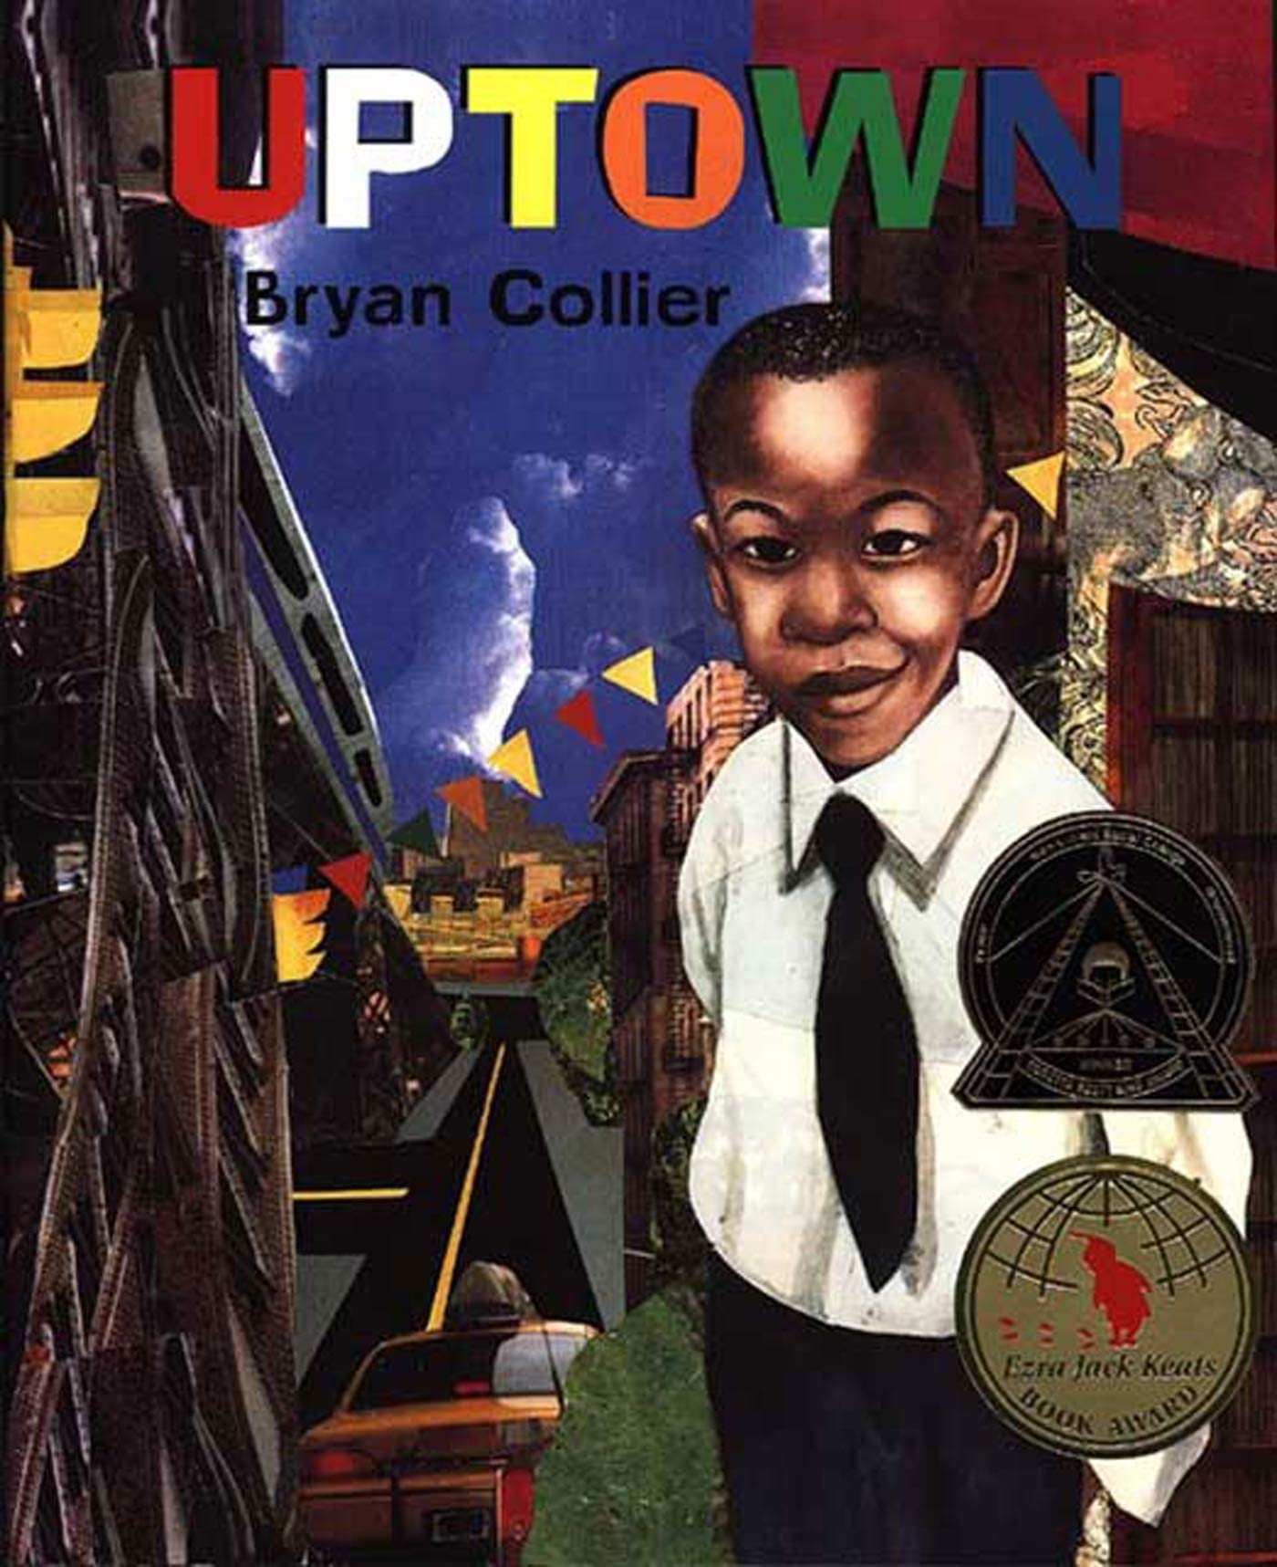
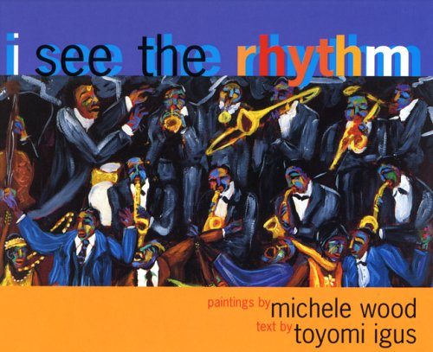
Featuring luminous art by Coretta Scott King Award–winning illustrator Kadir Nelson, this reflective picture book by poet Ntozake Shange looks back at the great Black thinkers and innovators who visited her father’s house.
A close-knit group of Black innovators formed their own community in the early to mid-twentieth century. These men of vision lived at a time when the color of their skin dictated where they could live, what schools they could attend, and even where they could sit on a bus or in a movie theater.
Yet in the face of this tremendous adversity, these dedicated souls and others like them not only demonstrated the importance of Black culture in America, but also helped issue in a movement that changed the world. Their lives and their works inspire us to this day and serve as a guide to how we approach the challenges of tomorrow.
Uptown is a rich mix of flavors, colors, sounds, and cultures that come together to create a vibrant community like no other in the world. Seen through the eyes of one little boy who lives there, the details of life in Harlem are as joyous as a game of basketball on a summer's afternoon and as personal as a trip to the barbershop where old-timers reminisce.
Bryan Collier's spare, poetic text and beautiful, intricate illustrations evoke every aspect of Harlem, from the legendary Apollo Theater to chocolate-colored brownstones, weekend shopping on 125th Street, and the music of Duke Ellington.
1970-1980
This award-winning picture book invites children along to dance to the rhythm of swing at the Savoy in Harlem, to rejoice to the rhythm of gospel from a church pew on a Sunday morning, and more. Each stunning spread—including art, poetic text, a description of the music style, and a time line of selected historical events—encompasses the spirit of the times and the strength of the communities where the music was born. Toyomi Igus's lyrical text, matched with artist Michele Wood's daring vision, captures the feel of each style of music and pays tribute to the musicians who gave the music life.

Slide 15
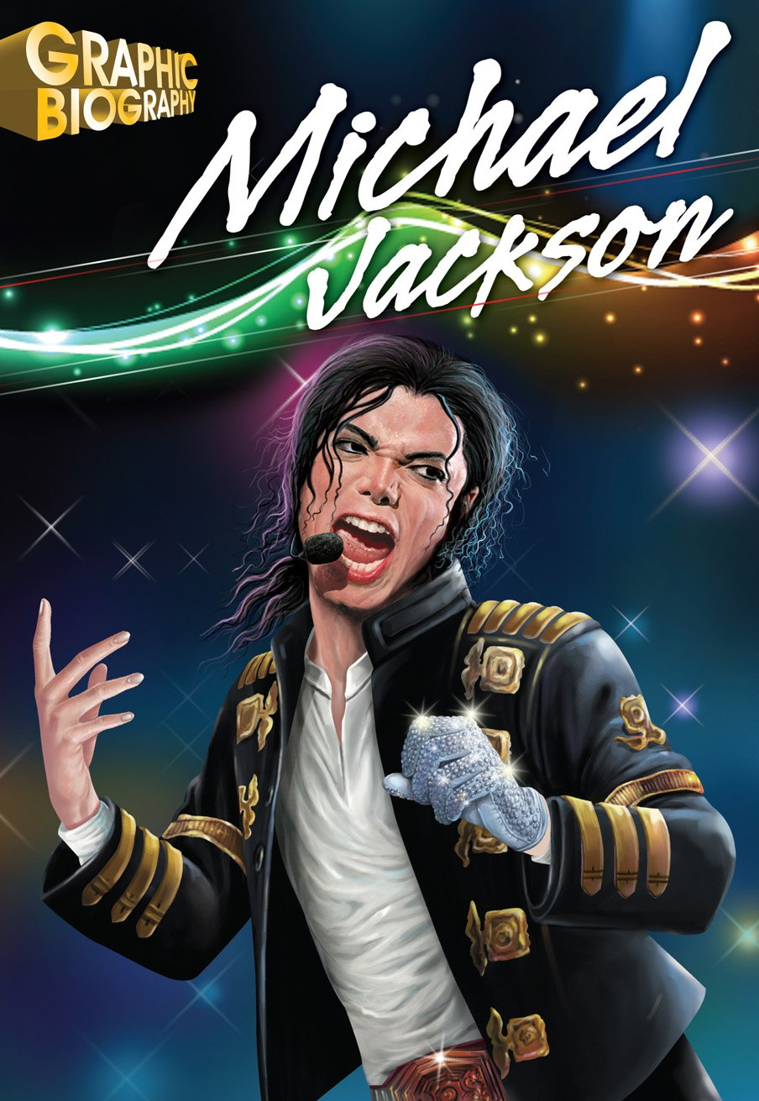
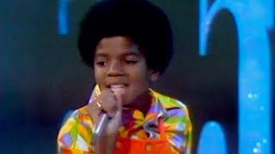
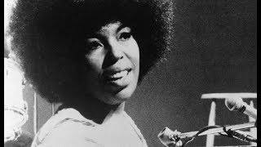
In St. Paul, Blacks lived in the Rondo neighborhood, south of University Avenue from Rice Street to Lexington Parkway. In the 1960s, the Rondo neighborhood was destroyed and more than six hundred residents were displaced to make way for Interstate 94. The annual Rondo Days and Jazz Festivals commemorate its history. In the 1970s, some African Americans moved from Rondo and other historically Black neighborhoods to new areas in the Twin Cities and the suburbs.
Graphic biographies teach about historical figures: those who lead us into new territory; pursued scientific discoveries; battled injustice and prejudice; and broke down creative and artistic barriers. These biographies offer a variety of rich primary and secondary source material to support teaching to the standards.
1970-1980

Slide 16
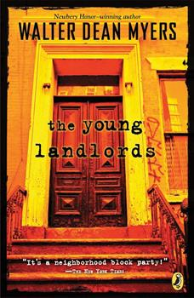
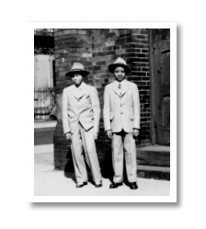
If you were looking for a real ghetto dump, you couldn't beat The Stratford Arms. There was Askia Ben Kenobi throwing karate chops upstairs, Petey Darden making booze downstairs, and Mrs. Brown grieving for Jack Johnson, who'd died for the third time in a month--and not a rent payer in the bunch. Still, when Paul Williams and the Action Group got the Arms for one dollar, they thought they had it made. But when their friend Chris was arrested for stealing stereos and Dean's dog started biting fire hydrants and Gloria started kissing, being a landlord turned out to be a lot more work than being a kid. The setting takes place in Harlem, New York at the Joint, it is a wrecked up old abandoned building and it keeps getting worse with Askia Ben Kenobi around.
1970-1980

Slide 17
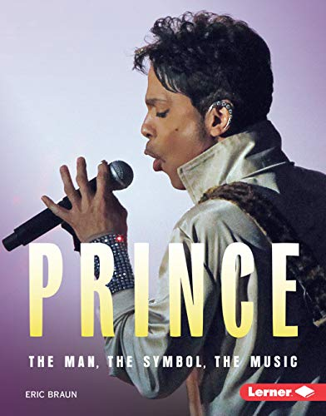
African Americans’ contributions to the arts transcended Minnesota and received international recognition. Prince Rogers Nelson (Prince), born in Minneapolis, was a legendary singer-songwriter, actor, multi-instrumentalist musician, philanthropist, and producer. He was also a best-selling artist who won Grammy, American Music, Golden Globe, and Academy awards. He was inducted into the Rock and Roll Hall of Fame in 2004. He created the “Minneapolis Sound,” a mix of soul, dance, funk, and rock and roll music that featured synthesizers and drum machines.
Jimmy “Jam” Harris III and Terry Lewis started their music careers in the Minneapolis band “Flyte Tyme.” The group later became “The Time,” which was produced by Prince. Harris and Lewis also wrote and produced hit songs for numerous artists, including Janet Jackson. Grammy-award-winning Sounds of Blackness, a musical ensemble, started in 1969 at Macalester College. Grammy-nominated band Mint Condition was started in the 1980s at St. Paul Central High School. Penumbra Theatre, founded in 1976 by artistic director Lou Bellamy, is credited with launching the career of Pulitzer Prize-winning playwright August Wilson.
1980-2000
Prince Rogers Nelson wrote his first song at age seven, and soon taught himself to play the piano, drums, and guitar. In the early 1980s, Prince wondered how to make his music—a mix of pop, funk, soul, and R&B—more appealing to an audience that loved more mainstream rock shows. He ended up making Purple Rain, the hit movie and soundtrack that turned him into a megastar.

Slide 18
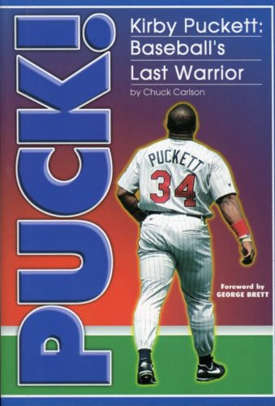
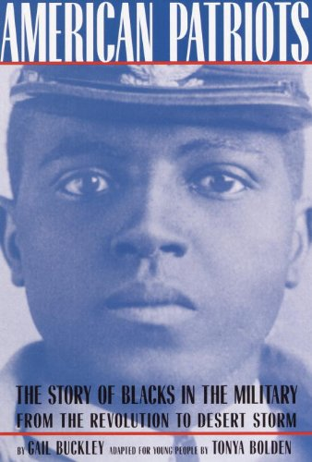
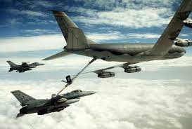
Operation Desert Storm occurs with approximately 11,000 Minnesotans in uniform helping to defeat Iraq and liberate Kuwait. The Minnesota Twins win the World Series.
1980-2000
This is the story of Kirby Puckett and his remarkable journey from the projects of the south.
They fought on Lexington Green the first morning of the Revolution and survived the bitter cold winter at Valley Forge. They stormed San Juan Hill with Theodore Roosevelt’s Rough Riders and manned an anti-aircraft gun at Pearl Harbor. They are the black Americans who fought, often in foreign lands, for freedoms that they did not enjoy at home.

Slide 19
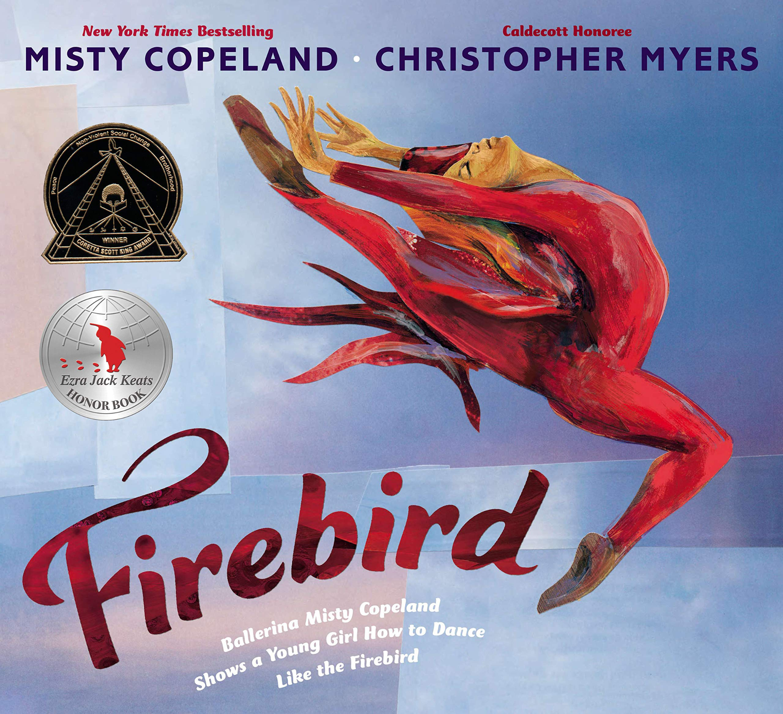
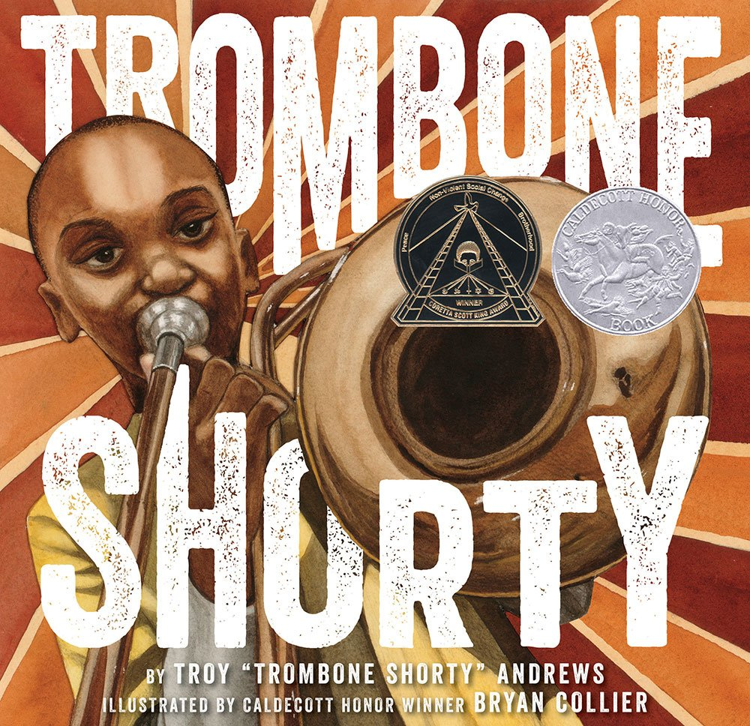
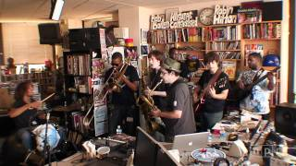
“Who’s that playing out there?” Bo Diddley asked the New Orleans crowd. It was a small child who’d been nicknamed “Trombone Shorty” because his trombone was twice as large as he was. Trombone Shorty was lifted in the air and carried through the audience until he reached the stage with Bo Diddley. He has been onstage ever since.
Hailing from the Tremé neighborhood of New Orleans, where music always floated in the air, Troy “Trombone Shorty” Andrews didn’t always have the money to buy an instrument, but he did have the dream to play music. This is the story of how he made his dream take flight.
Today, Troy Andrews is a Grammy-nominated musician who tours the world with his band, Trombone Shorty & Orleans Avenue. He continues to inspire hope for the next generation in New Orleans and for music lovers everywhere.
In her debut picture book, Misty Copeland tells the story of a young girl--an every girl--whose confidence is fragile and who is questioning her own ability to reach the heights that Misty has reached. Misty encourages this young girl's faith in herself and shows her exactly how, through hard work and dedication, she too can become Firebird.
Lyrical and affecting text paired with bold, striking illustrations that are some of Caldecott Honoree Christopher Myers's best work, makes Firebird perfect for aspiring ballerinas everywhere.
2000 +
Present Time Fiction

Slide 20
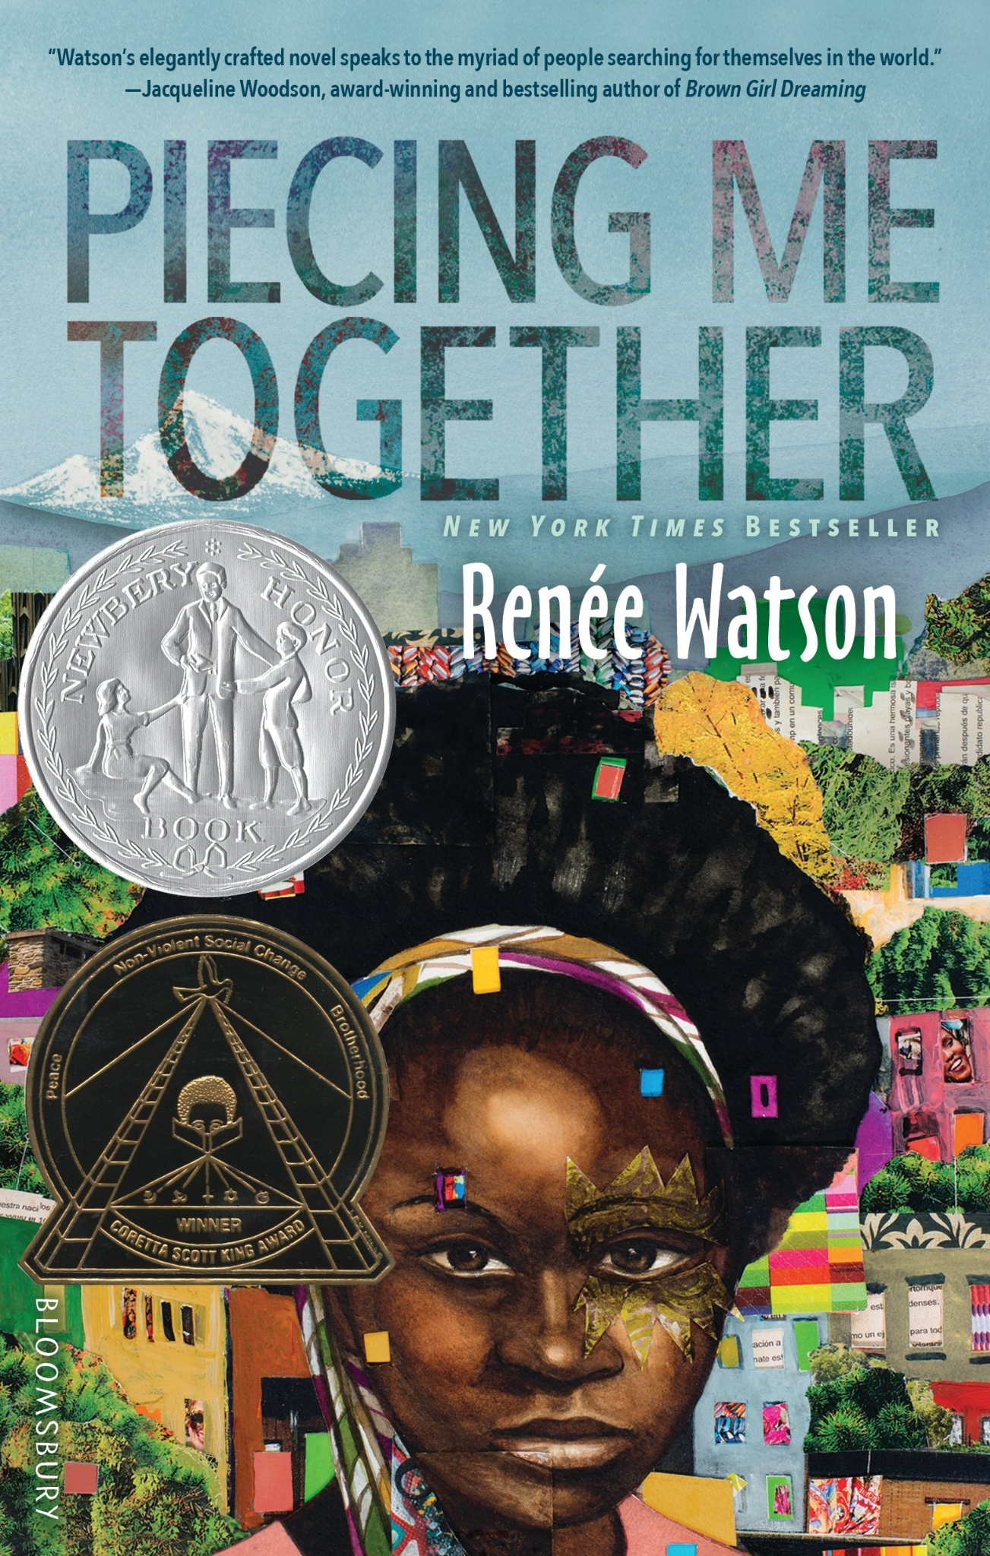
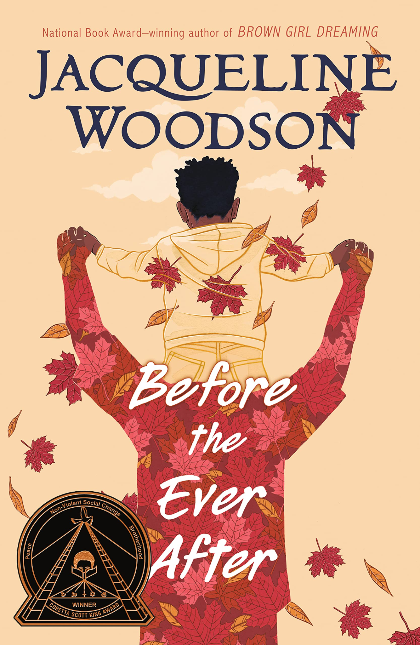
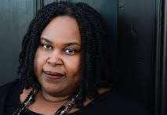
For as long as ZJ can remember, his dad has been everyone's hero. As a charming, talented pro football star, he's as beloved to the neighborhood kids he plays with as he is to his millions of adoring sports fans. But lately life at ZJ's house is anything but charming. His dad is having trouble remembering things and seems to be angry all the time. ZJ's mom explains it's because of all the head injuries his dad sustained during his career. ZJ can understand that--but it doesn't make the sting any less real when his own father forgets his name. As ZJ contemplates his new reality, he has to figure out how to hold on tight to family traditions and recollections of the glory days, all the while wondering what their past amounts to if his father can't remember it. And most importantly, can those happy feelings ever be claimed when they are all so busy aching for the past?
Jade believes she must get out of her poor neighborhood if she's ever going to succeed. Her mother tells her to take advantage of every opportunity that comes her way. And Jade has: every day she rides the bus away from her friends and to the private school where she feels like an outsider, but where she has plenty of opportunities. But some opportunities she doesn't really welcome, like an invitation to join Women to Women, a mentorship program for "at-risk" girls. Just because her mentor is black and graduated from the same high school doesn't mean she understands where Jade is coming from. She's tired of being singled out as someone who needs help, someone people want to fix. Jade wants to speak, to create, to express her joys and sorrows, her pain and her hope. Maybe there are some things she could show other women about understanding the world and finding ways to be real, to make a difference.
2000 +

Slide 21
For Lafayette and his brothers, the challenges of growing up in New York City are compounded by the facts that they've lost their parents and it's up to eldest brother Ty'ree to support the boys, and middle brother Charlie has just returned home from a correctional facility. Lafayette loves his brothers and would do anything if they could face the world as a team. But even though Ty'ree cares, he's just so busy with work and responsibility. And Charlie's changed so much that his former affection for his little brother has turned to open hostility. Now, as Lafayette approaches 13, he needs the guidance and answers only his brothers can give him. The events of one dramatic weekend force the boys to make the choice to be there for each other--to really see each other--or to give in to the pain and problems of every day.
2000 +
When Gerald was a child he was fascinated by fire. But fire is dangerous and powerful, and tragedy strikes. His substance-addicted mother is taken from him. Then he loses the loving generosity of a favorite aunt, and a brutal stepfather with a flaming temper and an evil secret makes his life miserable. The one bright light in Gerald's life is his little half sister, Angel, whom he struggles to protect from her father, who is abusing her.
Somehow Gerald manages to finds success as a member of the Hazelwood Tigers basketball team, and Angel develops her talents as a dancer, despite the trouble that still haunts them. And Gerald learns, painfully, that young friends can die and old enemies must be faced. In the end he must stand up to his stepfather alone in a blazing confrontation.

Slide 22
Seventeen-year-old Avery Anderson is convinced her senior year is ruined when she's uprooted from her life in DC and forced into the hostile home of her terminally ill grandmother, Mama Letty. The tension between Avery’s mom and Mama Letty makes for a frosty arrival and unearths past drama they refuse to talk about. Every time Avery tries to look deeper, she’s turned away, leaving her desperate to learn the secrets that split her family in two.
While tempers flare in her avoidant family, Avery finds friendship in unexpected places: in Simone Cole, her captivating next-door neighbor, and Jade Oliver, daughter of the town’s most prominent family―whose mother’s murder remains unsolved.
As the three girls grow closer―Avery and Simone’s friendship blossoming into romance―the sharp-edged opinions of their small southern town begin to hint at something insidious underneath. The racist history of Bardell, Georgia is rooted in Avery’s family in ways she can’t even imagine. With Mama Letty's health dwindling every day, Avery must decide if digging for the truth is worth toppling the delicate relationships she's built in Bardell―or if some things are better left buried.
Since they were first brought as captives to Virginia, the people who would become African Americans have struggled for freedom. Thousands fought for the rights of all Americans during the Revolutionary War, and for their own rights during the Civil War. Here is African-American history, told through the stories of the people whose experiences have shaped and continue to shape the America in which we live. A Coretta Scott King Author Award Winner.
2000 +

Slide 23
The day that changed it all for those in bondage on Galveston Island had begun as a Monday like any other. But once the proclamation of General Order No. 3 came, June 19th 1865 was forever transformed into a jubilee day, one all freedom-loving people continue to celebrate throughout America. "Juneteenth: This Day Was Made for You and Me" chronicles the history of that Texas proclamation along with a remembrance of the cost paid by so many to expand liberty's reach throughout the land. As decades' long champions of Juneteenth themselves say, "Juneteenth is [for] everyone."
2000 +

Slide 24
Smoky Night is a 1994 children's book by Eve Bunting. It tells the story of a Los Angeles riot and its aftermath through the eyes of a young boy named Daniel. The ongoing fires and looting force neighbors who previously disliked each other to work together to find their cats.
2000 +

Slide 25
Minnesota Music

Slide 26
Minnesota Theater

