Slide 1
Restoring the Native Voice
A multi-modal text set
& integrated website
By: Jesús Millán

Slide 2
Synopsis
Native American culture is rooted in oral history. For thousands of years, indigenous languages developed independently and in many cases alongside a neighboring tribe. In the past 500+ years, because of Anglo expansion across the continent, the native language has significantly diminished for a variety of reasons. Often, erasing the native language was a more ‘efficient’ way of removing, relocating, or extinguishing the people of this country.
The focus of this text set is to explore the ways in which the indigenous voice, specifically Navajo or Diné, has been reclaimed and reinforced.

Slide 3
Guiding inquiry questions
Does language define our history or culture?
Did historical representation of the Navajo in newspaper media influence public perception and U.S. policy?
In which ways has United States legislation affected Native American culture?
How have native peoples recovered their culture in recent years?
What are the ways in which we be advocates for the rights of indigenous people?

Slide 4
Note
This multi-modal set is divided into these parts: timeline, historic photos & newspaper articles, relevant legislation, advocate organizations, multimedia, and texts.

Slide 5
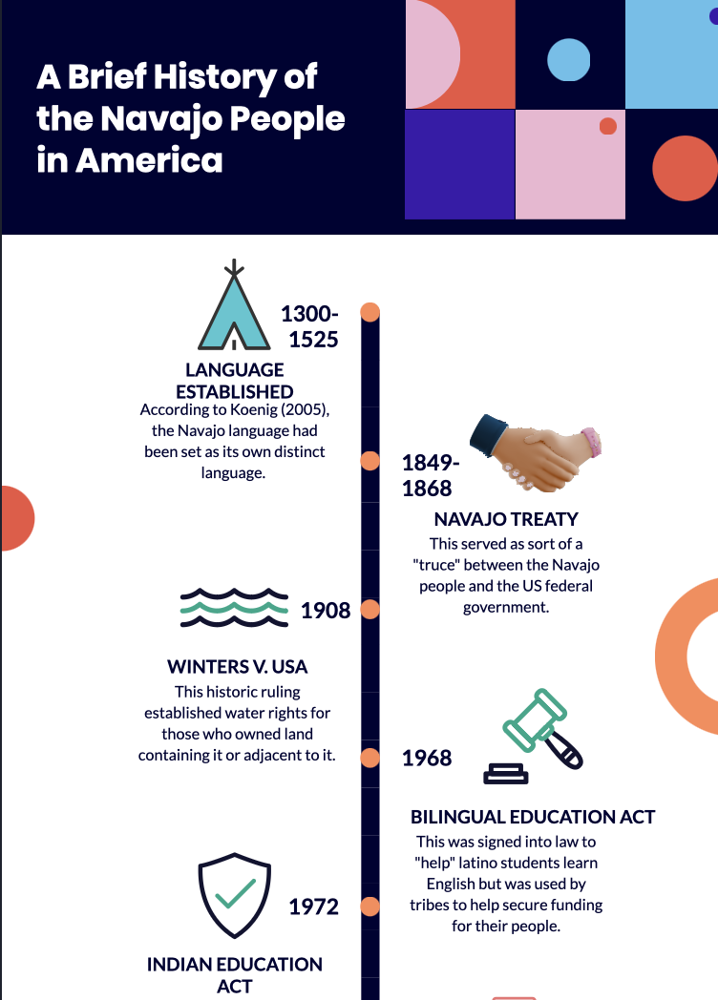
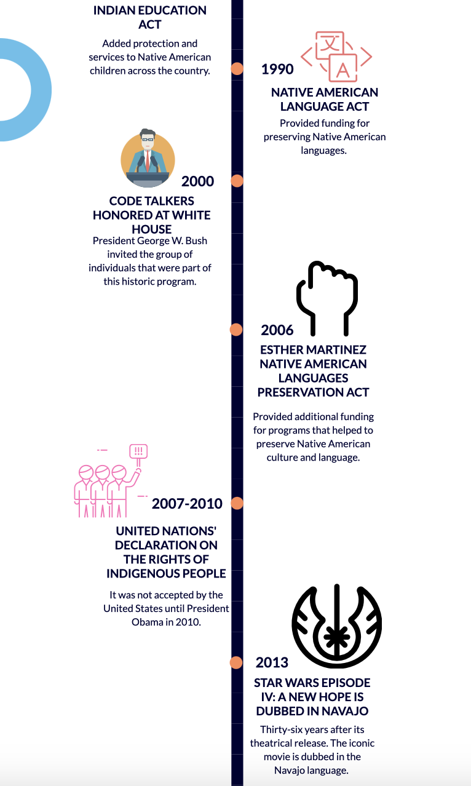
Part 1: timeline
Title | Description
1. Navajo Timeline | The dates represent significant moments in the history of Navajo people especially in respect to language. It was cut in two due to formatting.

Slide 6
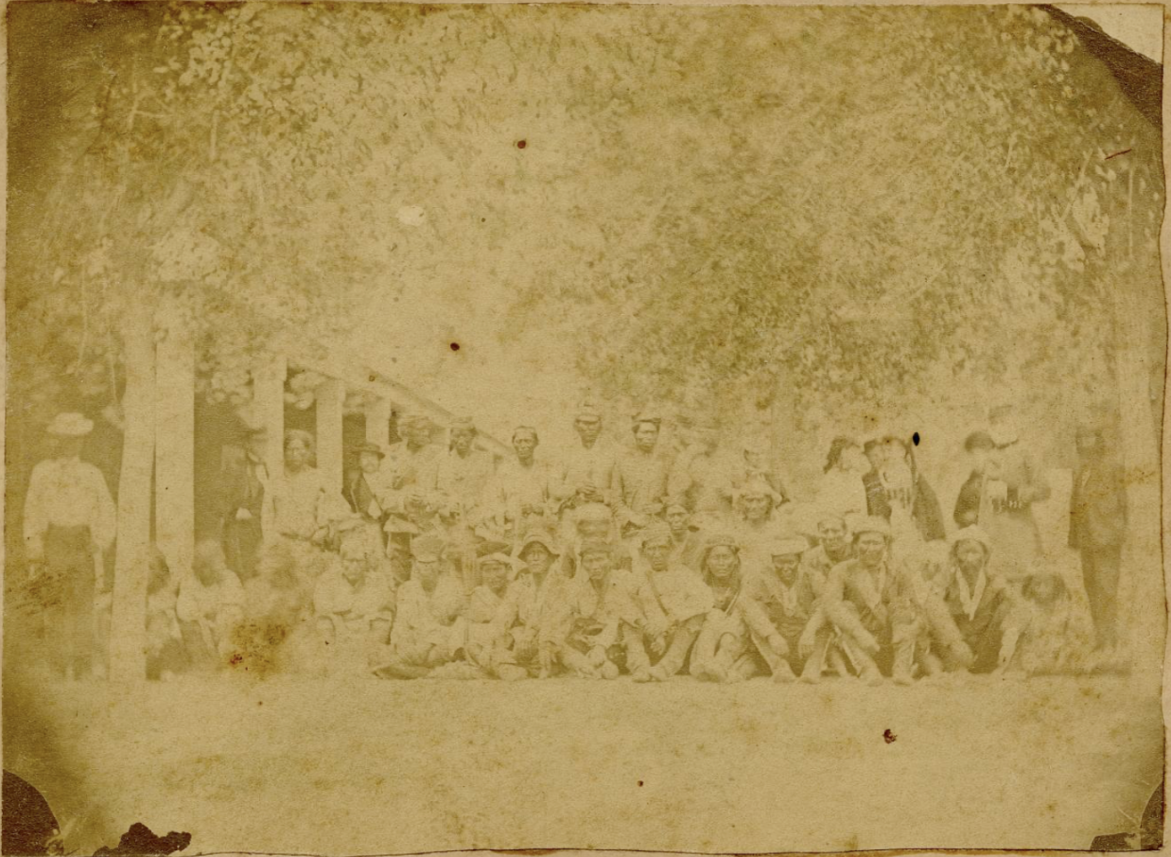
Part 2: photos & Articles
Title | Description
2. Group portrait of Diné (Navajo) Treaty signers and company | This picture was taken to commemorate the treaty signed between the United States government and the Navajo people. https://americanindian.si.edu/collections-search/archives/components/sova-nmai-ac-126-ref9

Slide 7
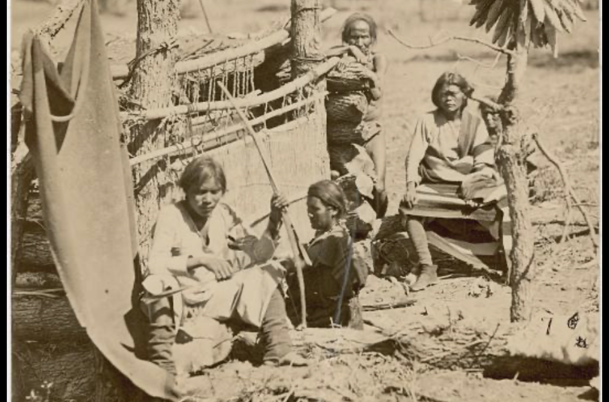
Part 2: photos & Articles
Title | Description
3. U.S. Geographical Surveys West of the 100th Meridian | This picture was from a government survey of the American continent to the west of the 100th meridian. One objective was to document indigenous people living in each region. https://americanindian.si.edu/collections-search/archives/sova-nmai-ac-229 https://pubs.usgs.gov/circ/c1050/surveys.htm

Slide 8
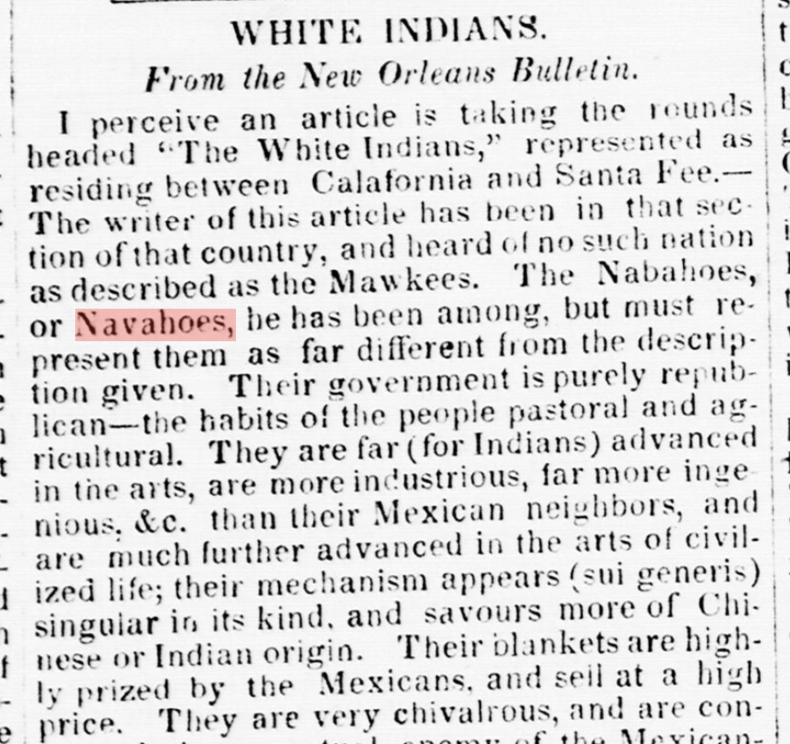
Part 2: photos & Articles
Title | Description
4. ‘White Indians’ Article | This was the earliest (1836) mention that I could find of the Navajo. The article served as an exploratory piece. https://chroniclingamerica.loc.gov/data/batches/vi_aquasox_ver01/data/sn85025007/00414215634/1836072601/0159.pdf

Slide 9
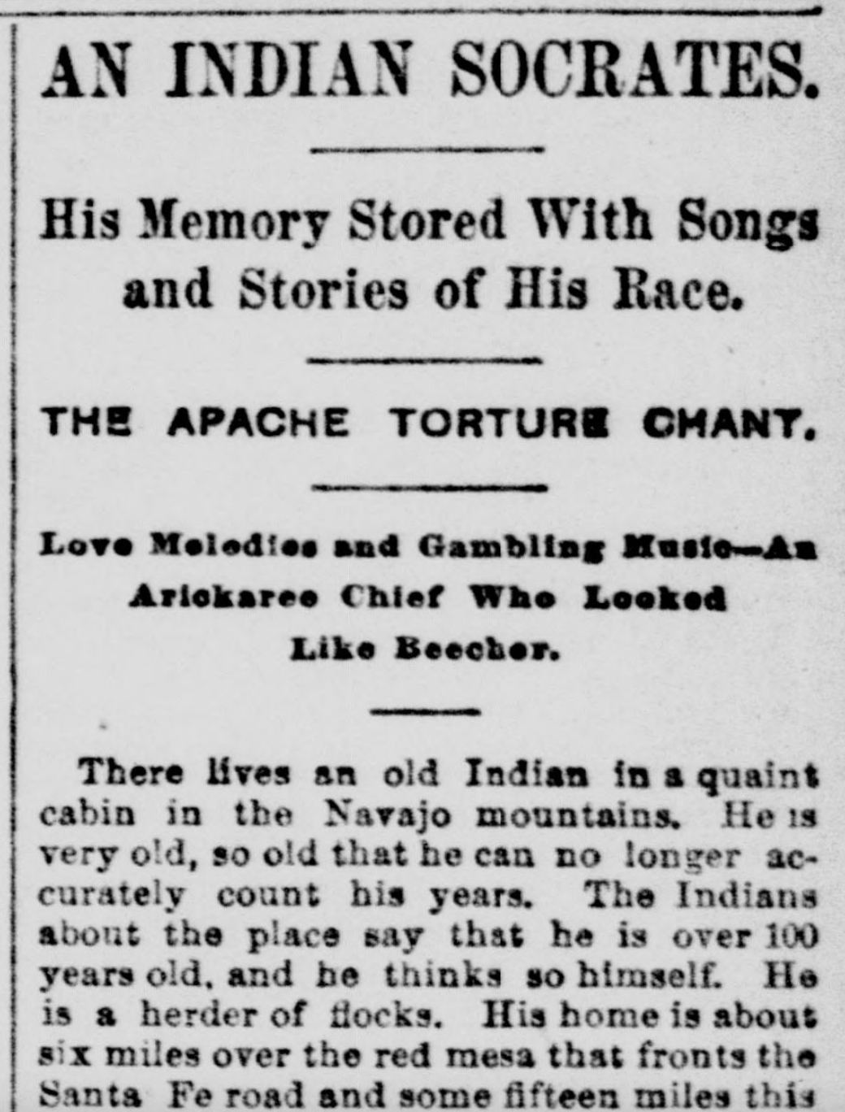
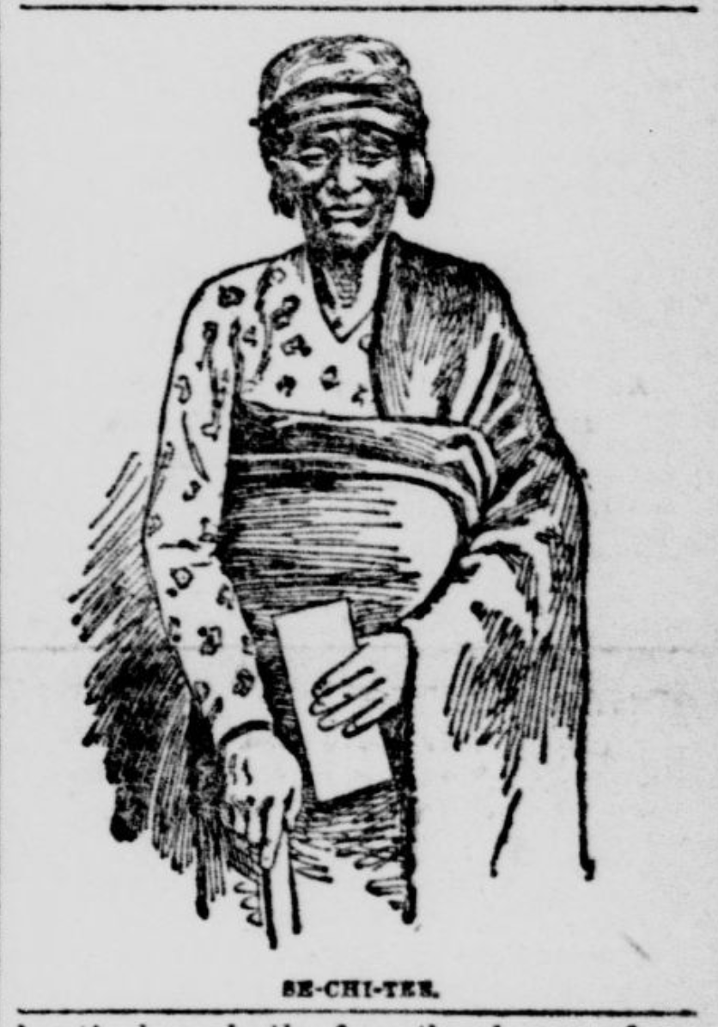
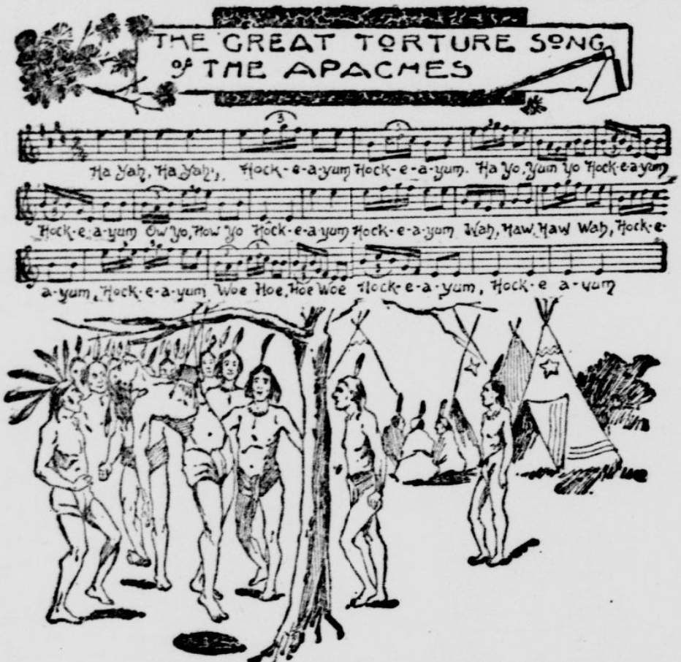
Part 2: photos & Articles
Title | Description
5. ‘An Indian Socrates’ Article | The January 1st edition of The Seattle Post-Intelligencer in 1896 had a focus on Se-Chi-Tee a Navajo man that agreed to be interviewed. https://chroniclingamerica.loc.gov/data/batches/wa_forks_ver01/data/sn83045604/00202199148/1893010101/0526.pdf

Slide 10
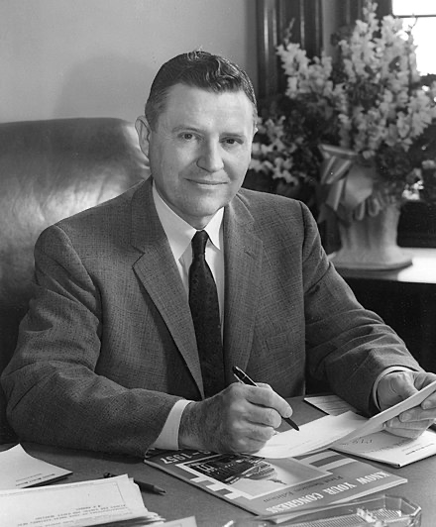
Part 3: Relevant legislation
Title | Description
6. Bilingual Education Act (1967) | With dropout rates among Hispanic students at approximately 50%, Senator Ralph Yarborough introduced legislation that would provide funding for students who were acquiring English as a second language. https://www.britannica.com/topic/Bilingual-Education-Act

Slide 11
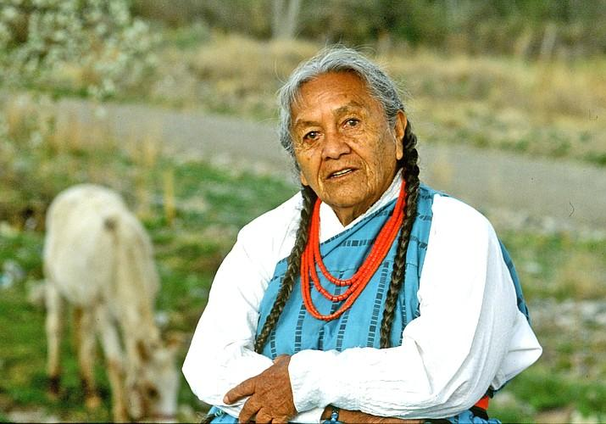
Part 3: Relevant legislation
Title | Description
7. Esther Martinez Native American Languages Preservation Act (2006) | Esther Martinez is one of the greatest advocates for restoring native languages. In 2006, Congress passed an act that dedicated a significant amount of funding for native language development and/or restoration. The page linked below is the reauthorization of funding through 2024. https://www.congress.gov/116/plaws/publ101/PLAW-116publ101.pdf

Slide 12

Part 4: advocate organizations
Title | Description
8. The Keres Children's Learning Center | The KCLC has a Montessori centered approach to supporting children when learning native languages. https://kclcmontessori.org/our-mission/

Slide 13
Part 4: advocate organizations
Title | Description
9. The American Indian Language Development Institute (AILDI) | "The American Indian Language Development Institute's (AILDI) mission is to provide critical training to strengthen efforts to revitalize and promote the use of Indigenous languages across generations. This is accomplished by engaging educators, schools, Indigenous communities and policy makers nationally and internationally through outreach, transformative teaching, purposeful research and collaborative partnerships." https://aildi.arizona.edu/content/language-revitalization

Slide 14

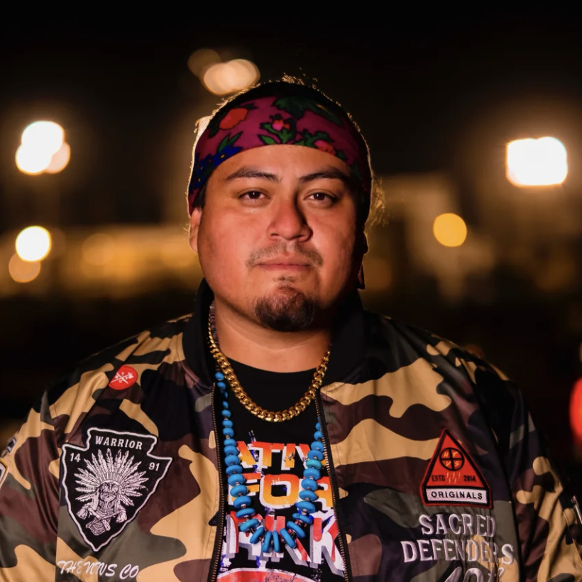
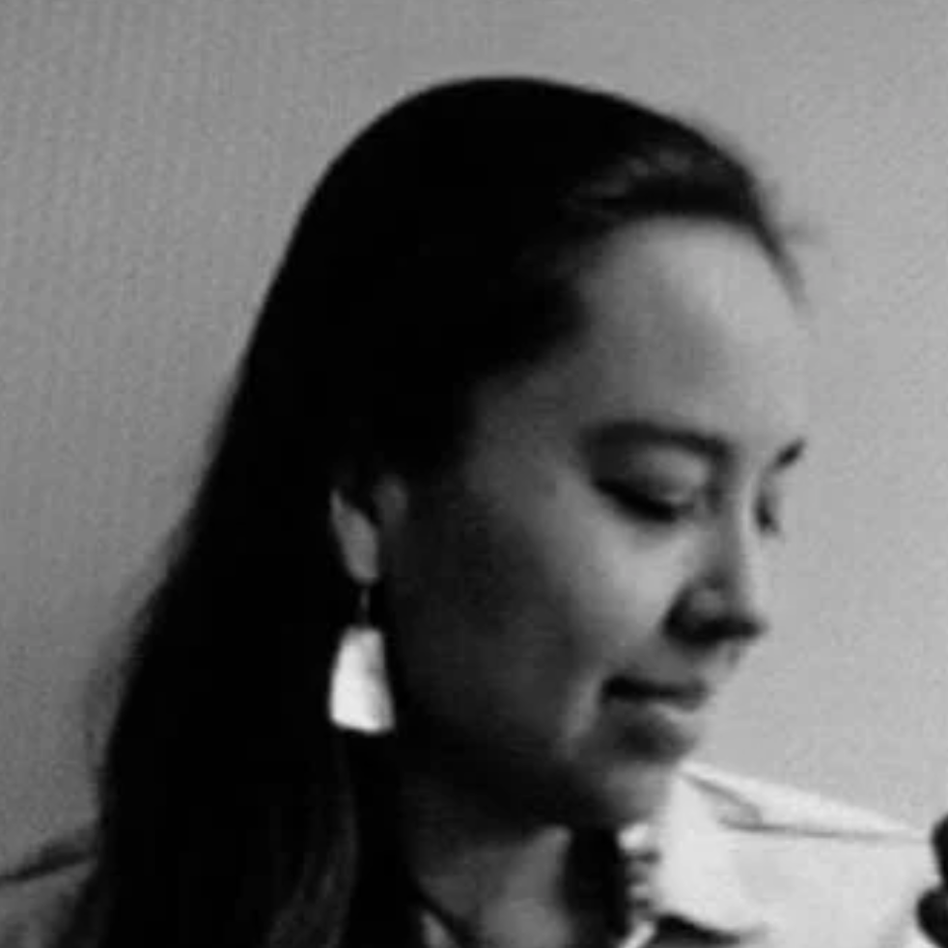
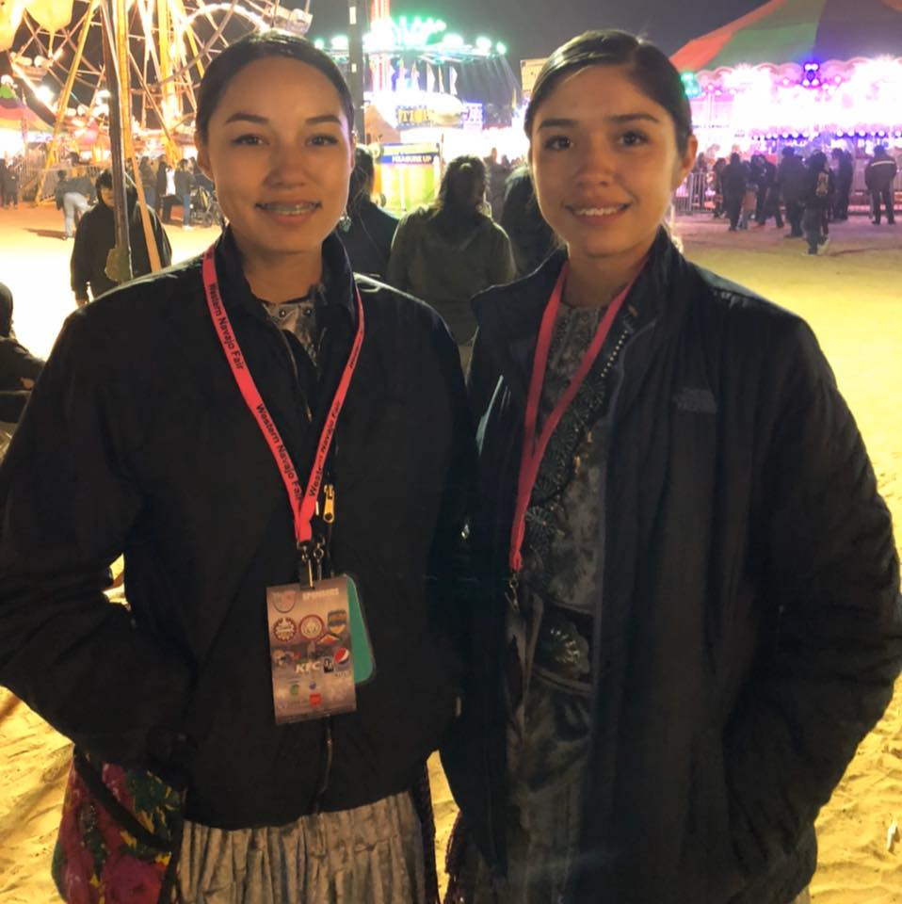
Part 5: multimedia
Title | Description
10. Native American musical artists: Halluci Nation Nataanii Lyla June The Martin Sisters | Aside from traditional music, there is a growing popularity with a new wave of indigenous artists that are taking music to new levels. Artists names on the left are linked; photos below in listed order.

Slide 15
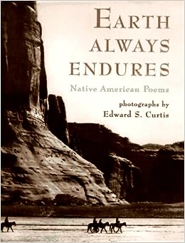
Part 6: Texts
Title | Description
11. EARTH ALWAYS ENDURES | Written By: Various Native American Authors Photographs By: Edward S. Curtis Description: A collection of native American poems translated and accompanied by stunning photographs.

Slide 16
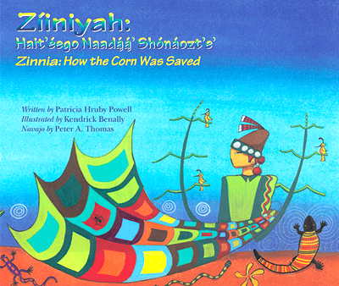
Part 6: Texts
Title | Description
12. ZÍINIYAH: HAIT’ÉEGO NAADÁÁ SHÓNÁOZT’E’ ZINNIA: HOW THE CORN WAS SAVED | Written By: Patricia Hruby Powell Navajo By: Peter A. Thomas Illustrated By: Kendrick Benally Description: This is a retelling of a Navajo story which the reader learns why Zinnias are planted near crops and spiders are allowed to stay.

Slide 17
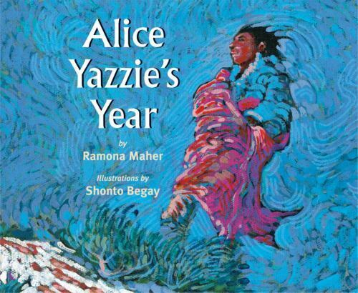
Part 6: Texts
Title | Description
13. ALICE YAZZIE’S YEAR | Written By: Ramona Maher Illustrated By: Shonto Begay Description: A young Native American girl named Alice describes her life throughout the course of one year. Political to playful with Navajo language being taught within.

Slide 18
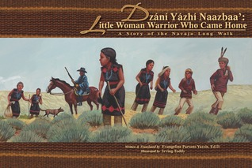
Part 6: Texts
Title | Description
14. DZÁNÍ YÁZHÍ NAAZBAA’ LITTLE WOMAN WARRIOR WHO CAME HOME: A STORY OF THE NAVAJO LONG WALK | Written By: Evangeline Parsons Yazzi, Ed.D. Illustrated By: Irving Toddy Description: In this text that is geared towards 5th graders, troops kidnap Dzanibaa and force her into a life far from her family both by distance and by culture. She endures by hanging on to her language and beliefs.

Slide 19
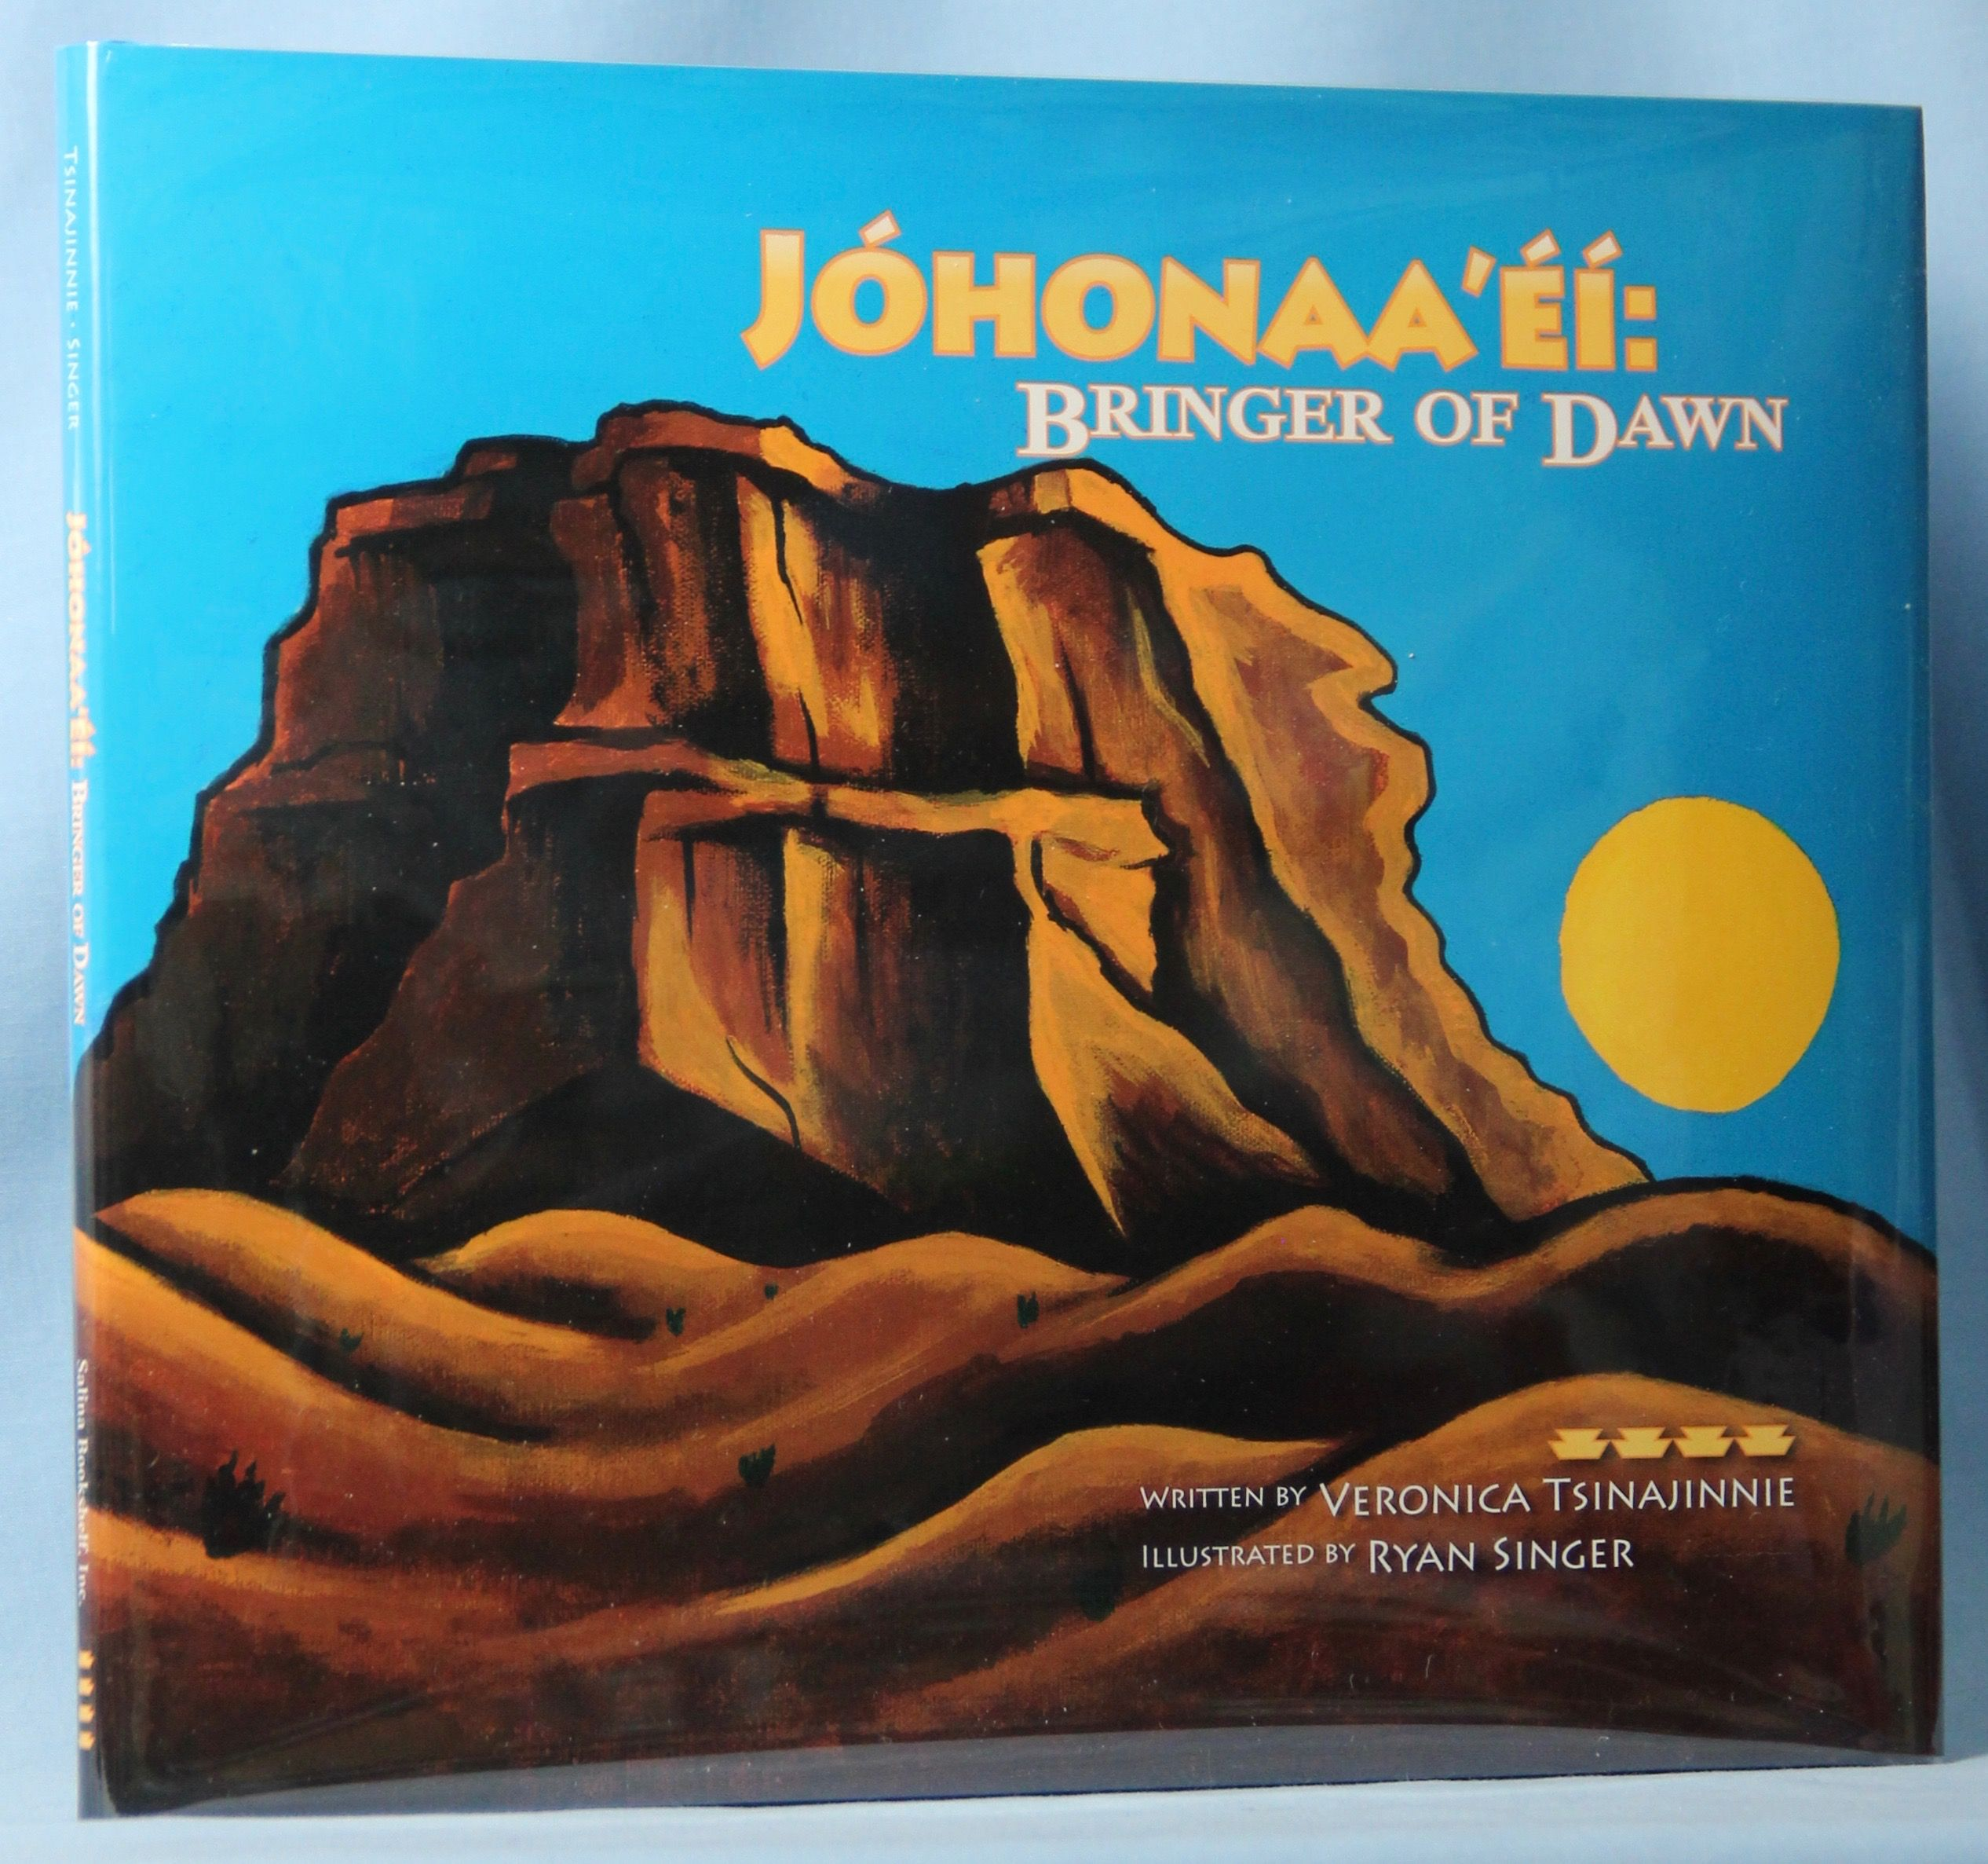
Part 6: Texts
Title | Description
15. JÓHONAA’ÉÍ BRINGER OF DAWN | Written By: Veronica Tsinajinnie Illustrated By: Ryan Singer Description: This story describes everything the sun does for our planet. Using the Navajo word for sun, JÓHONAA’ÉÍ, story paints a beautiful of nature and creatures living side by side with native people.

Slide 20
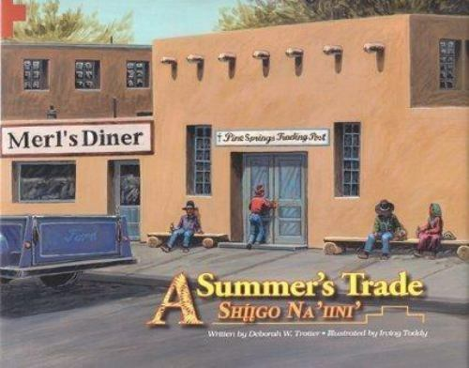
Part 6: Texts
Title | Description
16. A SUMMER’S TRADE SHIIGO NA ’IINI | Written By: Deborah W. Trotter Illustrated By: Irving Toddy Description: In this bilingual story, Tony must make a sacrifice for his family, and he learns how people in his tribe look out for each other.

Slide 21
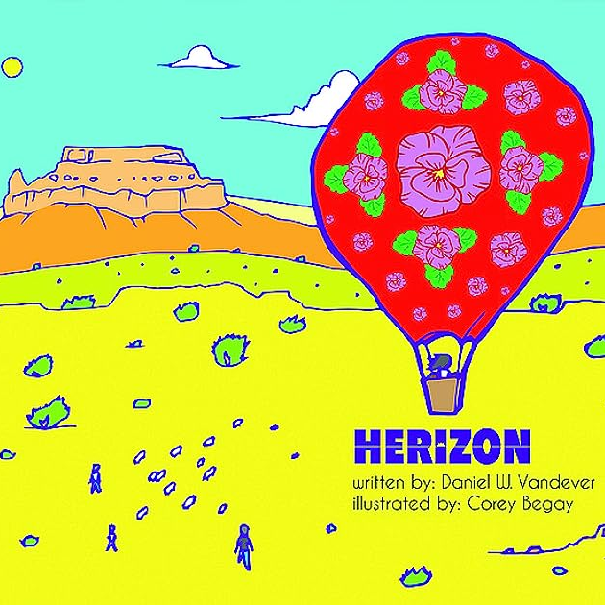
Part 6: Texts
Title | Description
17. HERIZON | Written By: Daniel W. Vandever Illustrated By: Corey Begay Description: In this wordless book, a little girl helps her grandmother gather a flock of sheep using the help of a magic scarf. This book is intended to promote oral production of Navajo.

