Slide 1
Multimodal Text Set
Representation of Latinos/as in Children’s Literature: Immigration and Empowerment
Cynthia Villarreal Cantu

Slide 2
Summary:
This text set focuses on the struggles that many Latino/a students may face as immigrants and emergent bilinguals. Through authentic and culturally relevant literature, students can gain empowerment. Self-reflection can ultimately lead to positive identity and equity in multicultural children’s literature. Diverse educational resources can help children connect to their past and present experiences.
Notes:
Connect to their specific community

Slide 3
Pam Muñoz Ryan
https://www.pammunozryan.com/wp-content/uploads/2015/06/scriptEsperanza.pdf
Esperanza, a young Latina girl, is forced to leave her rancho in Mexico to become a field worker in California. As she struggles with poverty and oppression during the Great Depression, she overcomes difficulties in her life. Esperanza forms connections with family and friends. Through translanguaging, the reader can engage with the story and help emergent bilingual students and marginalized groups connect to literature.

Slide 4
Ernesto Cisneros
https://www.teachingbooks.net/tb.cgi?tid=70687
After Efrén’s Amá is deported to Mexico, he finds himself responsible for his siblings. As his father works additional jobs to earn money for Amá’s return, Efrén realizes the importance of his culture and language. He also decides to run for class president to advocate for other students that are facing hardships.

Slide 5
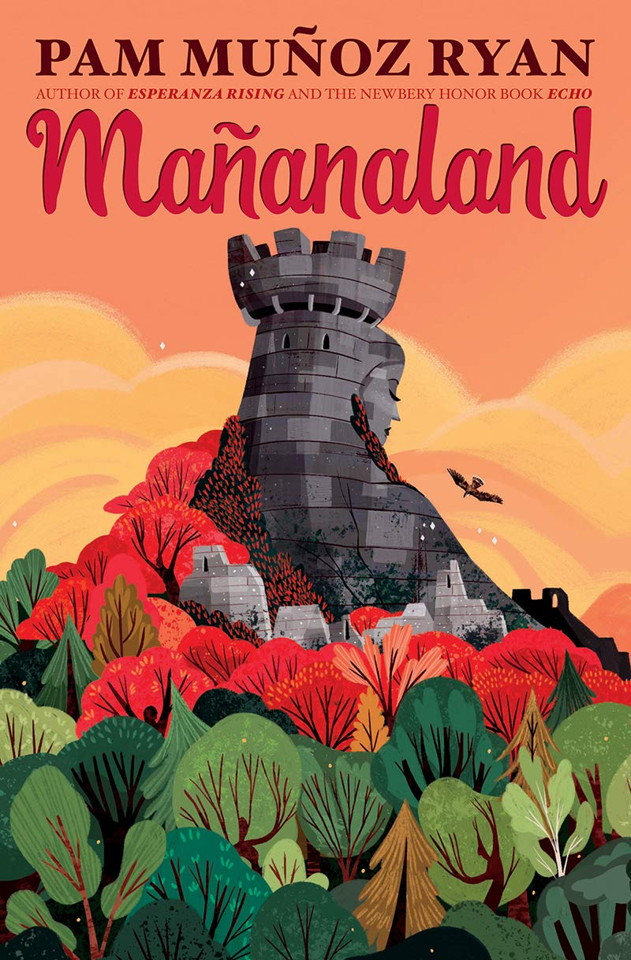
Maximiliano dreams of making the football team and seeing his mother. However, through a family secret, Max uncovers secrets and answers. This book embraces the uniqueness that all cultures hold.
Pam Muñoz Ryan
https://www.pammunozryan.com/mananaland/

Slide 6
Gary Soto
https://garysoto.com/
This collection of poems by Gary Soto bring to life the experiences of the Mexican American culture. These inspiring odes include translanguaging and connect the reader to the culture and heritage of the Latino/a culture.

Slide 7
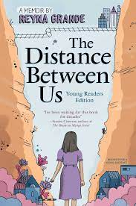
Reyna Grande
http://reynagrande.com/books/distance/
Reyna Grande discusses her experiences as an immigrant child. Her journey to the United States with her father and siblings presents some challenges. However, through determination, she perseveres. The author connects the young reader to the text by focusing on her success.

Slide 8
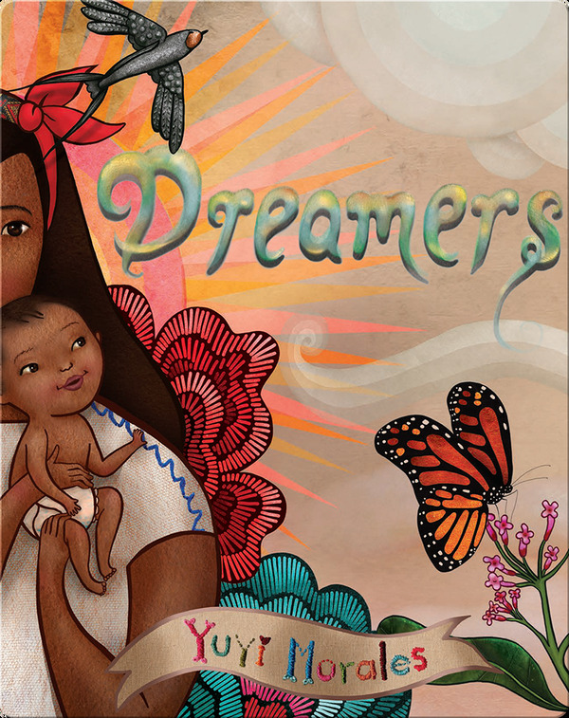
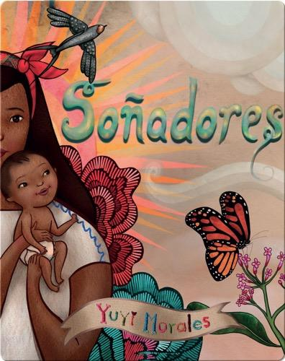
Yuyi travels to the United States with her infant child in search of a better life. Ultimately, she discovers that her strength and resilience guide her to learn a new language and adapt to a new culture.
Yuji Morales was also awarded the Pura Belpré award for her creativity with art that is seen throughout the book.
Yuyi Morales
https://www.youtube.com/watch?v=8IukT6gkeQ0
https://www.youtube.com/watch?v=lBxabgXKA_4

Slide 9
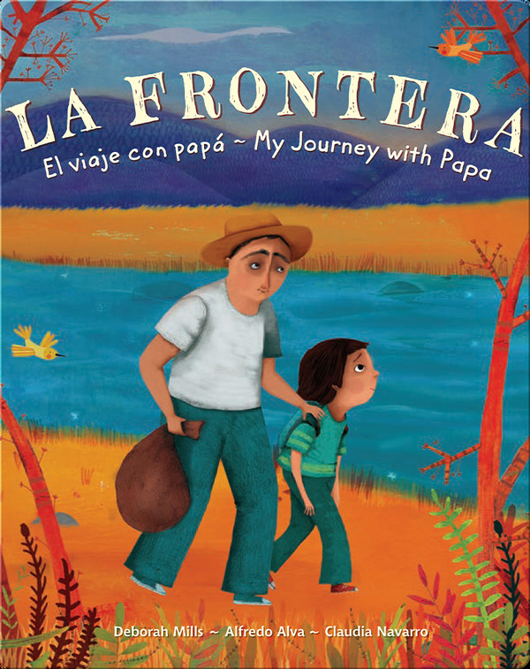
A young boy and his father travel to the United States in search of a new life. Through courage and bravery, they successfully cross to the land of freedom.
Alfredo Alva & Deborah Mills
https://socialjusticebooks.org/la-frontera-el-viaje-con-papa-my-journey-with-papa/

Slide 10
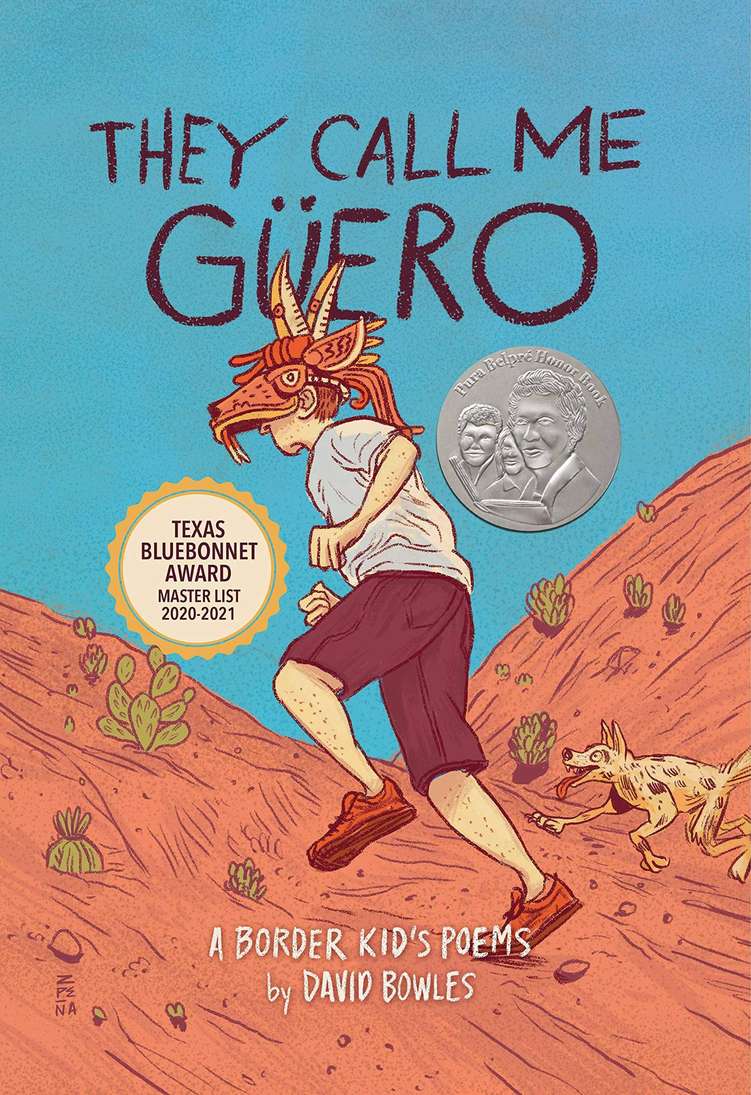
David Bowles
https://www.youtube.com/watch?v=fsWIH8xnLFk
This book contains amazing poetry written from the point-of-view of Güero, the young David Bowles. As a light skin Mexican, he experiences racism but is empowered through the voices of his family. His experiences as a Latino can form connections to students that are facing adversity.

Slide 11
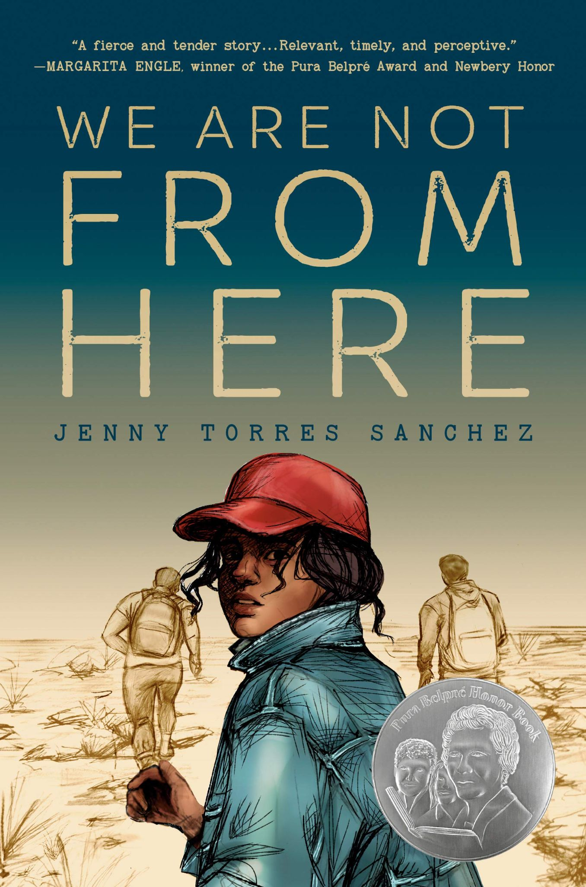
Three teens, Pulga, Chico, and Pequeña, travel from Guatemala through Mexico on La Bestia. Their goal is to arrive in the United States, a place of freedom. They are driven by the promise of a better life that promises safety.
Jenny Torres Sanchez
https://pennykittle.net/uploads/images/PDFs/Workshop_Handouts/We%20are%20not%20from%20here.pdf

Slide 12
After Lupita's mother becomes ill, she is forced to grow up quickly. Writing under the tree gives her a temporary escape from chaos in her life. Through the hardships, Lupita embraces family and culture.
Guadalupe Garcia McCall
https://www.leeandlow.com/books/under-the-mesquite

Slide 13
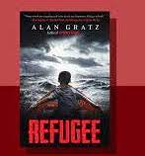
Three children, all in different time periods, are facing hardships. Josef, a 13-year-old boy, is trapped in the holocaust. Mahmoud is on a journey to escape his brutal homeland of Syria. Isabel is escaping poverty and hunger in Cuba. All children are fighting to survive oppression and seek a better life.
Alan Gratz
https://www.alangratz.com/

Slide 14
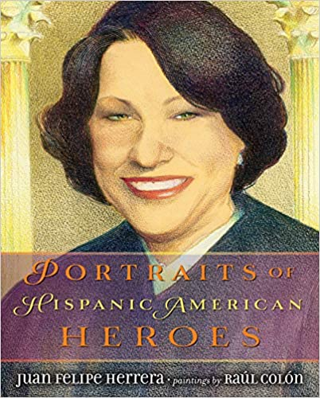
In this book, Herrera (2014) acknowledges the hard work and contributions of several Hispanic American Heroes. This book can inspire and empower young Latinos/as that are striving for success.
Juan Felipe Herrera
https://www.poetryfoundation.org/poets/juan-felipe-herrera
https://www.poetryfoundation.org/video

Slide 15
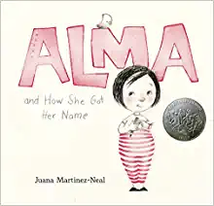
As Alma gains insight into the importance of all her names, she realizes the essence of who she is. She becomes proud of her family and culture. Many Latino/a children have unique names that are connected to relatives.
Juana Martinez-Neal
https://juanamartinezneal.com/

Slide 16
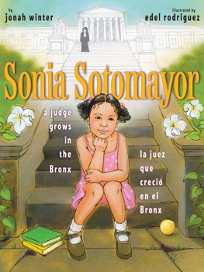
Sonia, a young Puerto Rican girl from the Bronx, is loved and supported by her mother, who worked extra hours so that her children could go to school. Sonia admires her mother’s hard work. Through the support of her family, Sonia becomes a judge and the first Latina Supreme Court Justice.
Jonah Winter
https://www.youtube.com/watch?v=X_zt5IYCRGs

Slide 17
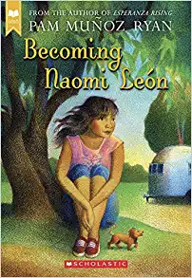
Pam Muñoz Ryan
https://www.pammunozryan.com/wp-content/uploads/2015/06/scriptLeon.pdf
https://www.teachingbooks.net/book_reading.cgi?a=1&id=12419
https://www.pammunozryan.com/wp-content/uploads/2015/07/Author-Interview-about-BECOMING-NAOMI-LE%C3%93N.pdf
Naomi’s life has always been happy and living in a peaceful community has always been normal. However, a mysterious journey challenges her optimistic thinking as she strives to save her family.

Slide 18
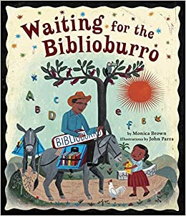
After Ana’s teacher moves, she wishes for books that engage her imagination. Ana is surprised when a traveling librarian on a burro (donkey) comes through her village. Through her creative imagination, she begins to write stories.
Monica Brown
http://www.monicabrown.net/
https://www.youtube.com/watch?v=L-WTJjb9lPo

Slide 19
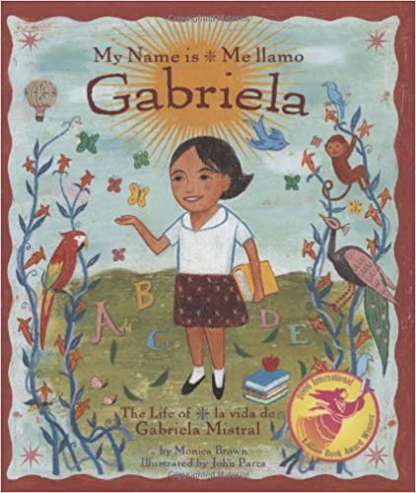
Monica Brown
http://www.monicabrown.net/
https://www.youtube.com/watch?v=BsJu9dRPbx0
https://www.youtube.com/watch?v=cZBdw4_3iNk
An imaginative girl named Gabriela is inspired to become a teacher that loves poetry and bilingual stories. He stories are influential throughout the world, and she becomes the first Latina woman to win the Nobel Prize.

Slide 20
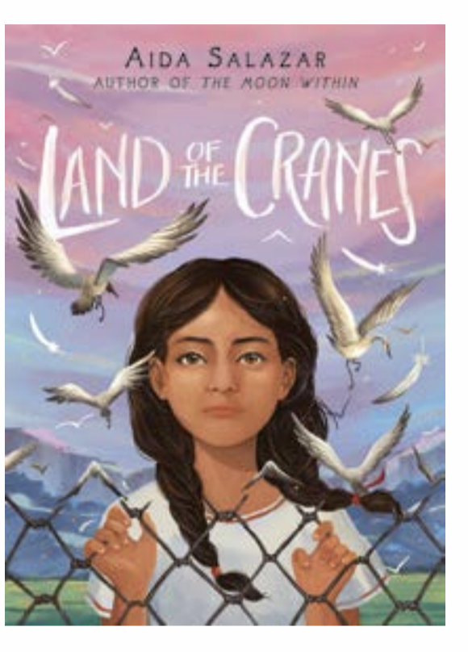
Aida Salazar
http://www.aidasalazar.com/land-of-the-cranes.html
http://www.aidasalazar.com/
https://www.youtube.com/watch?v=2q9ZGQuLGQ0
After Betita’s father is deported to Mexican, she and her pregnant mother suffer living at a detention center. Through poetry, 9-year-old Betita finds comfort and inspires a change.

