Slide 1
Adverse Indigenous Experiences
in the making and becoming of a so called ‘Greatest Nation in the World’
By: Terry Posey
Synopsis
It is crucial to provide resources to show how Indigenous Nations have been affected and are seeking the road to healing from past traumas and experiences. Adverse Indigenous Experiences will show how traumas, injustices, and genocide have impacts Indigenous Nations. My multimodal text project will present Indigenous lens’s to past historical traumas and present-day injustices that continue to toxify Indigenous lands, cultures, and ways of life. I will also show how Indigenous Nations are resilient.

Slide 2
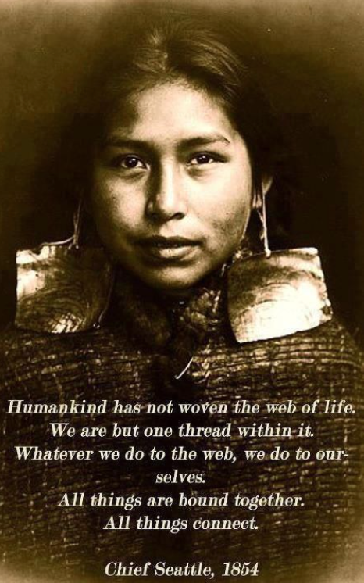

Slide 3
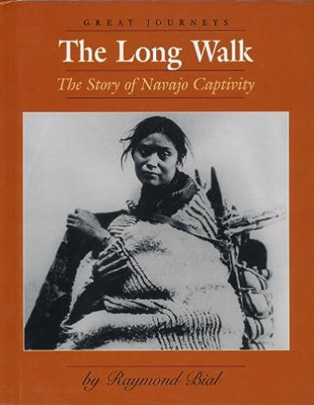
Books
This book presents an overview of the history of the Navajos, with a detailed account of how the United States Government, represented by Kit Carson, forced them on a 300-mile walk from their homeland in the Southwest to a prison camp at Bosque Redondo, New Mexico, in 1864, and their eventual return home after the United States-Navajo Treaty of 1868.
Raymond Bial (Author) (2002) The Long Walk: The Story of Navajo Captivity

Slide 4
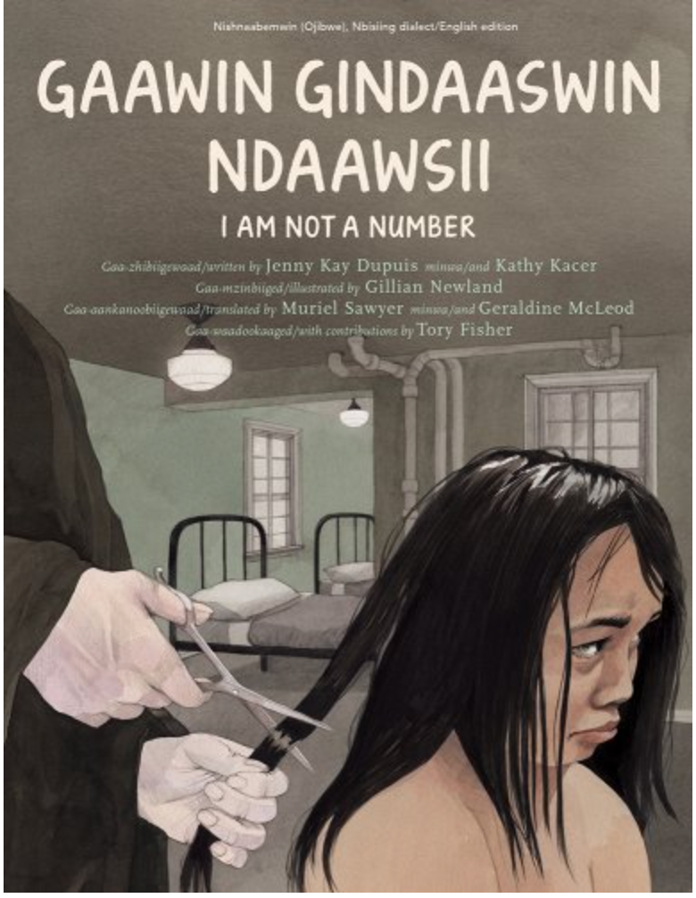
I Am Not A Number opens with a frightening moment. An Indian agent is at their door, to take Irene and her brothers to residential school. When Irene's mother tries to keep Irene, the agent says "Give me all three or you'll be fined or sent to jail." Irene's parents, like many Native parents, were coerced into giving up their children.
Jenny Kay Dupuis and Kathy Kacer's, illustrated by Gillian Newland (2016) I Am Not A Number

Slide 5
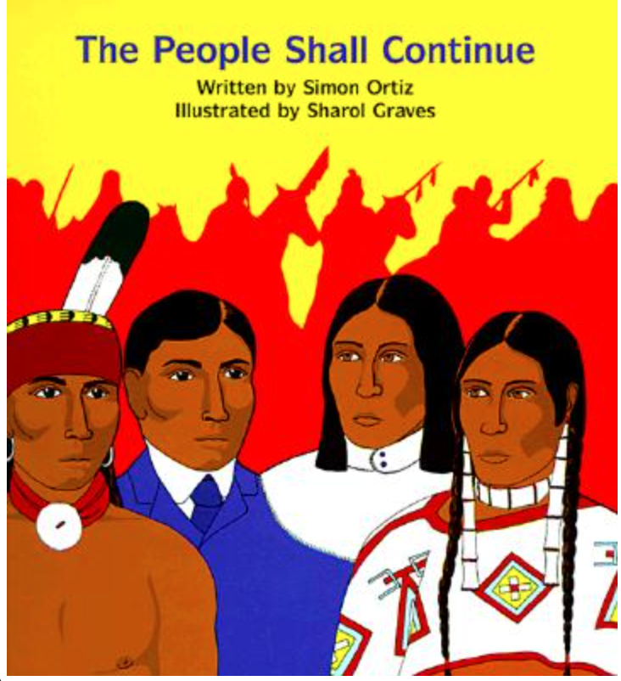
This book tells rhythms of traditional oral narrative, this powerful telling of the history of the Native/Indigenous peoples of North America recounts their story from Creation to the invasion and usurpation of Native lands. As more and more people arrived, The People saw that the new men did not respect the land. The People witnessed the destruction of their Nations and the enslavement of their people. The People fought hard, but eventually agreed to stop fighting and signed treaties.
Simon J Ortiz (Author), Sharol Graves (Illustrator) (2017) The People Shall Continue

Slide 6
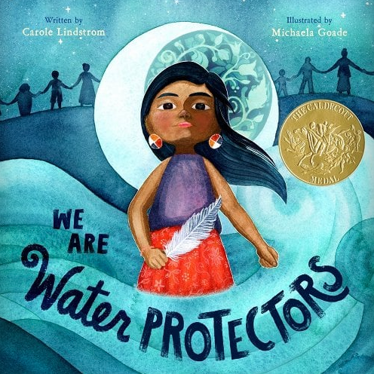
“We are stewards of the Earth / Our spirits have not been broken / We are water protectors. WE STAND!”
In this 2020 Caldecott award winner, a young Indigenous girl learns from her Grandmother that water is sacred. “Water is alive,” Grandmother says, “Water remembers our ancestors.” The book highlights water not just an important natural resource but as a sacred, living element that sustains and binds all together plants, animals, and humans.
By Carole Lindstrom Illustrated by Michaela Goade (2020) We Are Water Protectors

Slide 7
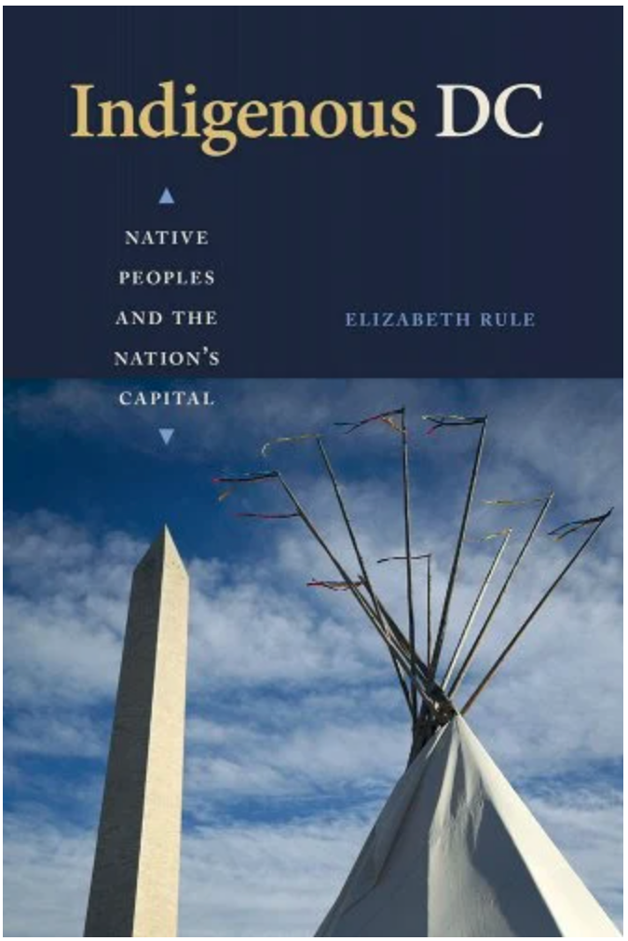
Washington, DC, is Indian land, but Indigenous peoples are often left out of the national narrative of the United States and erased in the capital city. To redress this myth of invisibility, Indigenous DC shines a light upon the oft-overlooked contributions of tribal leaders and politicians, artists and activists to the rich history of the District of Columbia, and their imprint ― at times memorialized in physical representations, and at other times living on only through oral history ― upon this place
Elizabeth Rule (Author) (2023) Indigenous DC: Native Peoples and the Nation's Capital

Slide 8
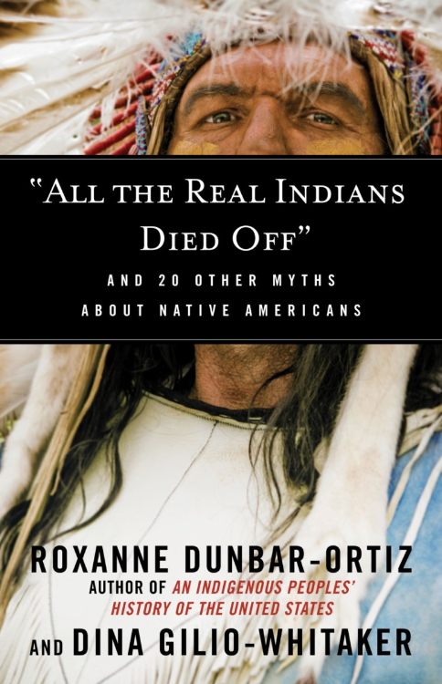
In this enlightening book, scholars and activists Roxanne Dunbar-Ortiz and Dina Gilio-Whitaker tackle a wide range of myths about Native American culture and history that have misinformed generations. Tracing how these ideas evolved, and drawing from history, the authors disrupt long-held and enduring myths such as:
“Columbus Discovered America”
“Thanksgiving Proves the Indians Welcomed Pilgrims”
“Indians Were Savage and Warlike”
“Europeans Brought Civilization to Backward Indians”
“The United States Did Not Have a Policy of Genocide”
“Sports Mascots Honor Native Americans”
“Most Indians Are on Government Welfare”
“Indian Casinos Make Them All Rich”
“Indians Are Naturally Predisposed to Alcohol”
Roxanne Dunbar-Ortiz (Author), Dina Gilio-Whitaker (Author) (2016) "All the Real Indians Died Off": And 20 Other Myths About Native Americans (Myths Made in America)

Slide 9
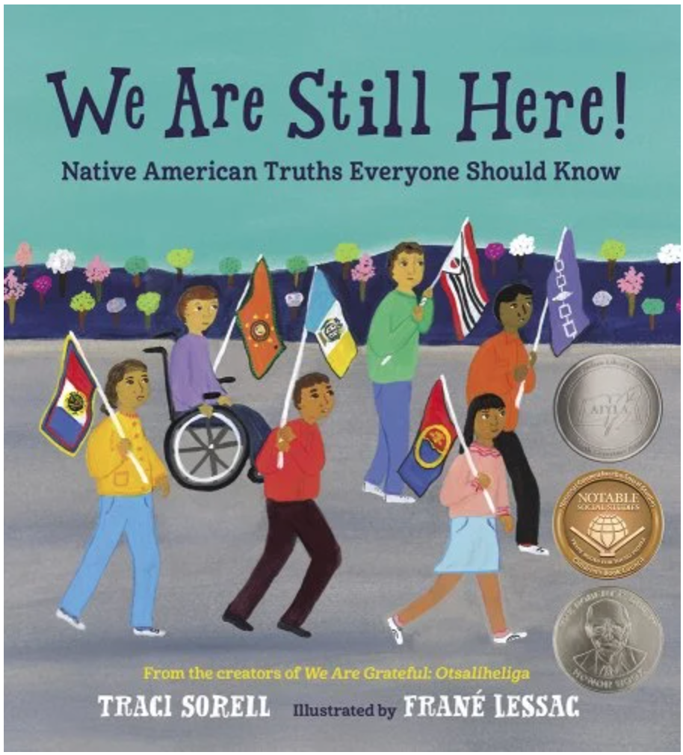
\
Twelve Native American kids present historical and contemporary laws, policies, struggles, and victories in Native life, each with a powerful refrain: We are still here!
Traci Sorell (Author), Frane Lessac (Illustrator) (2021) We Are Still Here!: Native American Truths Everyone Should Know

Slide 10
Podcast and Videos
https://www.youtube.com/watch?v=9djAFGAc4JM

Slide 11
https://www.youtube.com/watch?v=ecgXgHQySiE&t=257s

Slide 12
https://www.youtube.com/watch?v=FzGgIUSQr1g

Slide 13
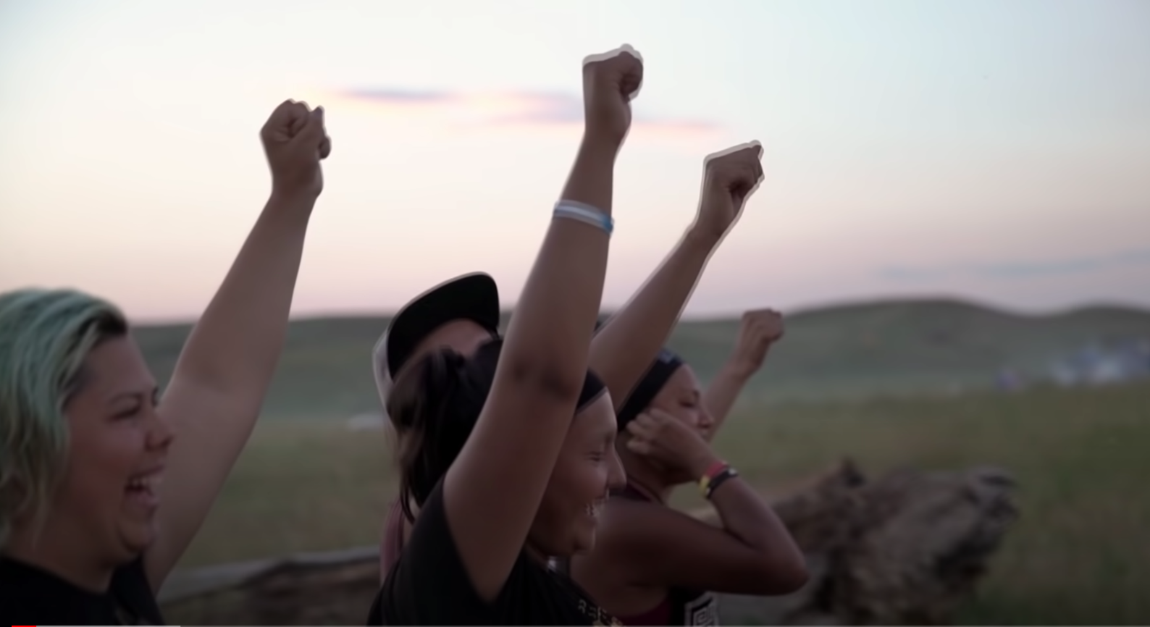
https://www.youtube.com/watch?v=Onyk7guvHK8

Slide 14
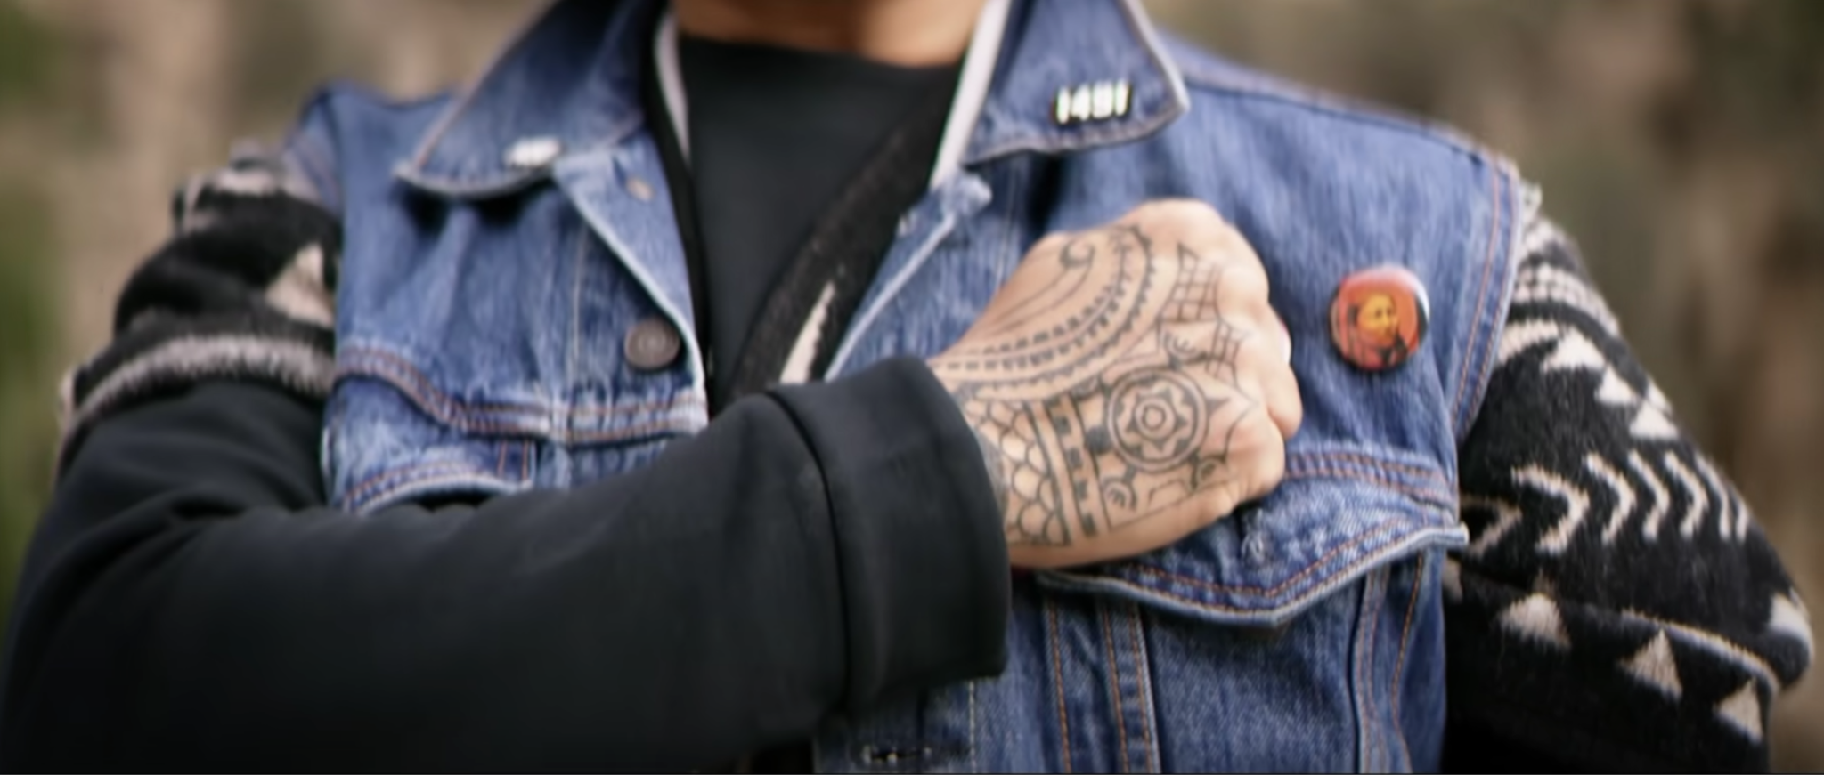
https://www.youtube.com/watch?v=XHhbeRJudY4

Slide 15
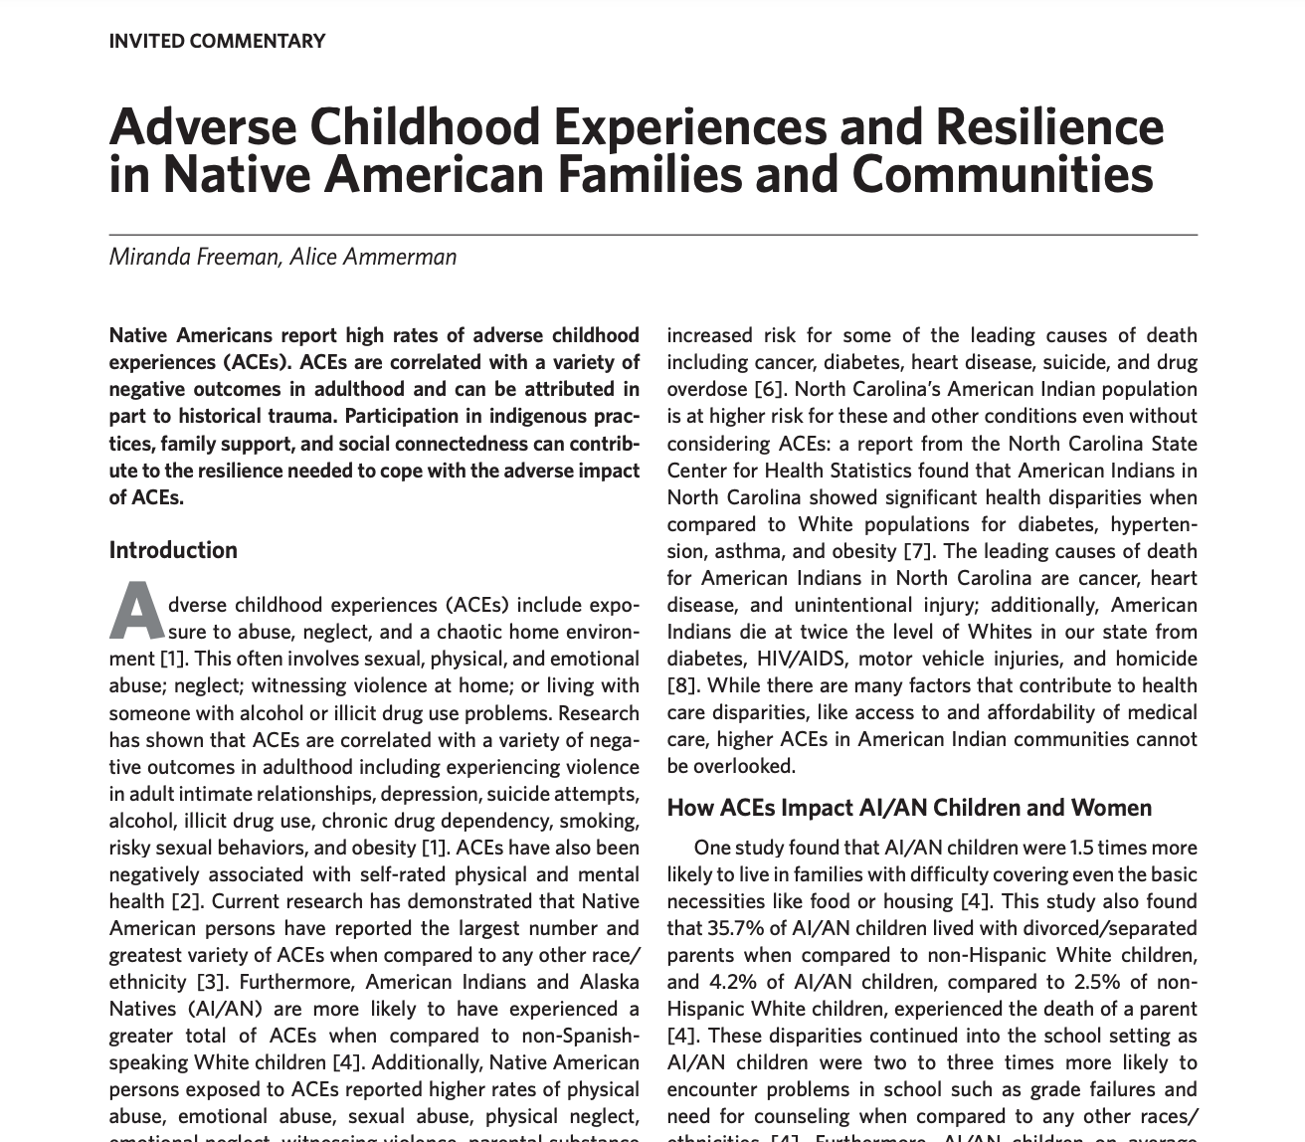
Articles
Adverse Childhood Experiences and Resilience in Native American …

Slide 16
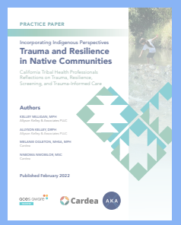
https://www.acesaware.org/wp-content/uploads/2022/01/Trauma-resillience-practice-paper.pdf

Slide 17
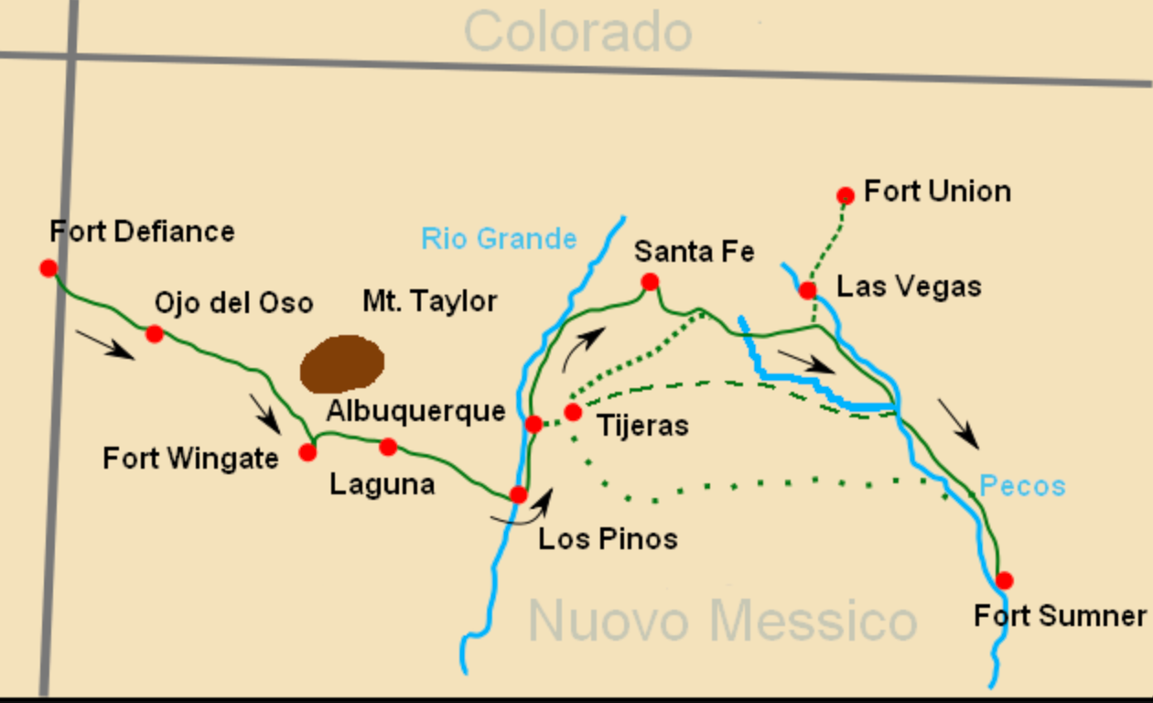
MAPS
Source: Dollman, Darla Sue, from Wild West History. “The Navajo Long Walks, the Bosque Redondo, and the Long Walks Home,” available at wildwesthistory.blogspot.com/2012/10/the-navajo-long-walks-bosque-redondo.html

Slide 18
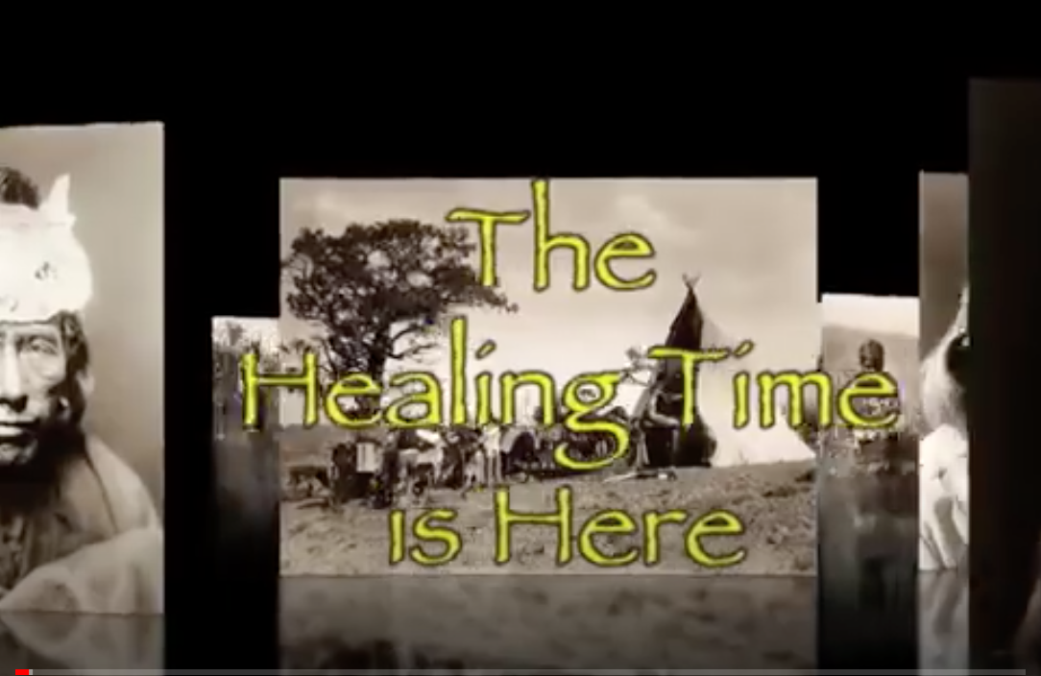
Film
https://www.youtube.com/watch?v=H20h2qjBFag

Slide 19
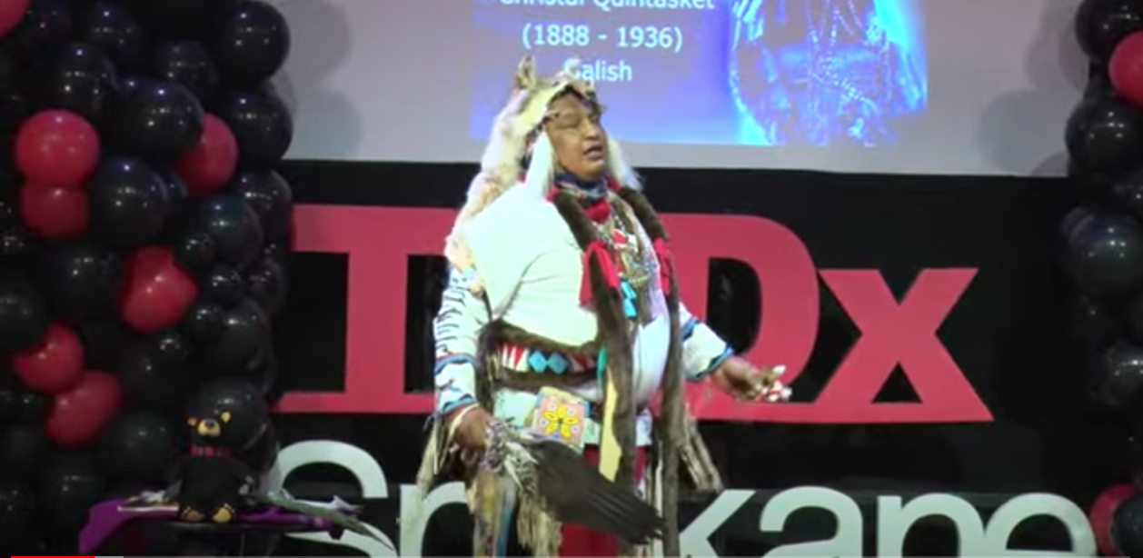
Story Telling
https://www.youtube.com/watch?v=YfNAXpn-czw&t=80s

