Slide 1
“Right Back to Where We Started From”
Tommy Reihl
Summer 2023
Overview: More ancient than even the oldest of stories is humanity’s perpetual quest for answers about and from the unknown. Whether through the stories people tell each other to bring meaning to the shapes, colors, smells, and sounds around us or the sincere supplications, words of worship, and earnest pleas offered to our deities and ancestors, humans continue to demonstrate their desire to understand the “Whys & Hows” of our world. The literature and resources included in this text set seek to explore ideas of how the world and the things within it came into existence as told through a variety of perspectives.

Slide 2
How can creation stories inform our understandings of gender/gender roles?
FURTHER INQUIRIES
How can creation stories inform the relationships humans have with the rest of the natural world?
How can creation stories inform the relationships humans have with one another ?
Why are the stories people tell to explain the world around them significant?
GUIDING QUESTIONS
What similarities or trends do we encounter when we read creation stories?

Slide 3
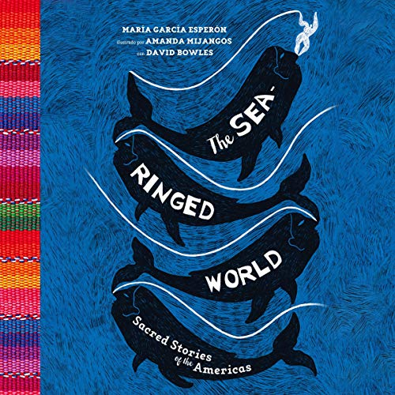
The Sea Ringed World: Sacred Stories of the Americas
Maria Garcia Esperón, Amanda Mijangos, David Bowles
Like all humans, Native Americans seek to understand their place in the universe, the nature of their relationship with the divine, and the origin of the world into which their ancestors had emerged. The answers lay in their sacred stories.
Author María García Esperón, illustrator Amanda Mijangos, and translator David Bowles have gifted us a treasure. Their talents have woven this collection of stories from nations and cultures across our two continents—the Sea-Ringed World, as the Aztecs called it—from the edge of Argentina all the way up to Alaska.

Slide 4
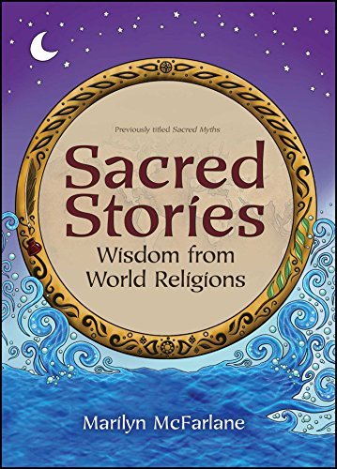
Sacred Stories: Wisdom from World Religions
Marilyn McFarlane
When attempting to find a simple, engaging, and unbiased approach to world religions for her own family, Marilyn McFarlane discovered such a book did not exist. Understanding how important it is for children to build both respect for and knowledge of a variety of religions, regardless of their own faith, McFarlane created Sacred Stories: Wisdom from World Religions.
Each captivating story and accompanying sidebar facts and spot illustrations brings to life the key tenets of a particular belief system, while the comprehensive glossary and resource list enable readers to expand their explorations.

Slide 5
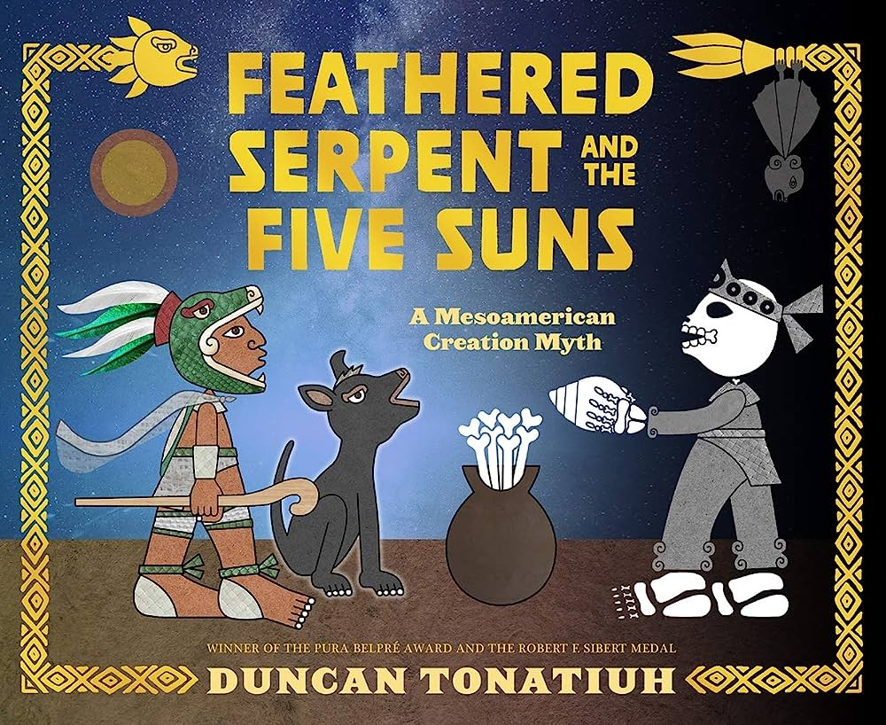
Feathered Serpent And The Five Suns: A Mesoamerican Creation Myth
Duncan Tonatiuh
This pre-Columbian creation myth tells the story of Quetzalcoatl, one of the most important deities in ancient Mesoamerica, and his quest to create humankind. The gods tried to make humans during each sun, or age, but each time failed. So when they grew tired, only one did not give up: Quetzalcoatl, also called the Feathered Serpent. Determined, the Feathered Serpent embarks on a dangerous journey full of fearsome foes and harsh elements, facing each trial with wisdom, bravery, and resourcefulness before confronting his final challenge at Mictlan, the underworld. With his instantly recognizable, acclaimed art style and grand storytelling, Tonatiuh recounts a dazzling creation tale of epic proportions.

Slide 6
Traditional Stories and Creation Stories
Diane Brown, Joanne Snowshoe, Wilfred Yellow Wings, Joan Tenasco, Peter Irniq, Stephen Augustine Webpage: Traditional Stories and Creation Stories | Canadian History Hall
First Peoples remember their origins through oral histories passed down by elders in each generation. These narratives describe the creation of the world and how First Peoples came to live in it. More than legends, they embody a view of how the world fits together, and how human beings should behave in it. Some oral histories refer to a time before human occupation. Others mark significant geographical, spiritual and life events that have occurred over the millennia. Listen to traditional stories and creation stories told by six Indigenous storytellers from communities across Canada. Each recording is available in the respective Indigenous language and in English, and French transcripts are available.

Slide 7
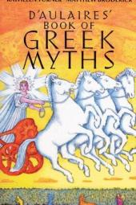
D’Aulaires’ Book of Greek Myths
Ingri d’Aulaire & Edgar Parin d’Aulaire
In print for over fifty years, D’Aulaires Book of Greek Myths has introduced generations to Greek mythology—and continues to enthrall young readers.
Here are the greats of ancient Greece—gods and goddesses, heroes and monsters—as freshly described in words and pictures as if they were alive today.

Slide 8
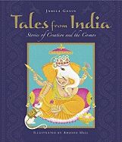
Tales from India: Stories from Creation and the Cosmos
Jamila Gavin & Amanda Hall
Renowned storyteller Jamila Gavin writes of great floods, legendary romances, and epic battles between good and evil. This new collection of Hindu tales, including the birth of the gods, tales of creation, and the arrival of humans, is illuminated by Amanda Hall’s exquisite artwork, which reflects the influence of both classical and contemporary Indian art.

Slide 9
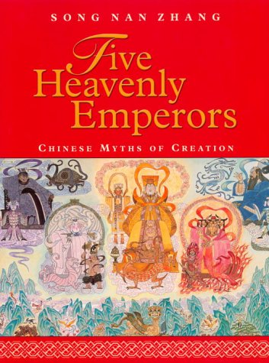
Five Heavenly Emperors: Chinese Myths of Creation
Song Nan Zhang
Between Pangu separating the sky from the earth and the Northern Emperor separating man from gods, we have an array of deities as busy and colorful as those in Greek and Roman myths. They create men out of clay, mend the broken sky after the flood, and shoot down suns so that life on earth will not die.Inspired by the art of the Ming Dynasty, this is a wonderful collection of Chinese myths of creation, illustrated by award-winning artist Song Nan Zhang.

Slide 10
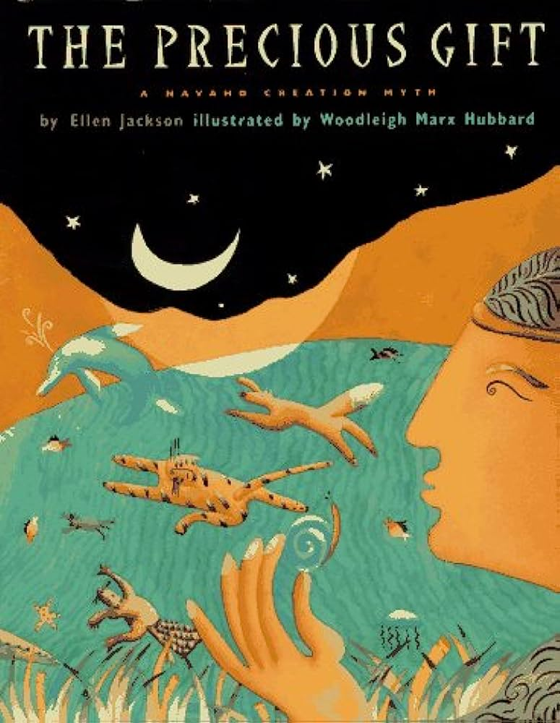
The Precious Gift: A Navajo Creation Myth
Ellen Jackson & Woodleigh Marx Hubbard
A telling of the story of the ascent of the first humans, thanks to the tireless help of their animal counterparts. In search of a viable water source, the first man and first woman enlist the assistance of the otter, beaver, frog, turtle, and the most unlikely hero: the snail.

Slide 11
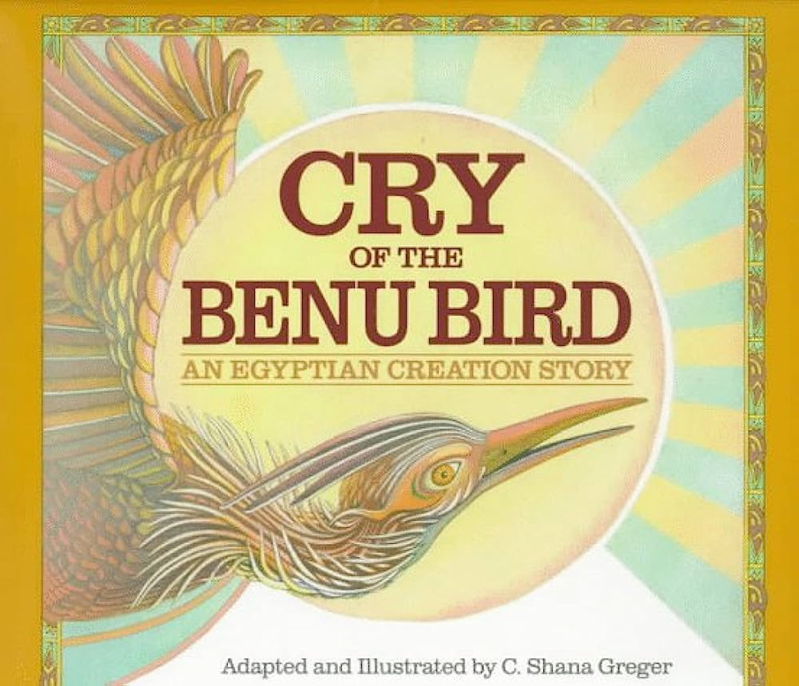
Cry of the Benu Bird: An Egyptian Creation Story
C. Shana Greger
From the Nun, a vast sleeping ocean of deep water surrounded on all sides by Chaos, rises the legendary Benu Bird, the ancestor of the phoenix and the bringer of light, and at its cry, time begins and the world comes into existence, in an ancient Egyptian story of creation.

Slide 12
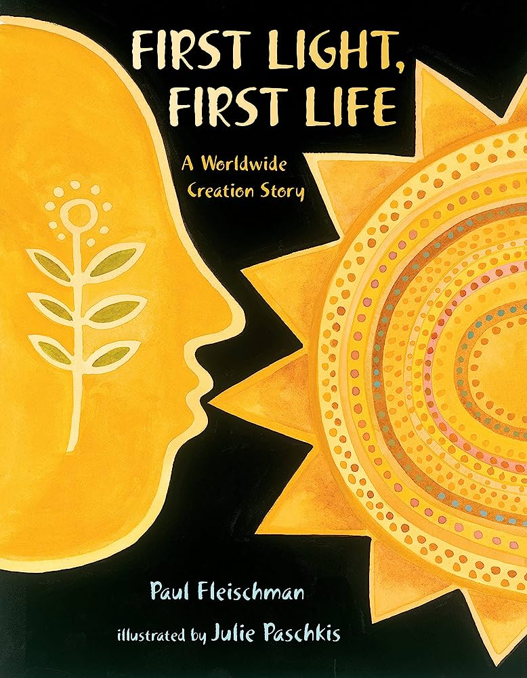
First Light, First Life: A Worldwide Creation Story
Paul Fleishman & Julie Paschkis
Combining elements of the creation story from different traditions, this narrative weaves together one complete picture of how the world began. First Light, First Life is a celebration of the many and varied peoples of the earth, of their commonalities and their differences. It is a celebration of life and humanity’s desire to explain our origins through storytelling.

Slide 13
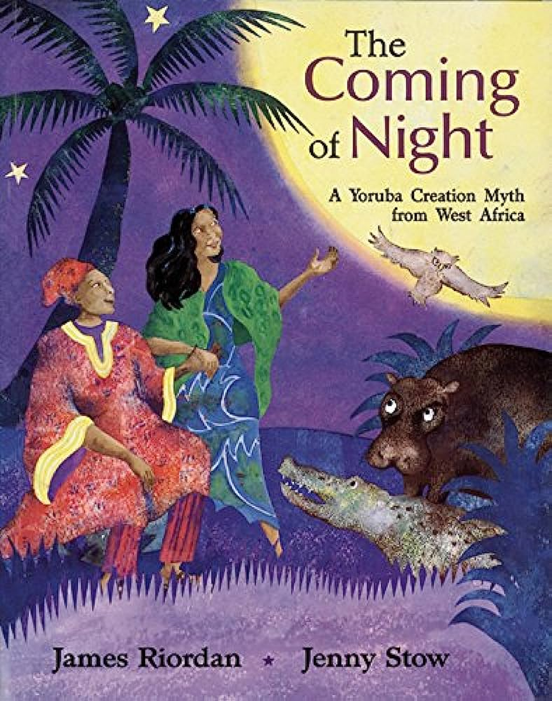
The Coming of Night: A Yoruba Creation Myth from West Africa
James Riordan & Jenny Stow
Long, long ago, when the earth was new, the great river goddess Yemoya sent her daughter Aje to marry a handsome earth chief in the Land of Shining Day. At first Aje was happy, but soon she started to pine for the cool shadows of her mother's realm. So her husband asked Crocodile and Hippopotamus to bring Aje a sackful of Night. As they carried it back, the animals heard strange noises coming from the sack - and curiosity finally got the better of them...
James Riordan's retelling of a Yoruba tale, vividly illustrated by Jenny Stow, gives an explanation of the coming of night to our world.

Slide 14
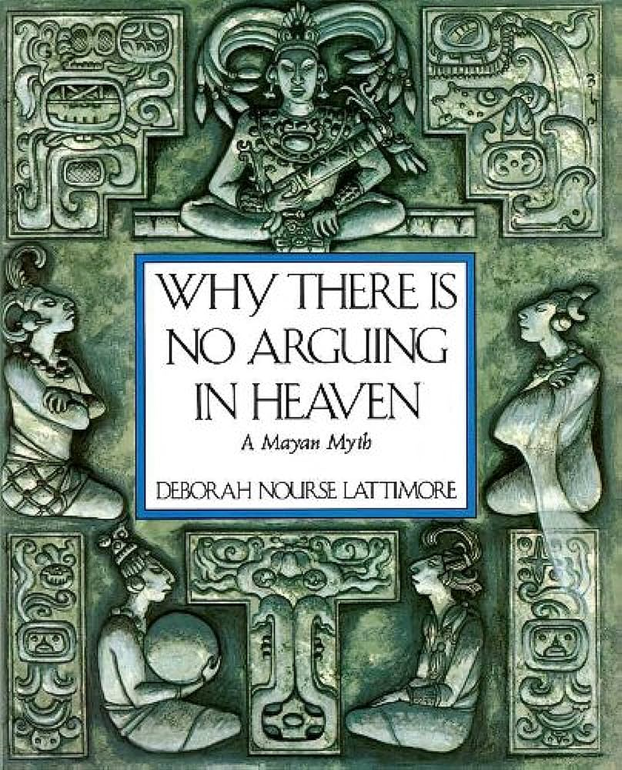
Why There is No Arguing in Heaven: A Mayan Myth
Deborah Nourse Lattimore
Before there was the world, darkness was all that was. In this darkness sat Hunab Ku, the first Creator God of the Mayas. At his feet sat other gods. The Sun God was quiet. The Maize God was watchful. But the moon Goddess and Lizard House argued as to which of the gods was the greatest after Hunab Ku. In this ancient Mayan Story of the creation of the world, Deborah Nourse Lattimore conveys the wisdom, vitality, and earthly humor of the people whose ancestors told this story and who still live today in Guatemala and parts of Mexico.

Slide 15
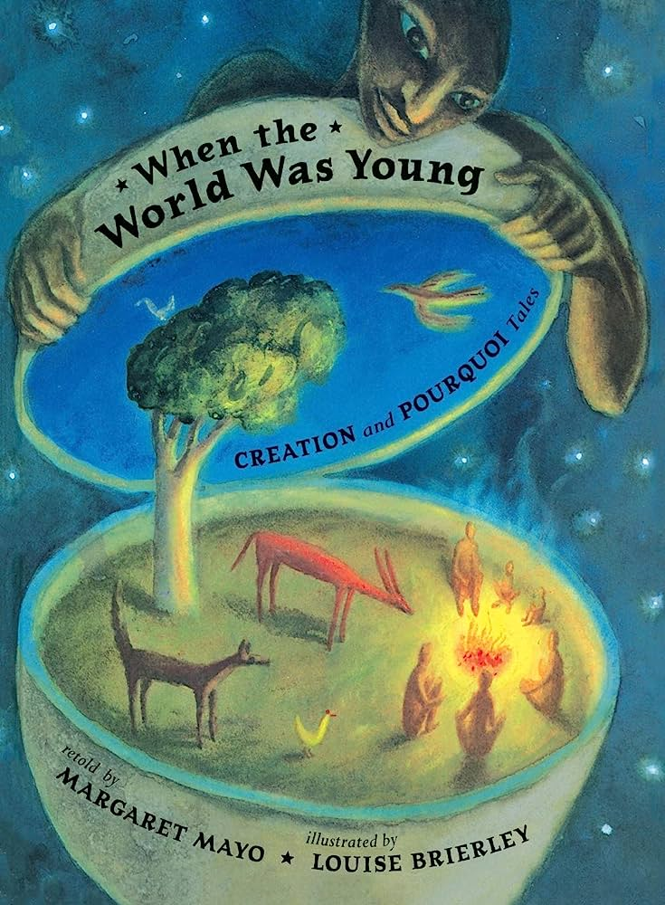
When The World Was Young: Creation & Pourquoi Tales
Margaret Mayo & Louise Brierley
Ten imaginative tales bring young readers into the stories of diverse cultures and create a provocative portrait of the origins of Earth. When the World Was Young shares creation and pourquoi tales from around the world, including African, Native American, Polynesian, Egyptian and Icelandic stories. Margaret Mayo’s “lively, suspenseful renditions bring masterful storytelling skill to ancient stories” in this sumptuous and thought-provoking book.

Slide 16
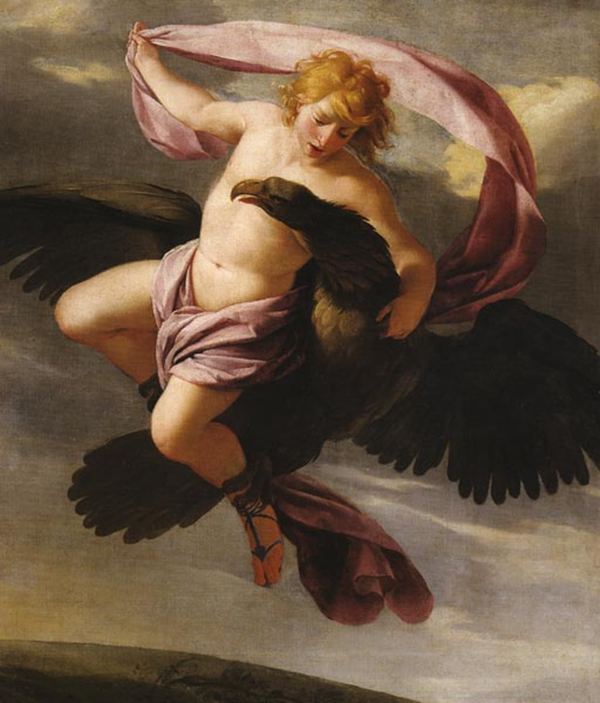
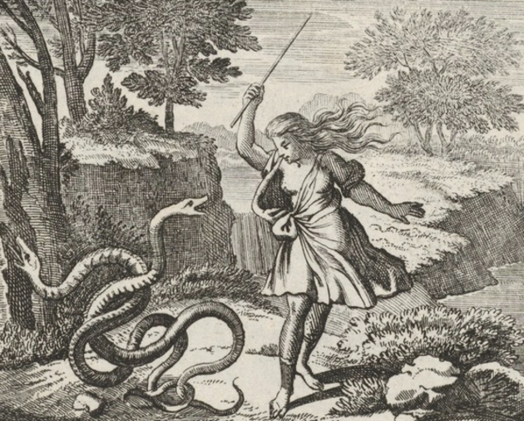
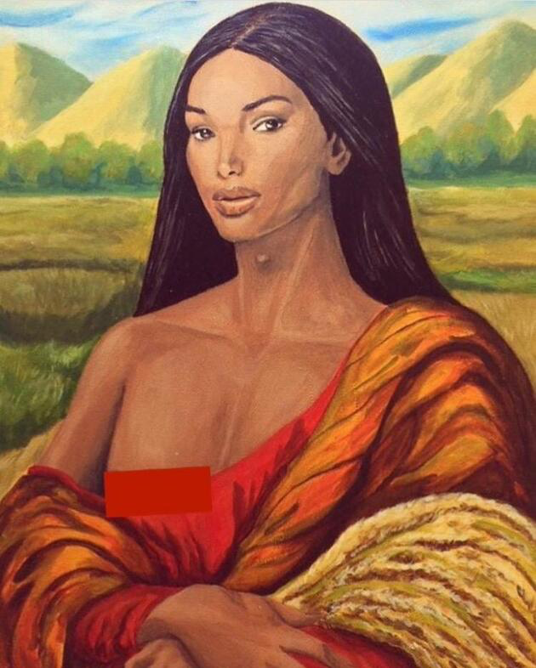
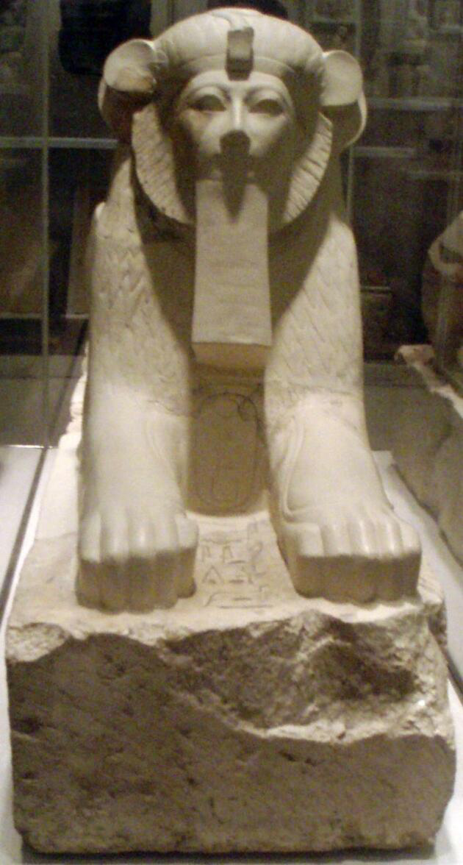
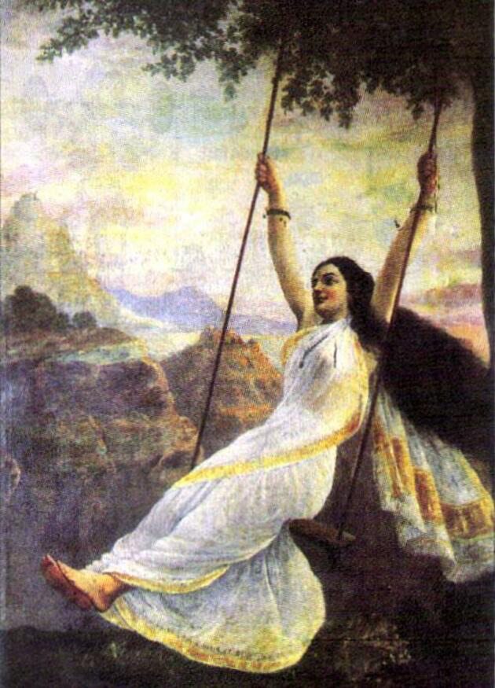
Finding Queer Belonging in Ancient Mythology Zoe Schultz
A listicle-style article that features a focus on how stories from ancient cultures represent an awareness and acceptance of queer identities and genders. Excellent opening examples for connecting the overall ideas of this text set with something more specific.

Slide 17
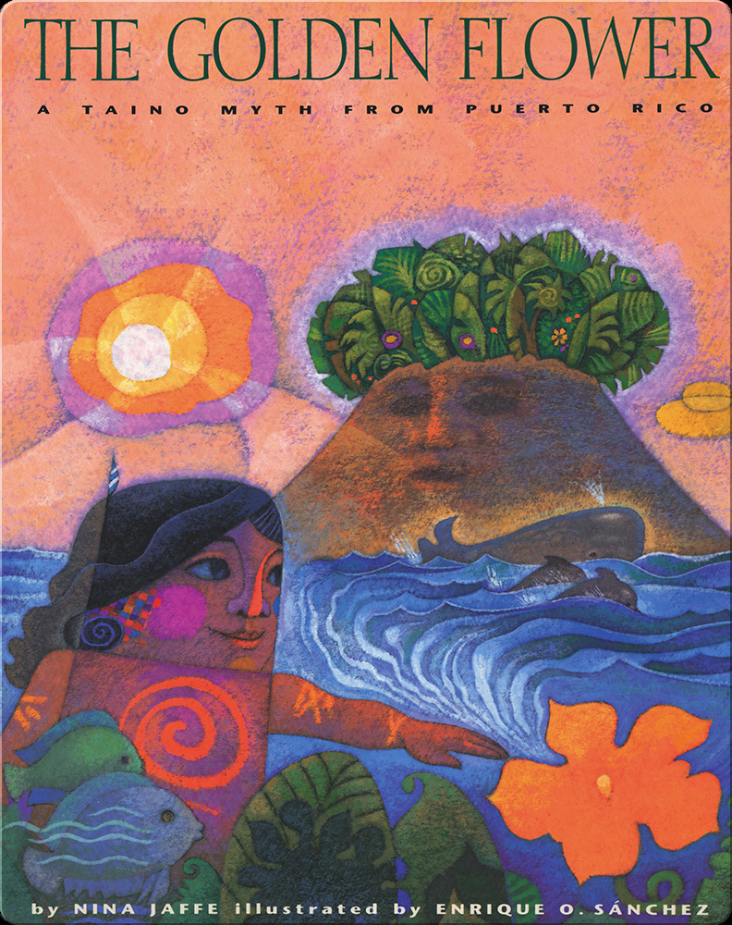
The Golden Flower: A Taino Myth from Puerto Rico
Nina Jaffa & Enrique O. Sánchez
This Taino creation story describes how the island of Puerto Rico came into existence when the Earth was a desert without water. A young boy's adventures lead to the growth of a beautiful forest on top of a mountain and then the introduction of the sea and its creatures around the base of the mountain, which becomes an island. The lovely, stylized illustrations are a perfect match for the traditional story.

Slide 18
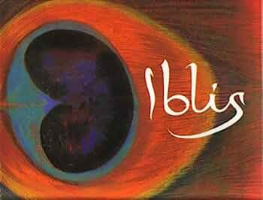
Iblis
Shulamith Levey Oppenheim & Ed Young
The story of Adam and Eve's banishment from Paradise has been part of the world's literary and religious heritage for almost 3,000 years. Focusing on the Islamic version of the story, Oppenheim retells the gripping, tragic tale of Iblis (the Devil) and his clever, wicked plot.

Slide 19
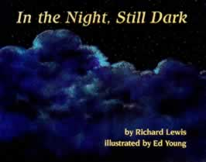
In the Night, Still Dark
Richard Lewis & Ed Young
A poetic description, adapted from the Kumulipo, a traditional Hawaiian creation chant, of how in the darkest night were born the simplest creatures, then with the breaking of dawn more complex ones, and finally people and day.

Slide 20
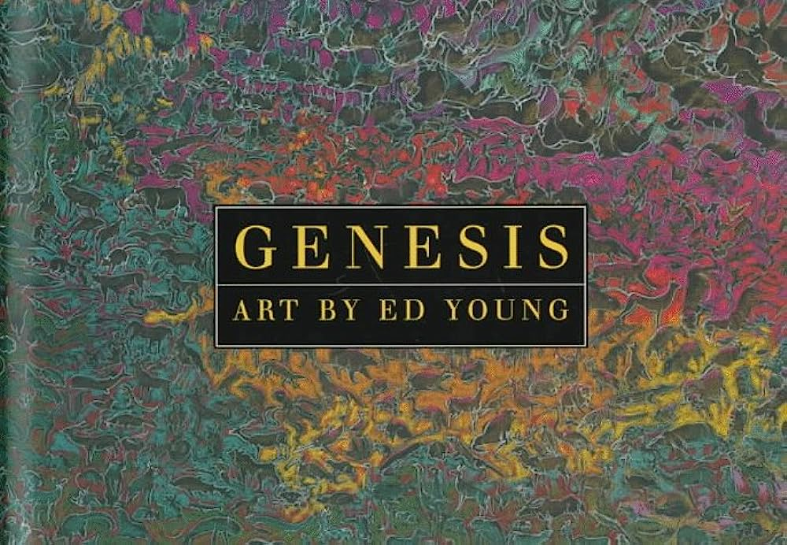
Genesis
Ed Young
The creation account found in the book of Genesis is gorgeously complimented by Ed Young’s moody and abstract visuals. Brings to mind the vagueness with which the story details the beginnings of all things by the hand of their creator.

Slide 21
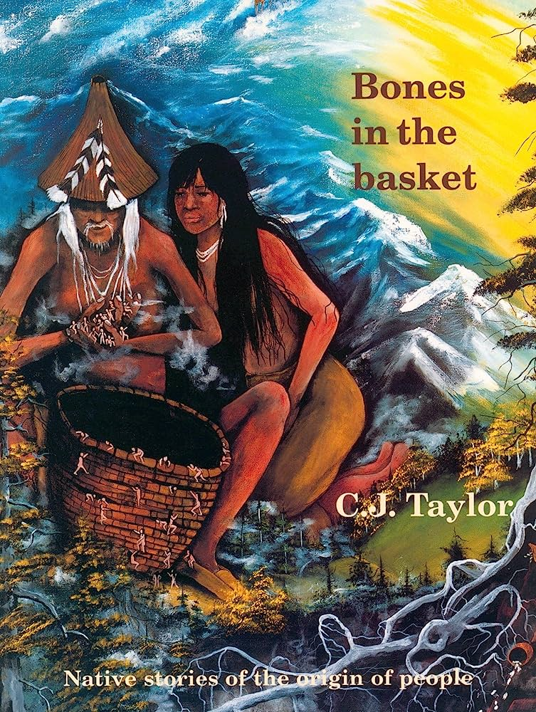
Bones in the Basket: Native Stories of the Origin of People
C.J. Taylor
How did people come to inhabit the Earth? Were bones, collected in a basket, changed into people and scattered East, West, North, South? Perhaps animals formed the Earth from moss floating on a raft after a great flood. Or did the first woman fall through a hole in the sky to make her home on the back of a turtle? Did souls emerge from a dark underworld by climbing a grapevine? A wonderful collection of stories taken from Chukchi, Cree, Mandan, Modoc, Mohawk, Osage, and Zuñi legends.

Slide 22
“The Original Riot”
Wynnie Mynerva
“The Original Riot,” is a visceral two-part installation by Lima-based painter and performer Wynnie Mynervaat the New Museum.
On view through September 17th in the New Museum, the show centers on the titular artwork: a 70-foot painted mural, Mynerva’s largest yet, in moody magenta with bold red and black interrupted by a passageway into the room’s back corner. There, one of Mynerva’s ribs, surgically removed, completes The First Cut (2023) atop a slender, pole-like brass plinth, its round base engraved with a continuous tangle of Eve’s and Lilith’s bodies.
Virtual Tour Article Artist Instagram

Slide 23
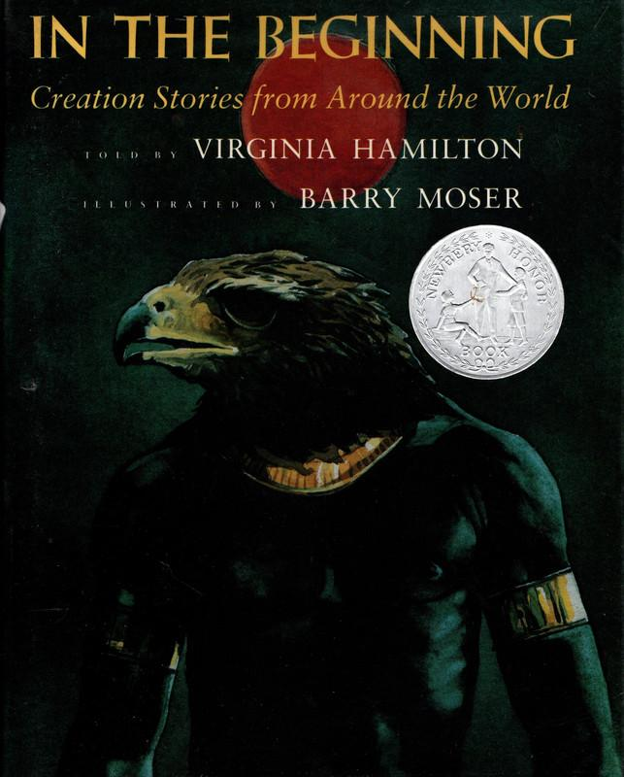
In the Beginning: Creation Stories from Around the World
Virginia Hamilton & Barry Moser
Beautifully told by Virginia Hamilton and splendidly illustrated by Barry Moser, In the Beginning is a collection of twenty-five creation myth stories that will engage and fascinate readers while introducing them to cultures around the world. Researched extensively by both author and illustrator, each story includes one or more illustrations — all stunning compliments to the text. Each story is followed by author comments explaining its origin. The stories in this book reflect the wonderful range of the human imagination.

Slide 24
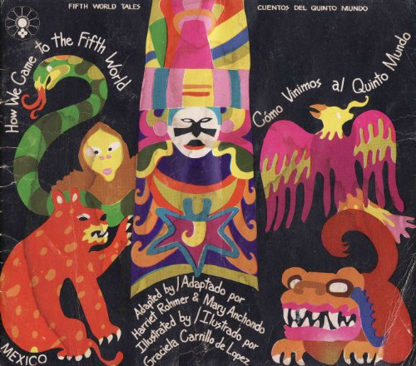
How We Came to the Fifth World
Harriet Rohmer, Mary Anchondo, Graciela Carrillo
An Aztec myth recounting the creation and destruction of the world by the deities of the four great elements. Along with its beautiful illustrations, this story is fully bilingual, with English and Spanish side by side throughout the book.

