Slide 1
Highlighting Other Stories in the AP US History Curriculum-A Multi-modal Text set
We the People Institute
John Robertson

Slide 2
Framework
This text set is designed to provide a range of text options highlighting groups that are often invisible in the traditional curriculum. The AP US History Curriculum is divided into nine sections and covers a time period of over 500 years. Having time to engage students with different perspectives on history is challenging.This text set attempts to provide an overlooked or ignored perspective or story for each time period in the curriculum.

Slide 3
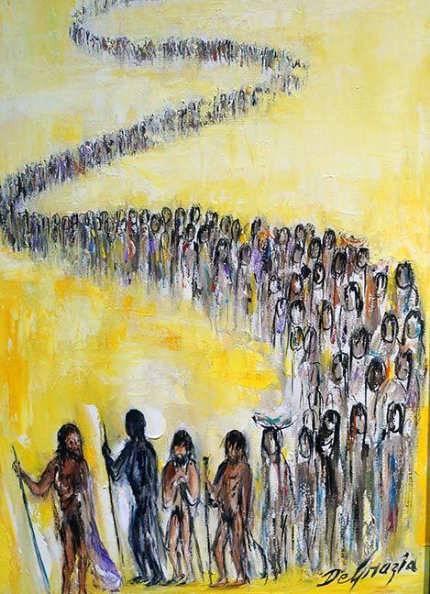
Period 1: 1491-1607
The image on the left is part of a series by Ted Degrazia in the 1970s. The subject is the Spanish explorer Cabeza de Vaca.
This website includes a podcast on the paintings. The part on Cabeza de Vaca starts at about the 7:00 minute mark. Do you find anything problematic about how this story is told?
This site is probably better for learning about free Africans in Spanish America.
Free Africans in Spanish America

Slide 4
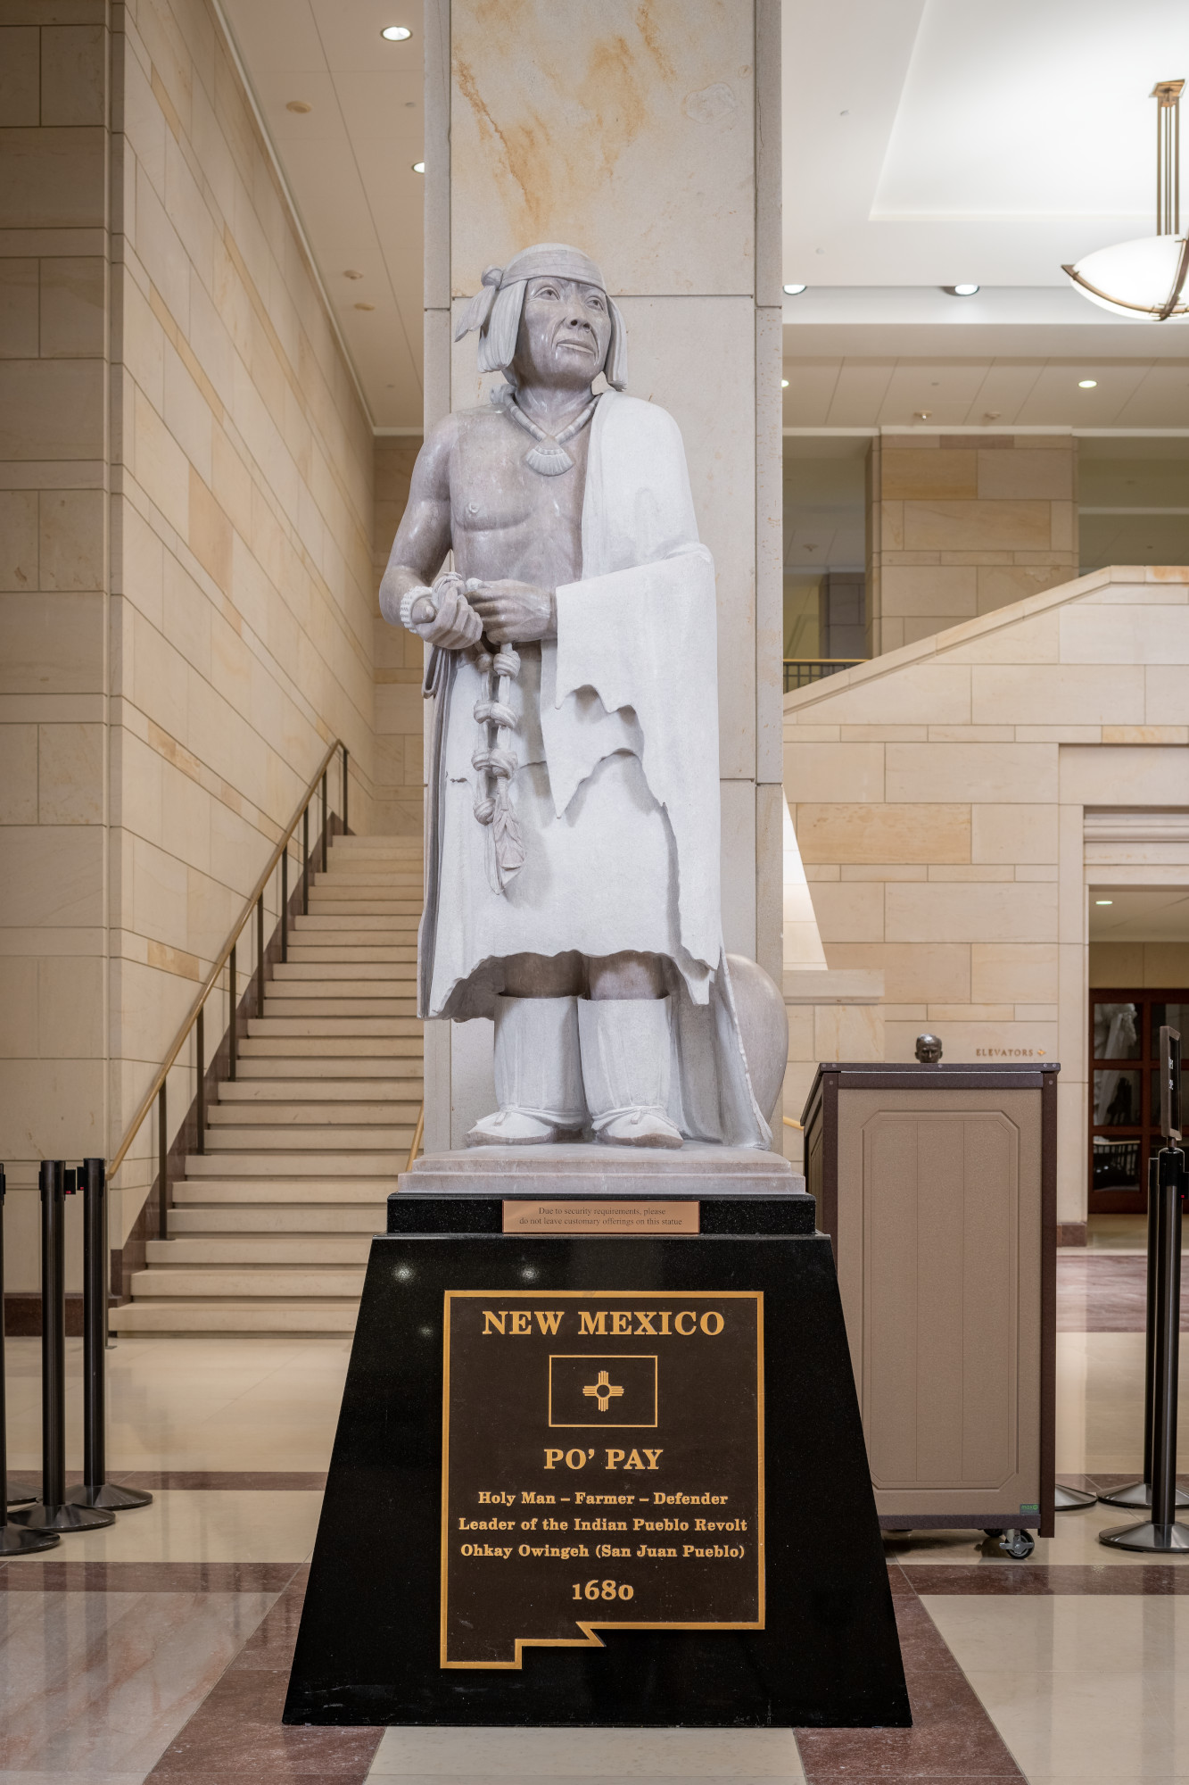

Period 2: 1607-1754
This 1640-1699 timeline of Virginia from the Library of Congress is representative many similar situation in the other British colonies at the time. Notice the role of religion, the impact of plantation slavery, and conflicts with the indigenous people. The book above is based on the 1619 Project.
The image above is of the Pueblo leader Po’Pay. It can be found in the Nation’s Capital. Each state can choose two statues to represent their heritage and New Mexico has chosen this image. Learn more about his tribal affiliation and his people’s victory over Spain in 1680 at this site.

Slide 5
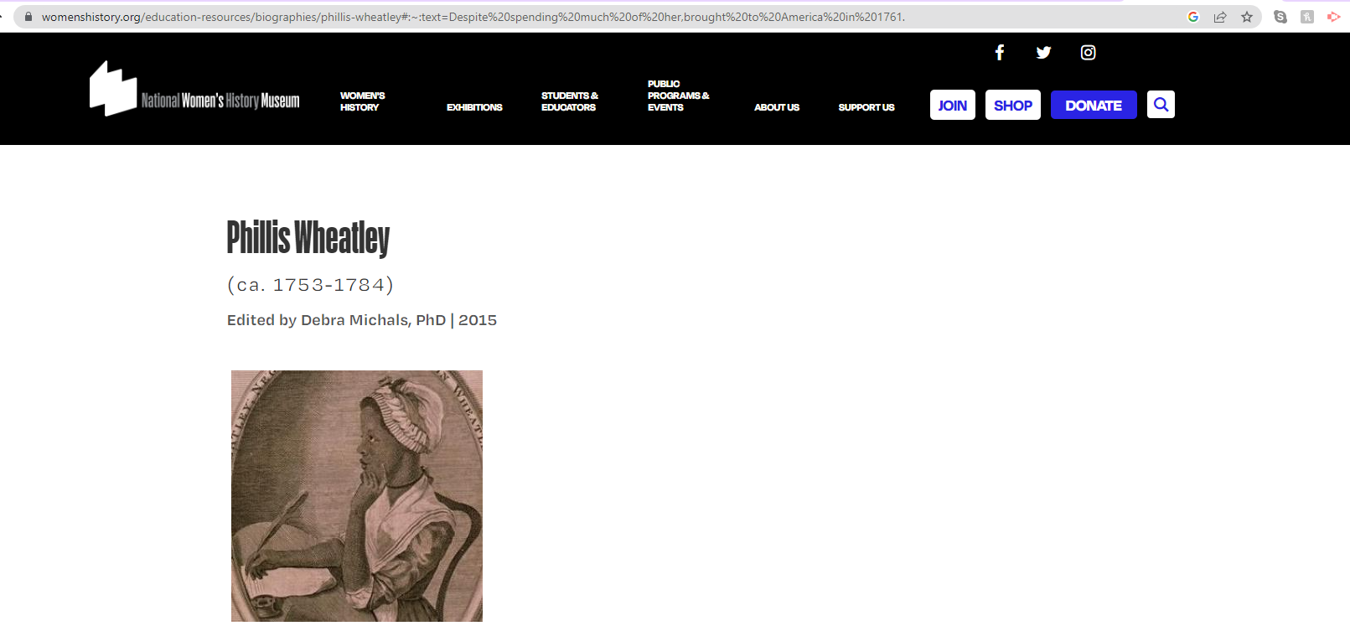
Period 3: 1754-1800
The American Revolution and the writing and ratification of the US Constitution falls under this time period and most teachers find that takes up the majority of their instructional time. As an enrichment, you can send students to this website and they could learn about Phillis Wheatley or they can explore other influential women in US History at the
National Women’s History Museum.

Slide 6

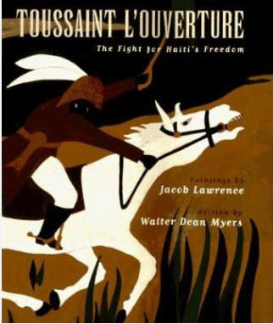
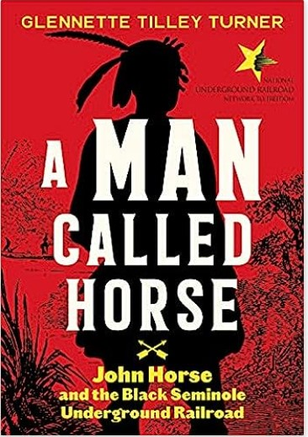
Period 4: 1800-1848
Haitian Revolution-
The impact of the Haitian Revolution can’t be overstated. On the left is “PBS Egalite for All: Toussaint Louverture and the Haitian Revolution.” On the right is a short children’s book on the life of Toussaint Louverture by award winning author Walter Dean Myers and award winning painter Jacob Lawrence.
The Seminole Wars and the Underground Railroad to Mexico.
The Seminole Tribe was a mixture of Creek and escaped slaves who resisted the US military and helped runaway slaves escape south as part of the Underground Railroad. It was not alway a northern route. John Horse’s story is an easy to read and engaging portrayal. You can also explore the National Park website for more information on the Seminole.

Slide 7
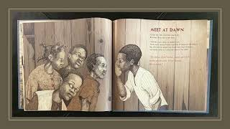
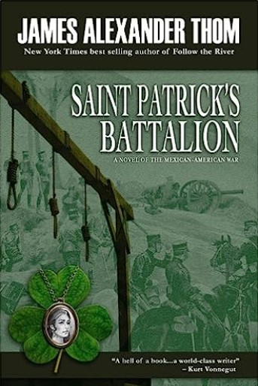
Period 5: 1844-1877
“Steamboat School” by Deborah Hopkinson tells the story of how one man used the Commerce Clause to open a school for enslaved children on the Mississippi River. The podcast below gives more details on the events in the children’s book.
The Floating Freedom School-Podcast
Resistance to the Mexican-American War
Henry David Thoreau-Dramatic reading of “On Civil Disobedience”
The San Patricios-The story of a battalion of Irish immigrants and Irish Americans who switched sides and fought for Mexico during the Mexican-American War. This is a novelization for young readers of the events.

Slide 8
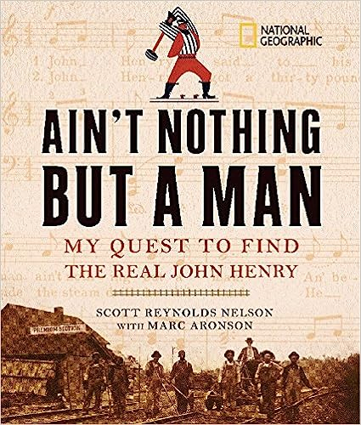
Period 6: 1865-1898
Railroads: Not just transportation. Consequences.
The Civil War allowed the United States to choose a route for the Transatlantic Railroad. It would take the northern route since the Southern states weren’t in Congress to vote. These are themes resources that are often overlooked when teaching about the expansion of the railroad.
Even though African Americans were no longer enslaved, the peonage system forced many into building the railroads in the South and Mid-Atlantic. This book by historian Scott Nelson tracks the author’s quest to find the real John Henry. He finds a John Henry and his conclusion shows how African Americans continued to be exploited after emancipation in ways that were often
indistinguishable
from slavery.

Slide 9
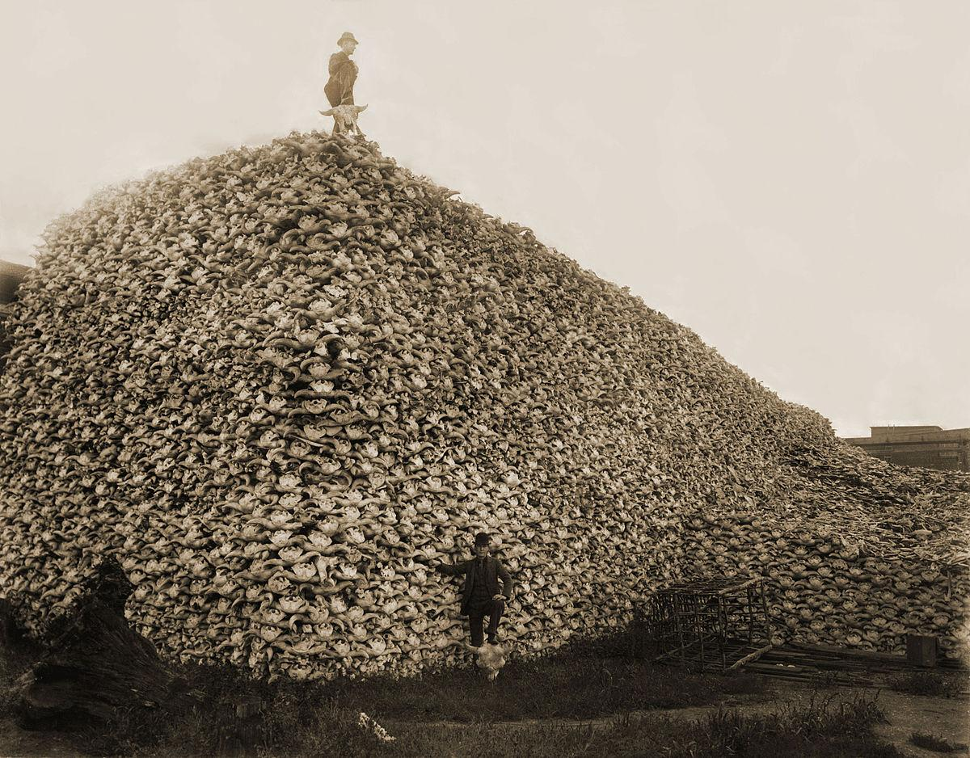
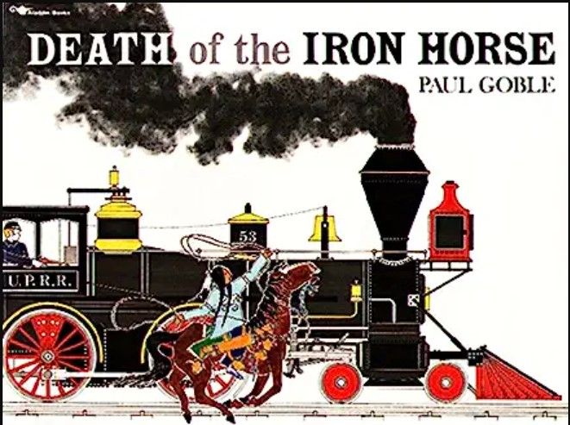
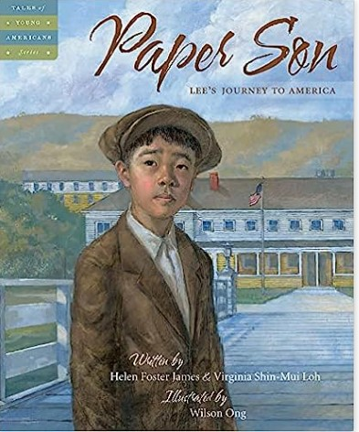
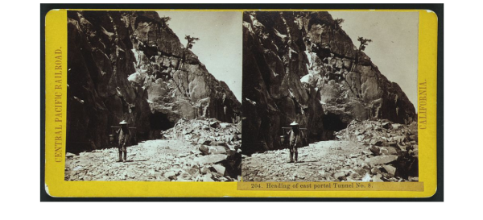
Period 6: 1865-1898 continued
Native Americans
The image to the left is a stack of buffalo skulls at a fertilizer factory. The book cover to the right describes the only time Native Americans successfully derailed a locomotive. The connection between the two is essential for understanding the time period.
Chinese
The impact of the railroad and the Chinese Exclusion Act is well documented. The sources here show the impact of the Act. On the left is the book “Paper Son” and on the right is a selection from The Stanford History Education Group showing a Chinese railroad worker. You can also learn about the Chinese experience at Angel Island using this link.

Slide 10
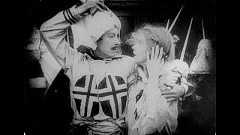
Period 7: 1890-1945
Challenges for Mexican Americans:
In 1915, The film, “Birth of a Nation,” was released. It was immensely popular. Until 1946, an estimated 200 million Americans watched this film. Very few people questioned it’s main premise and the dangerous rascist tropes that became ingrained in the dominant culture for so long. The topic of the film was the birth of the KKK and how it saved the South. Not surprisingly, lynchings and racial violence rose over the following decade for Mexican Americans as well as African Americans. It’s difficult to watch, but its impact can’t be overstated.

Slide 11
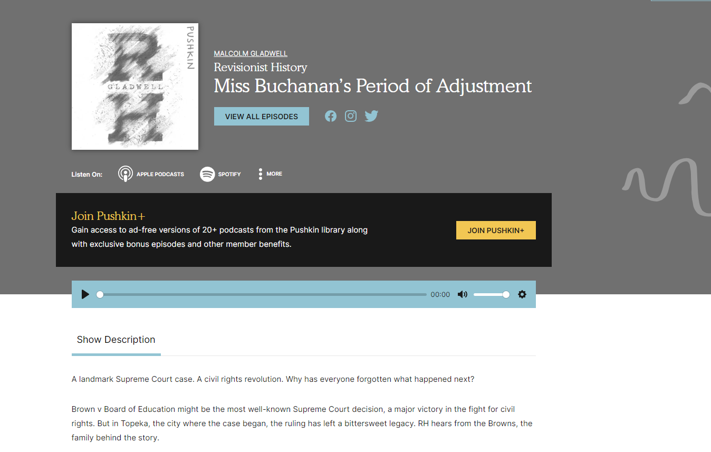

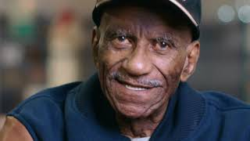
Period 8: 1945-1980
Overlooked moments from the Civil Rights era-
This California Supreme Court case laid the blueprint for Brown vs The Board of Education.
2. This episode of Revisionist History discusses the seldom discussed negative outcomes from the Brown decision-
https://www.pushkin.fm/podcasts/revisionist-history/miss-buchanans-period-of-adjustment
3. Jackie Robinson is rightfully given credit for desegregating baseball, but what happened to those left behind in the Negro Leagues. A brief documentary.

Slide 12

Period 8: 1945-1980
The Cold War is usually well covered
in most history curriculums, but the story of
those who fled Vietnam after the fall of Saigon
is unknown to most of our students today. Several
children’s books give poignant accounts of
this period.

Slide 13
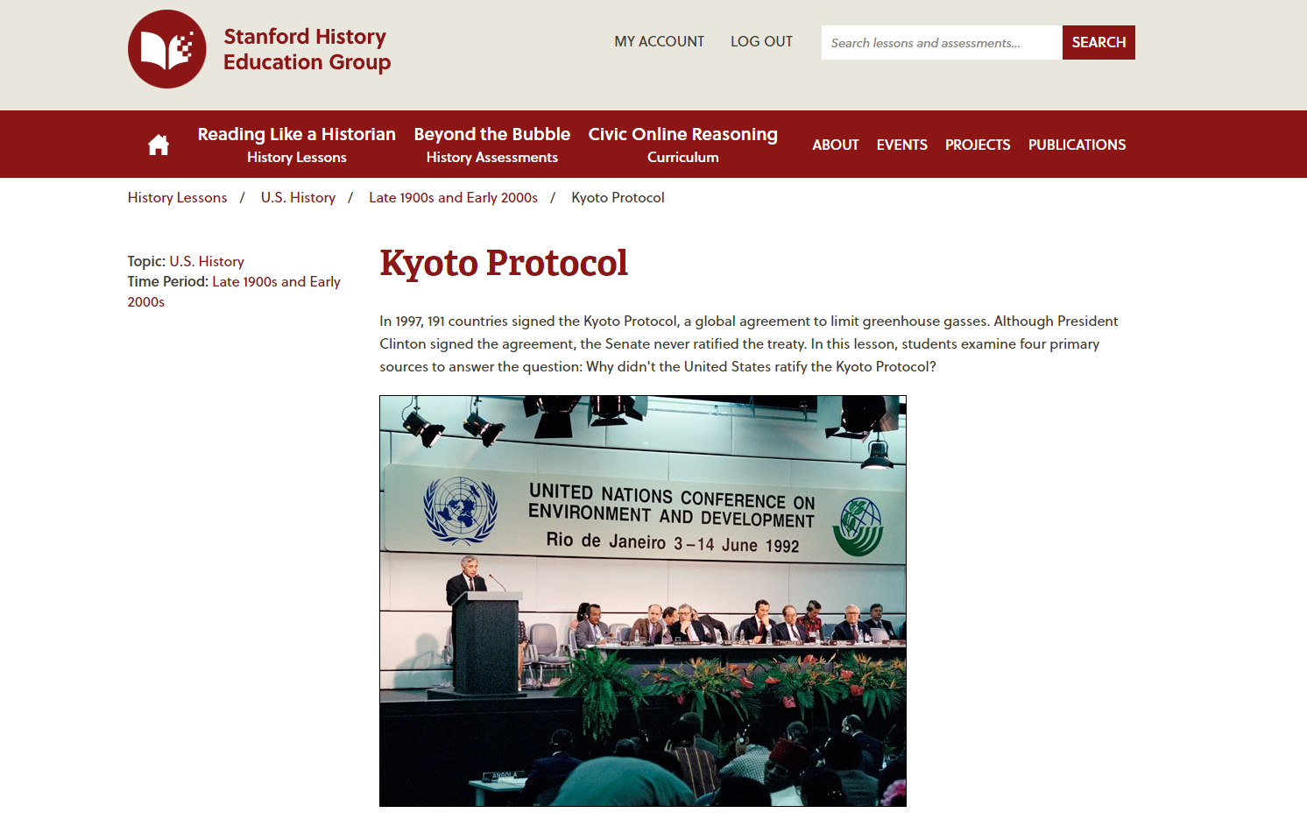
Period 9: 1980-present
For this last period, you will need to create a free account with the Stanford History Education Group to view the whole lesson. This lesson is based on the Kyoto protocols which were supposed to limit greenhouse gasses. SHEG has over 100 lessons with primary sources that teachers can use to develop the skills necessary to think like a historian. It is worth your time.

