Slide 1
Love and the Diaspora:
Narratives of Ecuadorian Migration
to New York
Cynthia Vele Sigcha

Slide 2
Text Set Overview
This text set focuses on the untold stories of Ecuadorian migrants to New York spread over the past 60 years. They share a story of resilience and resistance to the struggle of acculturation in a new land. Told through first person narratives, documentaries, children books and novels, photographs and songs, these stories are meant to shed light on the lived experiences of these migrants and uplift all those who connect to these stories.

Slide 3
Guiding Questions
What are the different experiences of Ecuadorian people that have migrated to Queens, NY?
How has love in the form of community care been central to the stories of migration within the Ecuadorian community to NY?
To what extent is migration creating new meanings and functions around the concepts of "family" and "home"? How do we reconcile this?
What counter stories/narratives do we share about our communities in an effort to preserve our families history and collective memory, that goes beyond that of colonization and its disastrous effects?
How do we honor our fluid and ever changing identities within the process of migration?

Slide 4
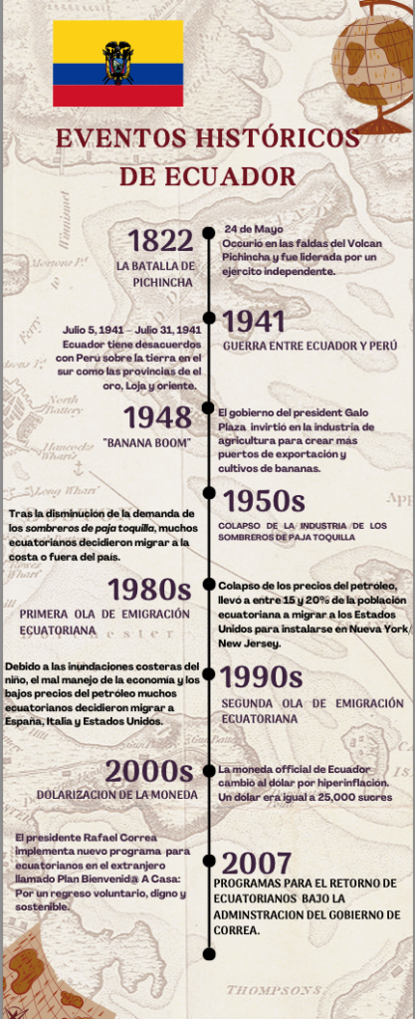
Reasons for Migration

Slide 5
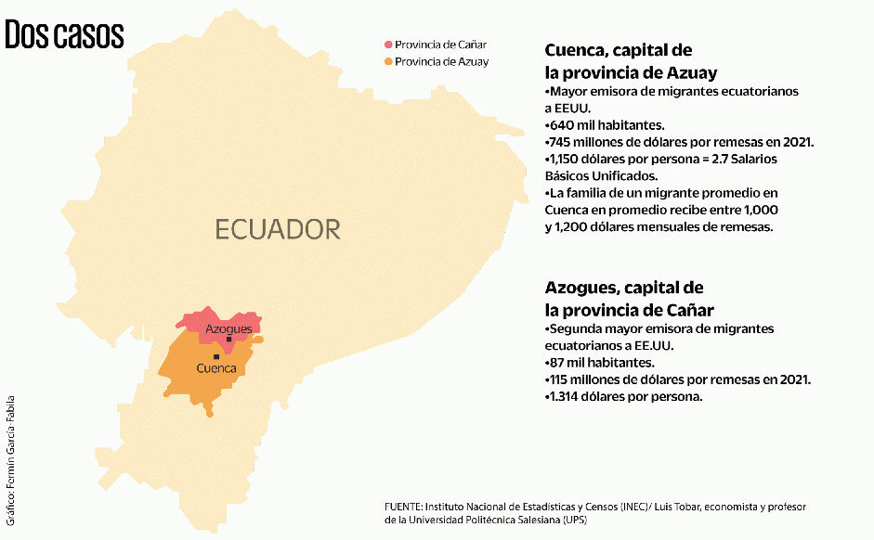
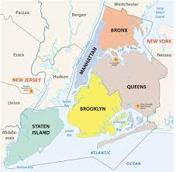
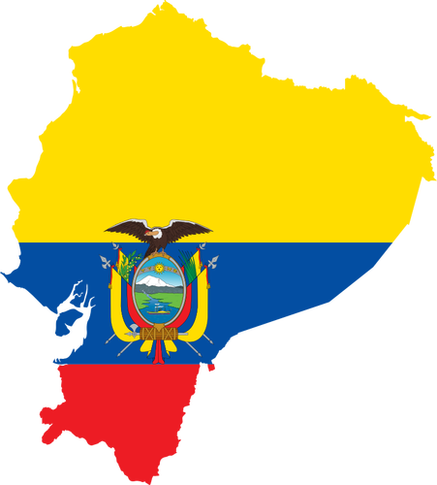
Reasons for Migration
EEUU - NYC

Slide 6
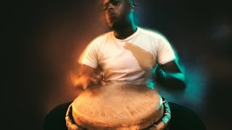
Documentaries
This documentary tells the story of the Afro-Ecuadorian band, Chota Madre, and its founder, Jose Juan Paredes, from the Chota Valley in Ecuador. Paredes passionately shares his musical upbringing and the profound happiness he finds in spreading the Bomba music of his community to a global audience, a responsibility he shoulders as one of the few Afro-Ecuadorians doing so. He firmly advocates for musicians to freely express their cultural identities at all times, fostering a diverse musical landscape that reflects the true essence of their heritage.
The documentary "History of the Pioneers" captures the first waves of the Ecuadorian immigrant experience in New York City from the 1960s to 1980s. It features stories of early immigrants, their childhood memories, family relations, struggles, and journeys to the U.S, which left a significant mark on the city's history. Part one of the documentary features seven individuals whose narratives shed light on the historical immigration process.

Slide 7
Personal Narratives & Interviews
Ninotska Love, an LGBTQ and Immigrants Rights and transgender activist, migrated from Guayaquil 12 years ago and became the first transgender woman to be accepted into a historically cis women's college. She is driven by her love for her community and actively collaborates with them to assist transgender folk in Ecuador with their migration processes.
Edison Javier Morocho, a migrant entrepreneur from Cañar and event organizer, has turned his passion for music and DJing into a business and motivates others to do the same. He advises other Ecuadorian migrants to always advocate for themselves by seeking support and never forgetting where one comes from.

Slide 8
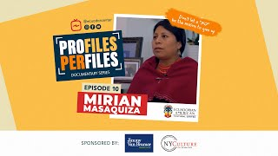
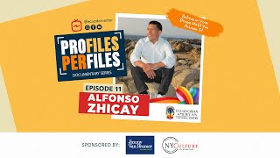
Personal Narratives & Interviews
Mirian Masaquiza Jerez is a Salasaca indigenous woman, diplomat and United Nations officer. She focuses on advancing the rights of indigenous peoples and believes that someone remains Kichwa, even if they are born in a different country, just like her daughter .
Alfonso Zhicay is an Ecuadorian chef who founded the restaurant “Casa del Chef” in Queens, New York. He seeks to leave his mark and expand multiculturally through his fusion dishes.

Slide 9
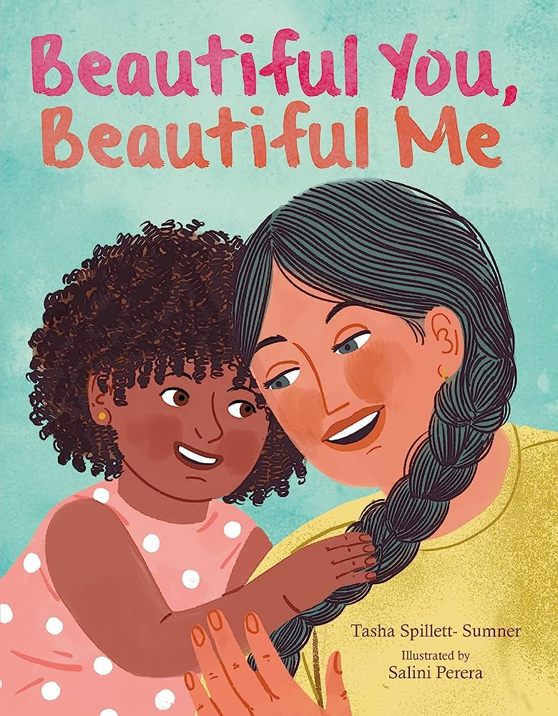
Children’s Books and Novels
Spanish is the Language of My Family by Michael Genhart
In this intergenerational story, a young boy prepares for a school Spanish spelling bee and in the process bonds with his abuela over their love for the language. As she helps him, she shares stories of the restrictions they faced on speaking Spanish in the past, motivating him to study harder and embrace his heritage. The book highlights the joy of preserving and passing down cultural heritage across generations.
Beautiful You, Beautiful Me by Tasha Spillett-Sumner
Izzy adores her mother and enjoys being embraced by her. One night when cuddled up on her lap, she notices their physical differences such as their skin color. Finding lessons from nature and repeating her affirming message, Mama encourages Izzy to see her own unique beauty. Izzy learns that it is important to celebrate the differences that make her uniquely beautiful, and the connection to her mother that transcends physical traits.

Slide 10
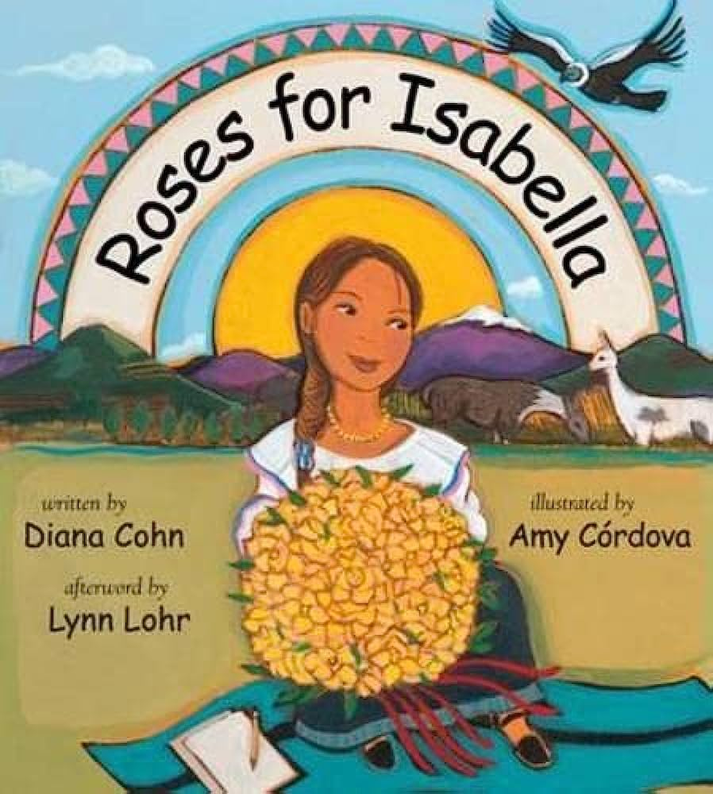
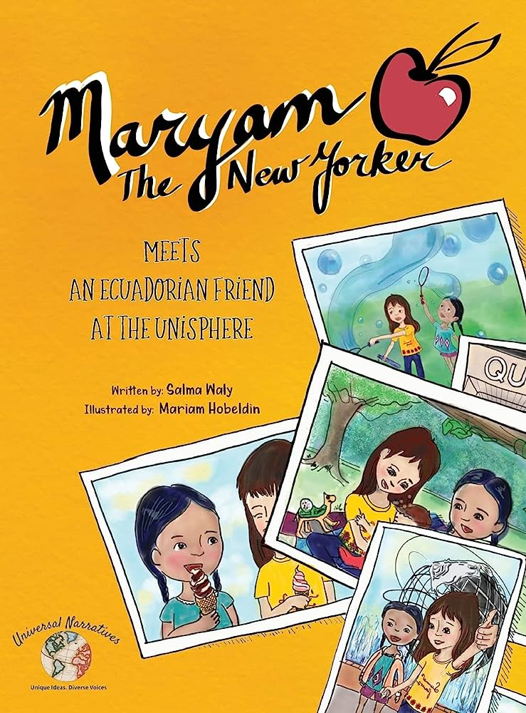
Children’s Books and Novels
Roses for Isabella by Diana Cohn
Isabella, a young girl living in Ecuador, loves writing and keeps a journal. In this book, she describes her family's experiences working on different rose farms, leading to a positive change in their lives when they find employment at a Fair Trade farm that treats workers well and is environmentally friendly.
Maryam the New Yorker Meets an Ecuadorian Friend at the Unisphere by Salma Waly
In this book, Maryam goes to Flushing Meadows Corona Park and her typical family outing in the park is soon transformed into a playdate with Maria, an Ecuadorian girl she meets who recently migrated to the United States. When the two girls and their families start sharing food and stories, Maryam realizes the beauty of friendship that transcends cultural barriers.

Slide 11
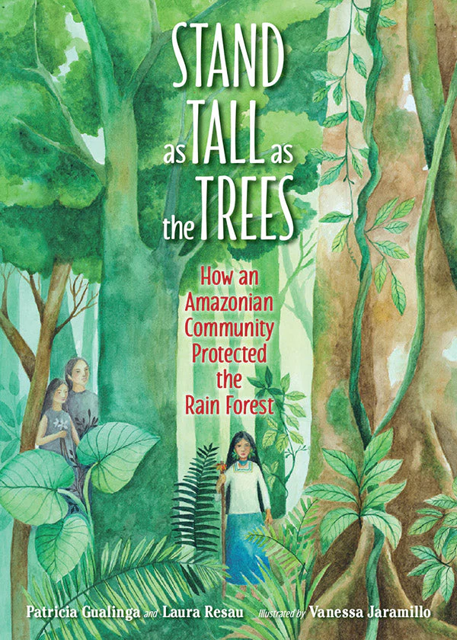
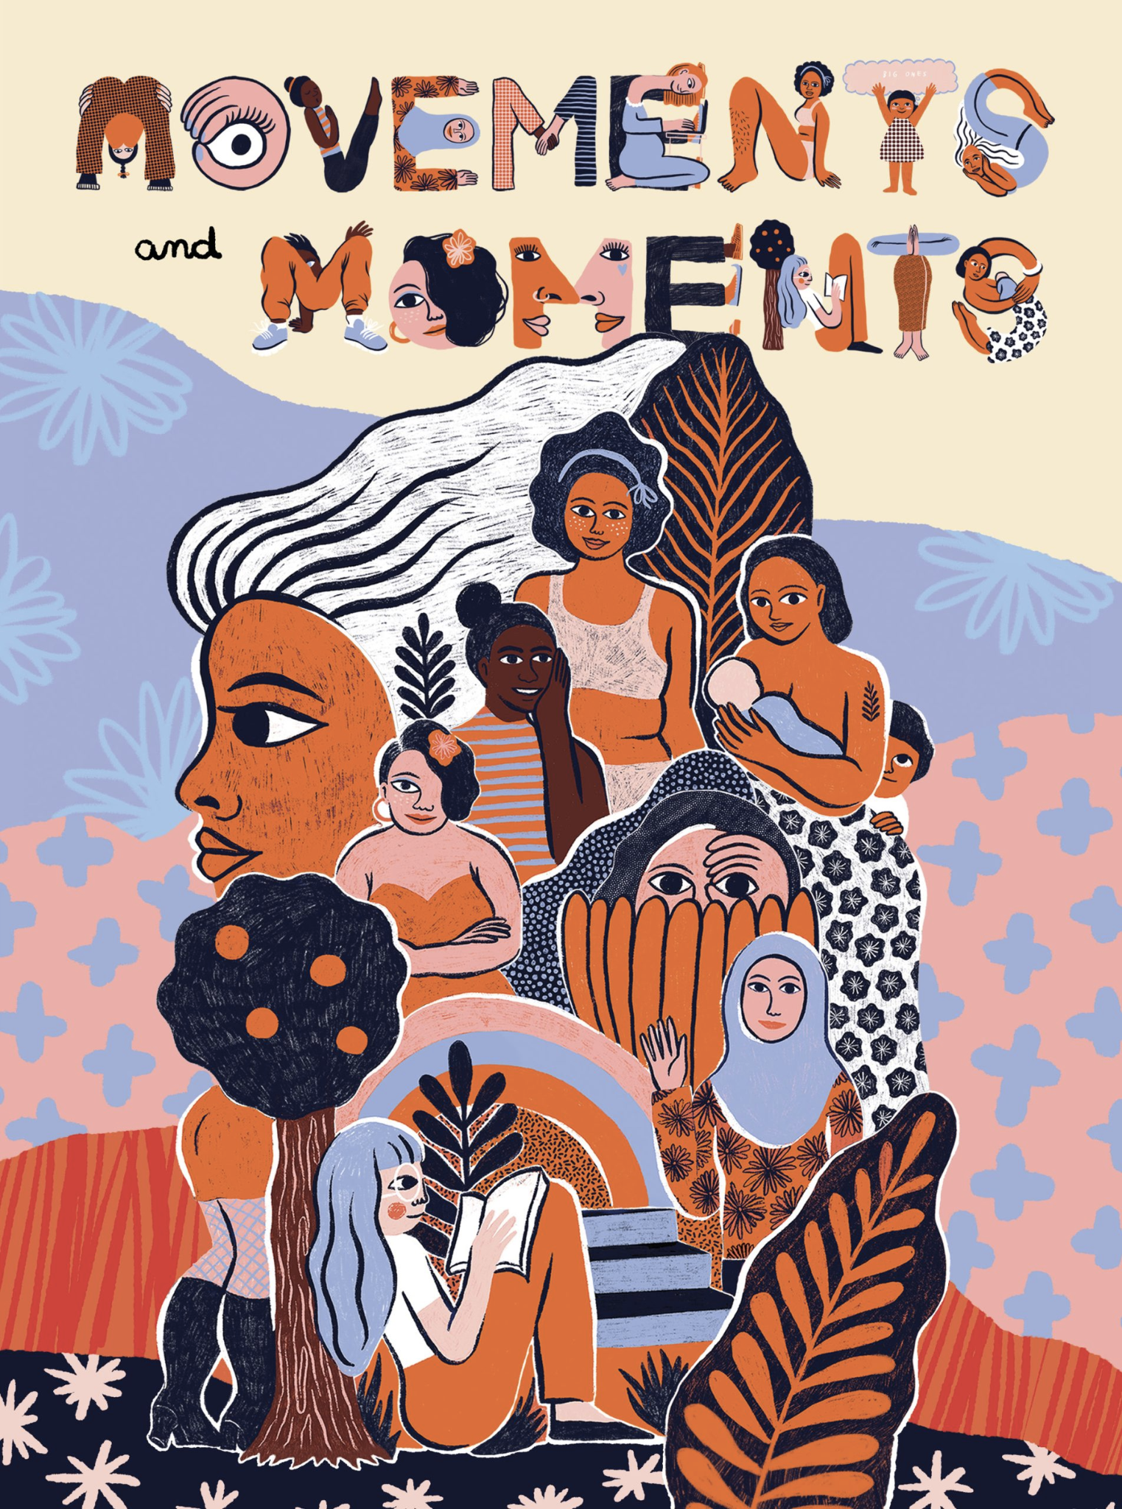
Children’s Books and Novels
Stand as Tall as the Trees by Patricia Gualinga
Patricia Gualinga, an Indigenous rights defender of the Pueblo Kichwa de Sarayaku, describes how she grew up in her village in the Amazon where mystical beings called Amazanga help protect the forest. After hearing that the Ecuadorian government sold part of the Amazon to an oil company that then proceeded to destroy her people’s lands, she returned home to fight alongside the Kichwa community and other Indigenous groups.
Movements and Moments by Sonja Eismann, Maya, and Ingo Schöningh
Mama Dulu Chapter
Mama Dolores Cacuango, an Indigenous leader from the Ecuadorian Andes, dedicated her life to advocating for equality and Indigenous rights, alongside other influential women like Tránsito Amaguaña. Their efforts resulted in progress for the Indigenous agenda, breaking barriers to education and land ownership. The text narrates Mama Dulu's journey of struggle, through the words of a young girl named Tamia and other women who carry on her legacy, to secure rights for Ecuadorian Indigenous communities.

Slide 12
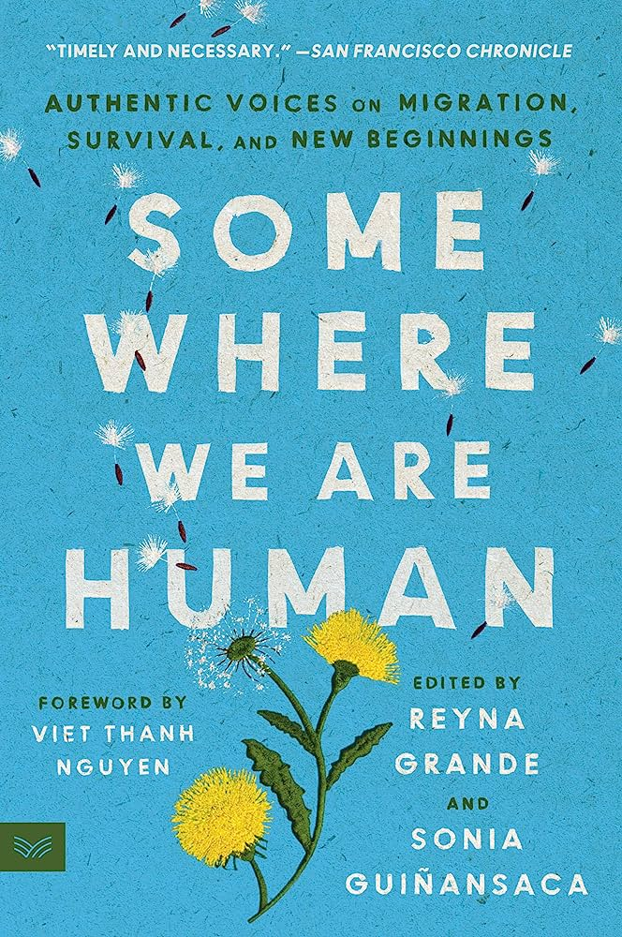
Children’s Books and Novels
Somewhere we are human: Authentic Voices on Migration, Survival, and New Beginnings by Reyna Grande and Sonia Guiñansaca
This anthology of essays, poetry, and art created by undocumented or formerly undocumented migrants aims to shift the immigration debate towards one rooted in humanity and justice. The contributors share nuanced stories of their lives before and after migration, their reasons for leaving their homeland, and the challenges they faced in a new country, emphasizing the desire for a future without borders. The book touches on various themes like race, class, gender, nationality, and politics, showcasing the resilience, hope, and perseverance that can flourish in difficult circumstances.
Nostalgia and Borders by Sonia Guiñansaca
In this chapter book, Sonia writes in poetry of her lived experiences as an undocumented youth in the United States. This collection of poetry weaves stories of being migrant, searching for home and finding herself.
.

Slide 13
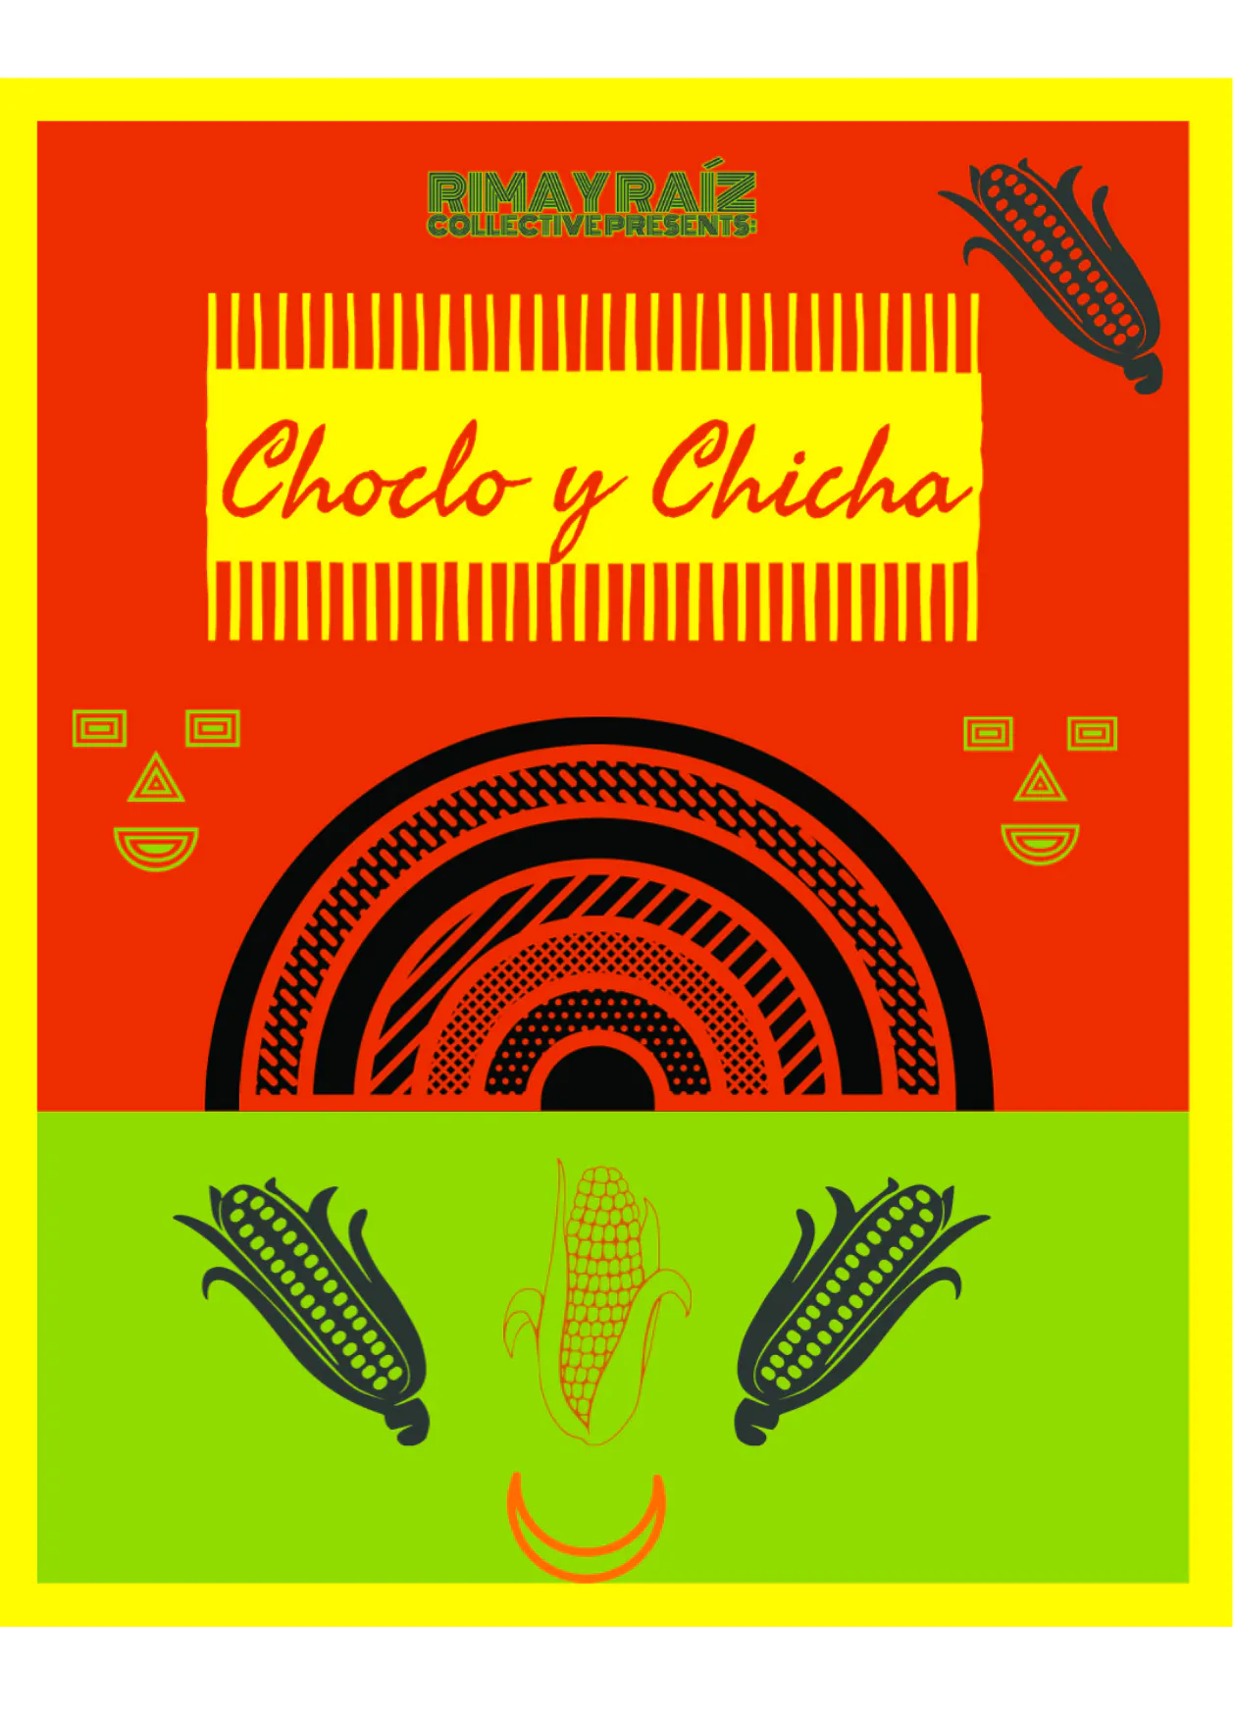
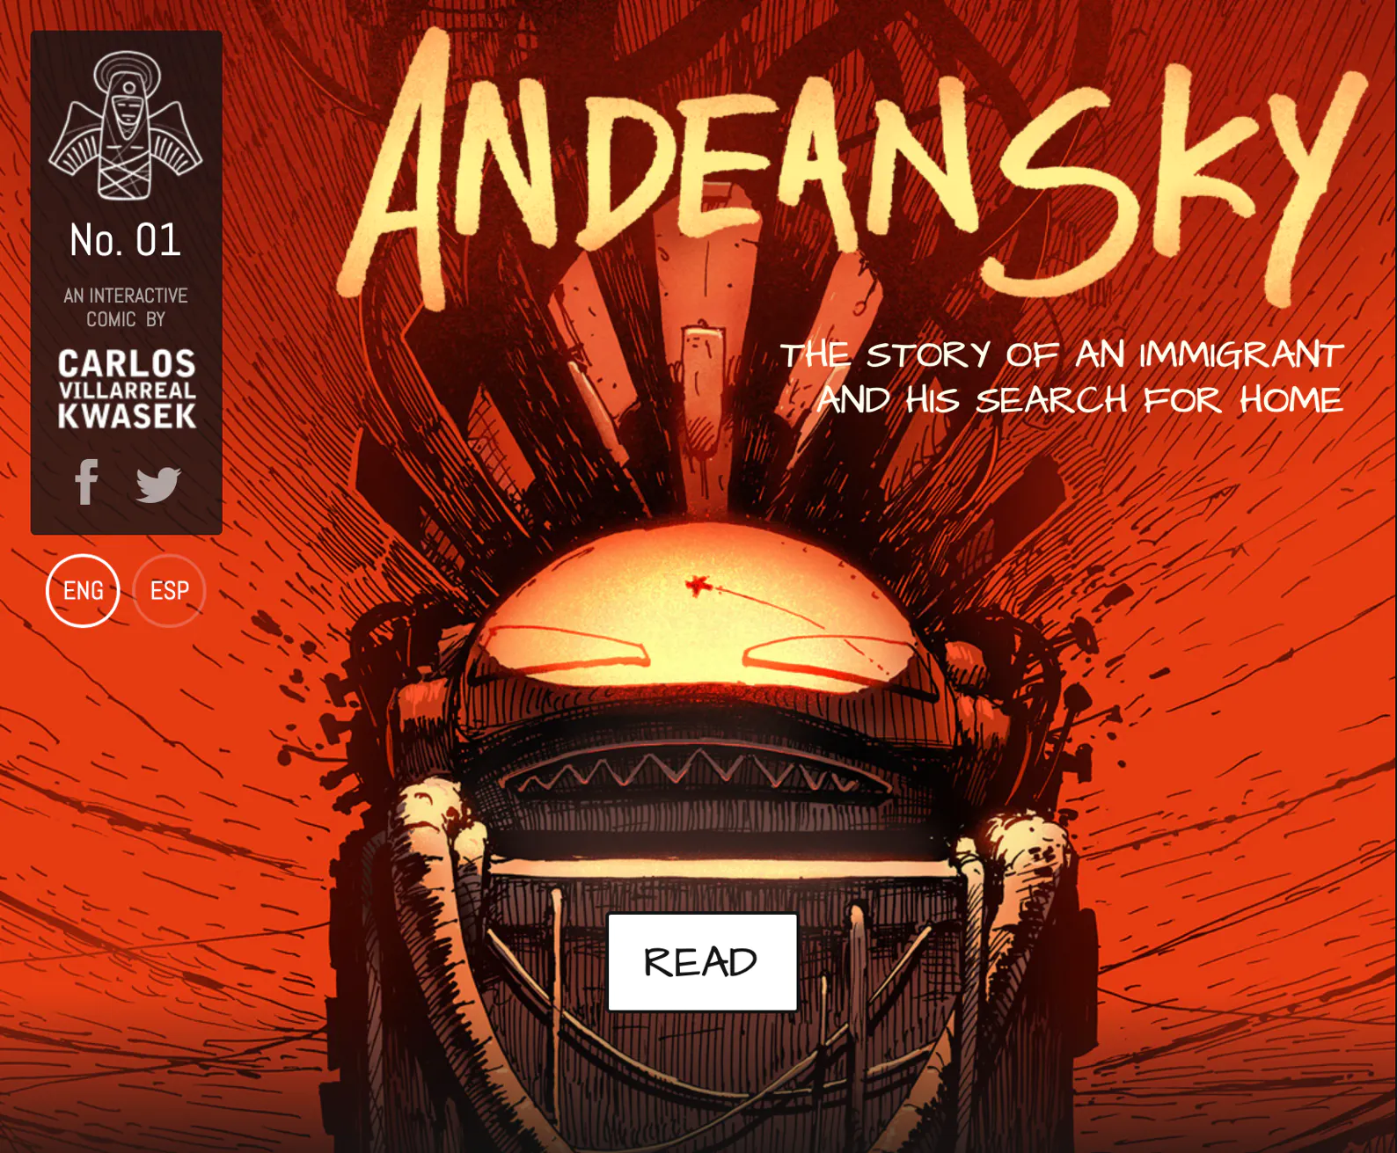
Zines
Choclo y Chicha by Rima y Raíz Collective
This zine shares the contributions of the Andean/Andinx diaspora through poetry, art, and storytelling. Such themes include reflections on identity and belonging, migration journeys, honoring our ancestors, reclaiming of indigenous language and nostalgia. The purpose of the texts within this zine is to document and share intergenerational oral histories in order to create solidarity and maintain our sense of identity and connection to one another.
Andean Sky by Carlos Villarreal Kwasek
Interactive webcomic link
."Andean Sky" is an interactive webcomic that follows the journey of an immigrant who decides to return to his home country, Ecuador, with the purpose of reconnecting with his own culture. The author envisions a positive future for humanity, where Ecuador undergoes transformative changes, representing a dynamic and thriving culture. As the protagonist forms a bond with his mother and strives to aid her in repairing her spaceship for the race, he acknowledges that cultural change and blending are inevitable. The webcomic presents a narrative in which the protagonist explores the landscapes, traditions, and customs of Ecuador, allowing readers to engage with the story through interactive elements.

Slide 14
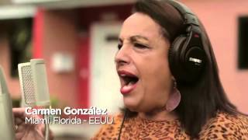
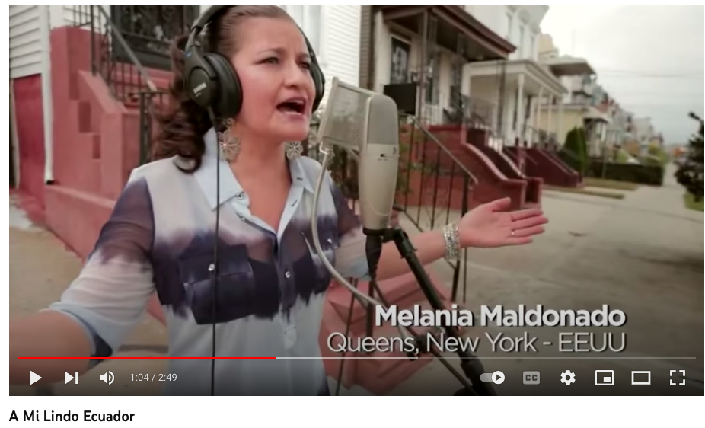
Songs
A Mi Lindo Ecuador
In this video, the message conveyed is that music has the power to bridge distances and bring people together regardless of their geographical locations. The video showcases a musical collaboration that involves Ecuadorian musicians emphasizing the shared cultural heritage and sense of pride among Ecuadorians. The video is an invitation for viewers who identify as Ecuadorian to spread this positive message, foster a sense of community and celebrate their heritage through the universal language of music.

Slide 15
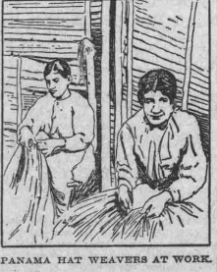
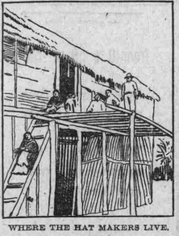
Primary Sources
Waterbury Evening Democrat
This newspaper article provides a brief look at the Panama hat as a fashion trend spreading throughout Western countries and credits Ecuadorian Indigenous weavers as the originators of this product. The process of making the hat involves many specific parts and special attention to the climate, materials, and region in which it was made.

Slide 16
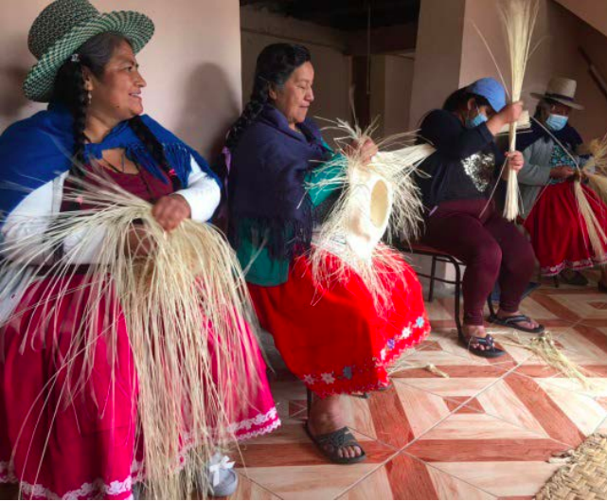
Articles and News
Tras las huellas de las familias migrantes del cantón Cañar
Alexandra Escobar García
This article shows us that family and kinship in the Cañar canton transforms and adapts and by doing so, challenges traditional conceptions as well as social challenges that many Ecuadorians must navigate. Although there seem to be cultural nuances and historical inequalities that distinguish the indigenous and non-indigenous population, at first glance this exploration did not find marked differences in the way in which the households of both groups rearrange the upbringing of migrant children and ensure the reproduction of their families.
The route from Ecuador to the United States
The article highlights two migration waves from Ecuador to the United States, one starting in the 1960s due to the decline in Panama Hat sales, and the second one in the mid-1990s driven by political instability and economic hardships. Several Ecuadorian folks describe their experiences having mourned disappearances of family members and the impact of remittances sent to Ecuador.

