Slide 1
Tucson: More Than A Century of Refuge
by Sasha Velgos

Slide 2

One of the first groups of people to search for safety in Tucson were the Yaqui. The Yaqui faced persecution and genocidal attacks in Mexico under Porfirio Diaz. The persecution continued during and after the Mexican Revolution leading many Yaqui to flee.

Slide 3
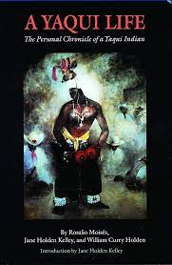
A book that records the life of a Yaqui man who lived during the period of genocidal actions by the Mexican government and the resettlement of Yaqui people in Tucson, Arizona.
A book that records the life of a Yaqui man who lived during the period of genocidal actions by the Mexican government and the resettlement of Yaqui peple in Tucson, Arizona.

Slide 4
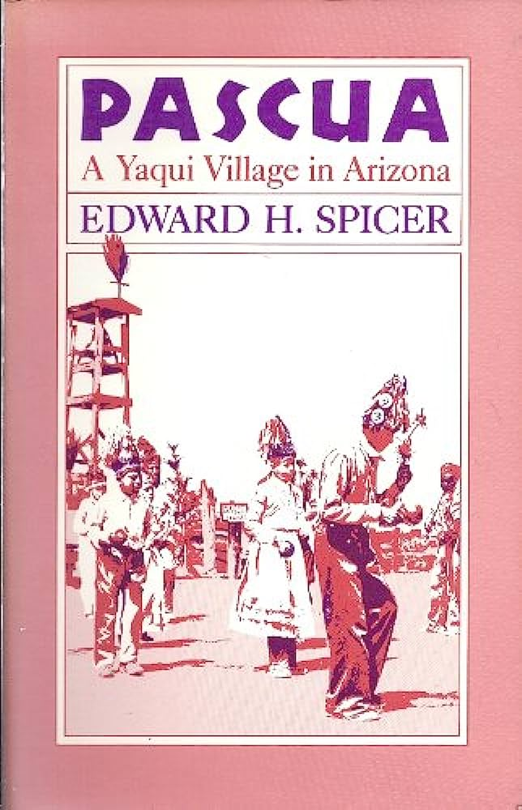
A book exploring Pascua, the Yaqui settlement in Tucson, Arizona.

Slide 5
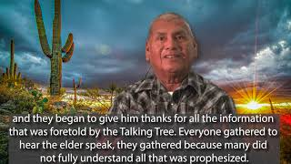
A video created by the Pascua Yaqui Tribe commemorating the anniversary of their tribe receiving federal recognition. The reservation is located in Tucson.

Slide 6
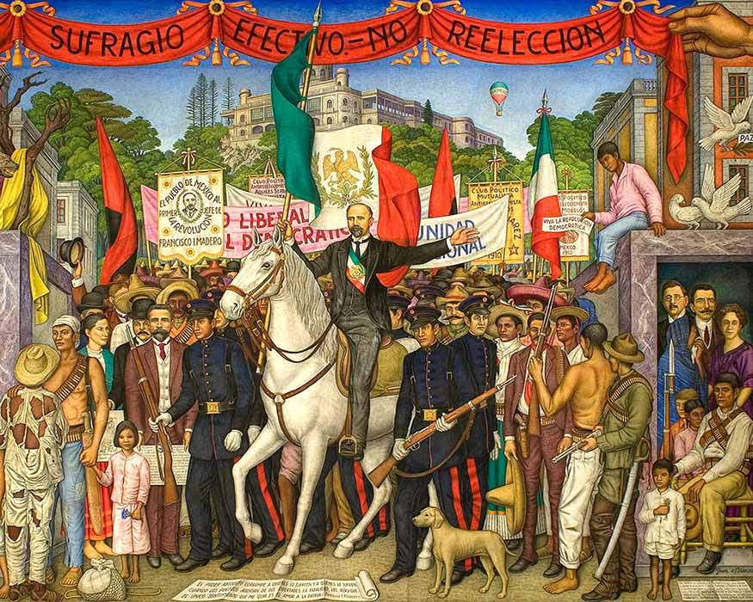
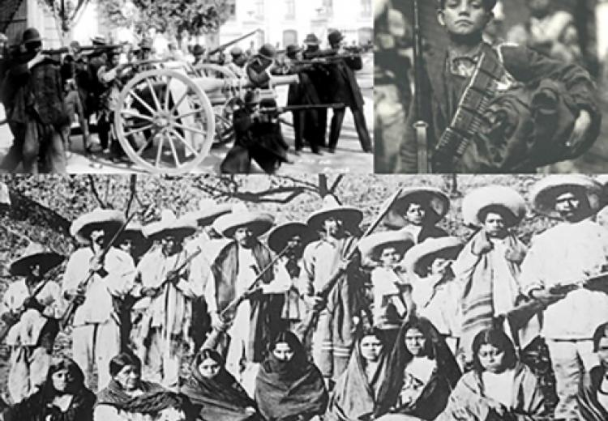
During the Mexican Revolution people fled violence. The borderlands of Arizona were where many people found safety.

Slide 7
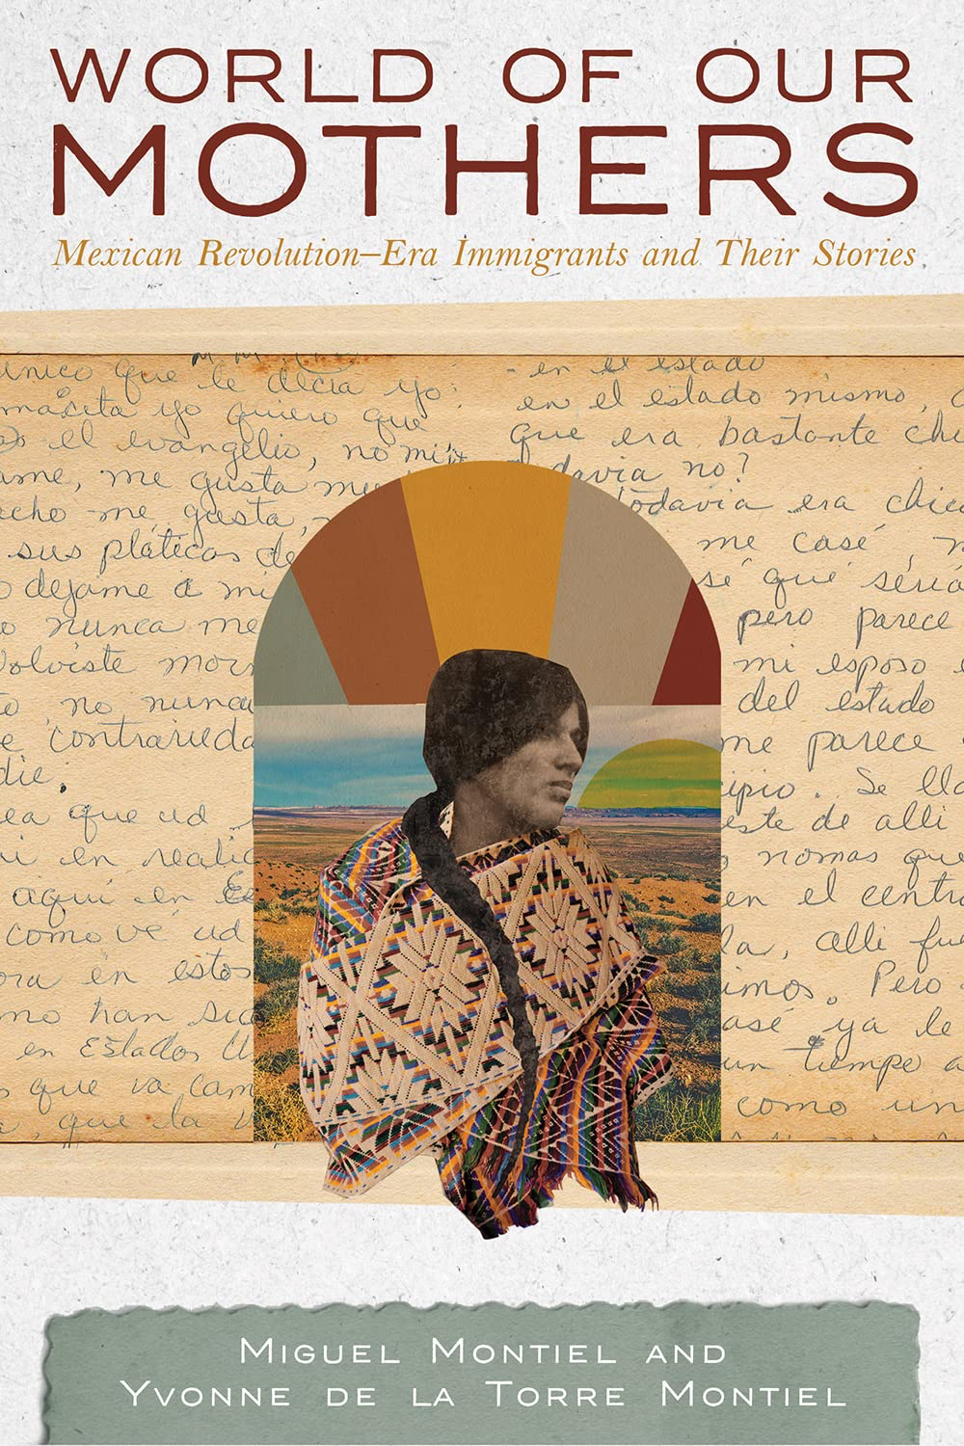
A book that tells the stories of Mexican women who fled the violence of the Mexican Revolution and came to live in the United States.
A book that tells the stories of Mexican women who fled the violence of the Mexican Revolution and came to live in the United States.

Slide 8
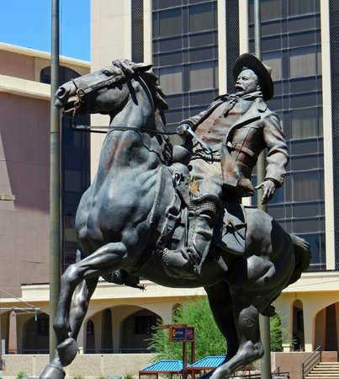
The statue of Pancho Villa located in Tucson, Arizona. The statue was a gift from the Mexican government to Tucson as recognition of the Mexican population that came to Tucson during the Revolution.

Slide 9
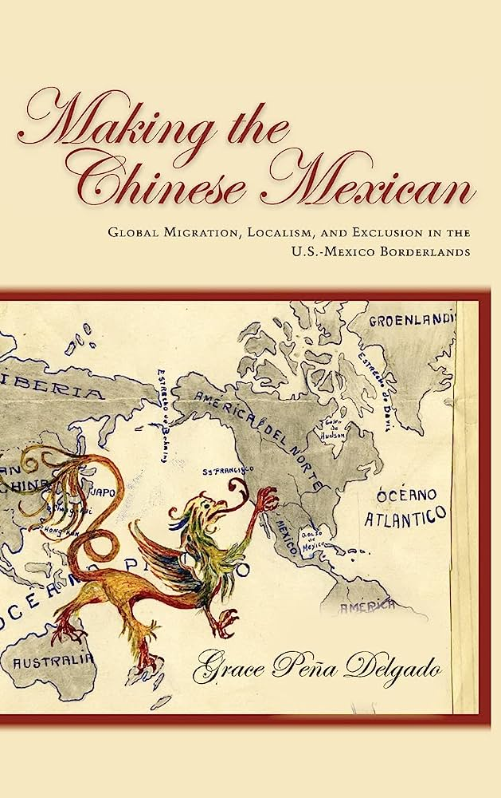
A book tracing the migration of ethnically Chinese people to the borderlands area and exploring how people created communities.

Slide 10
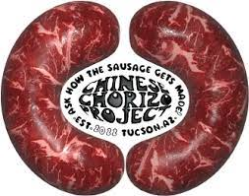
https://www.chinesechorizoproject.com/
A website focused on telling the story of ethnically Chinese people in Tucson, Arizona. The website includes a timeline of ethnically Chinese in Tucson focusing on cultural food. It also provides information about the “Tucson Chinese Chorizo Festival” and a proposed statue of a chorizo to be called “The Most Sacred Heart of the Barrio”.

Slide 11
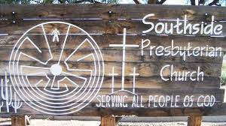
https://tucson.com/entertainment/photos-the-sanctuary-movement-in-1984/collection_bc2acbd2-b06c-11e8-8ce2-374c880cd0b9.html#1.
A collection of photographs from the early Sanctuary Movement founded in Tucson, Arizona.

Slide 12
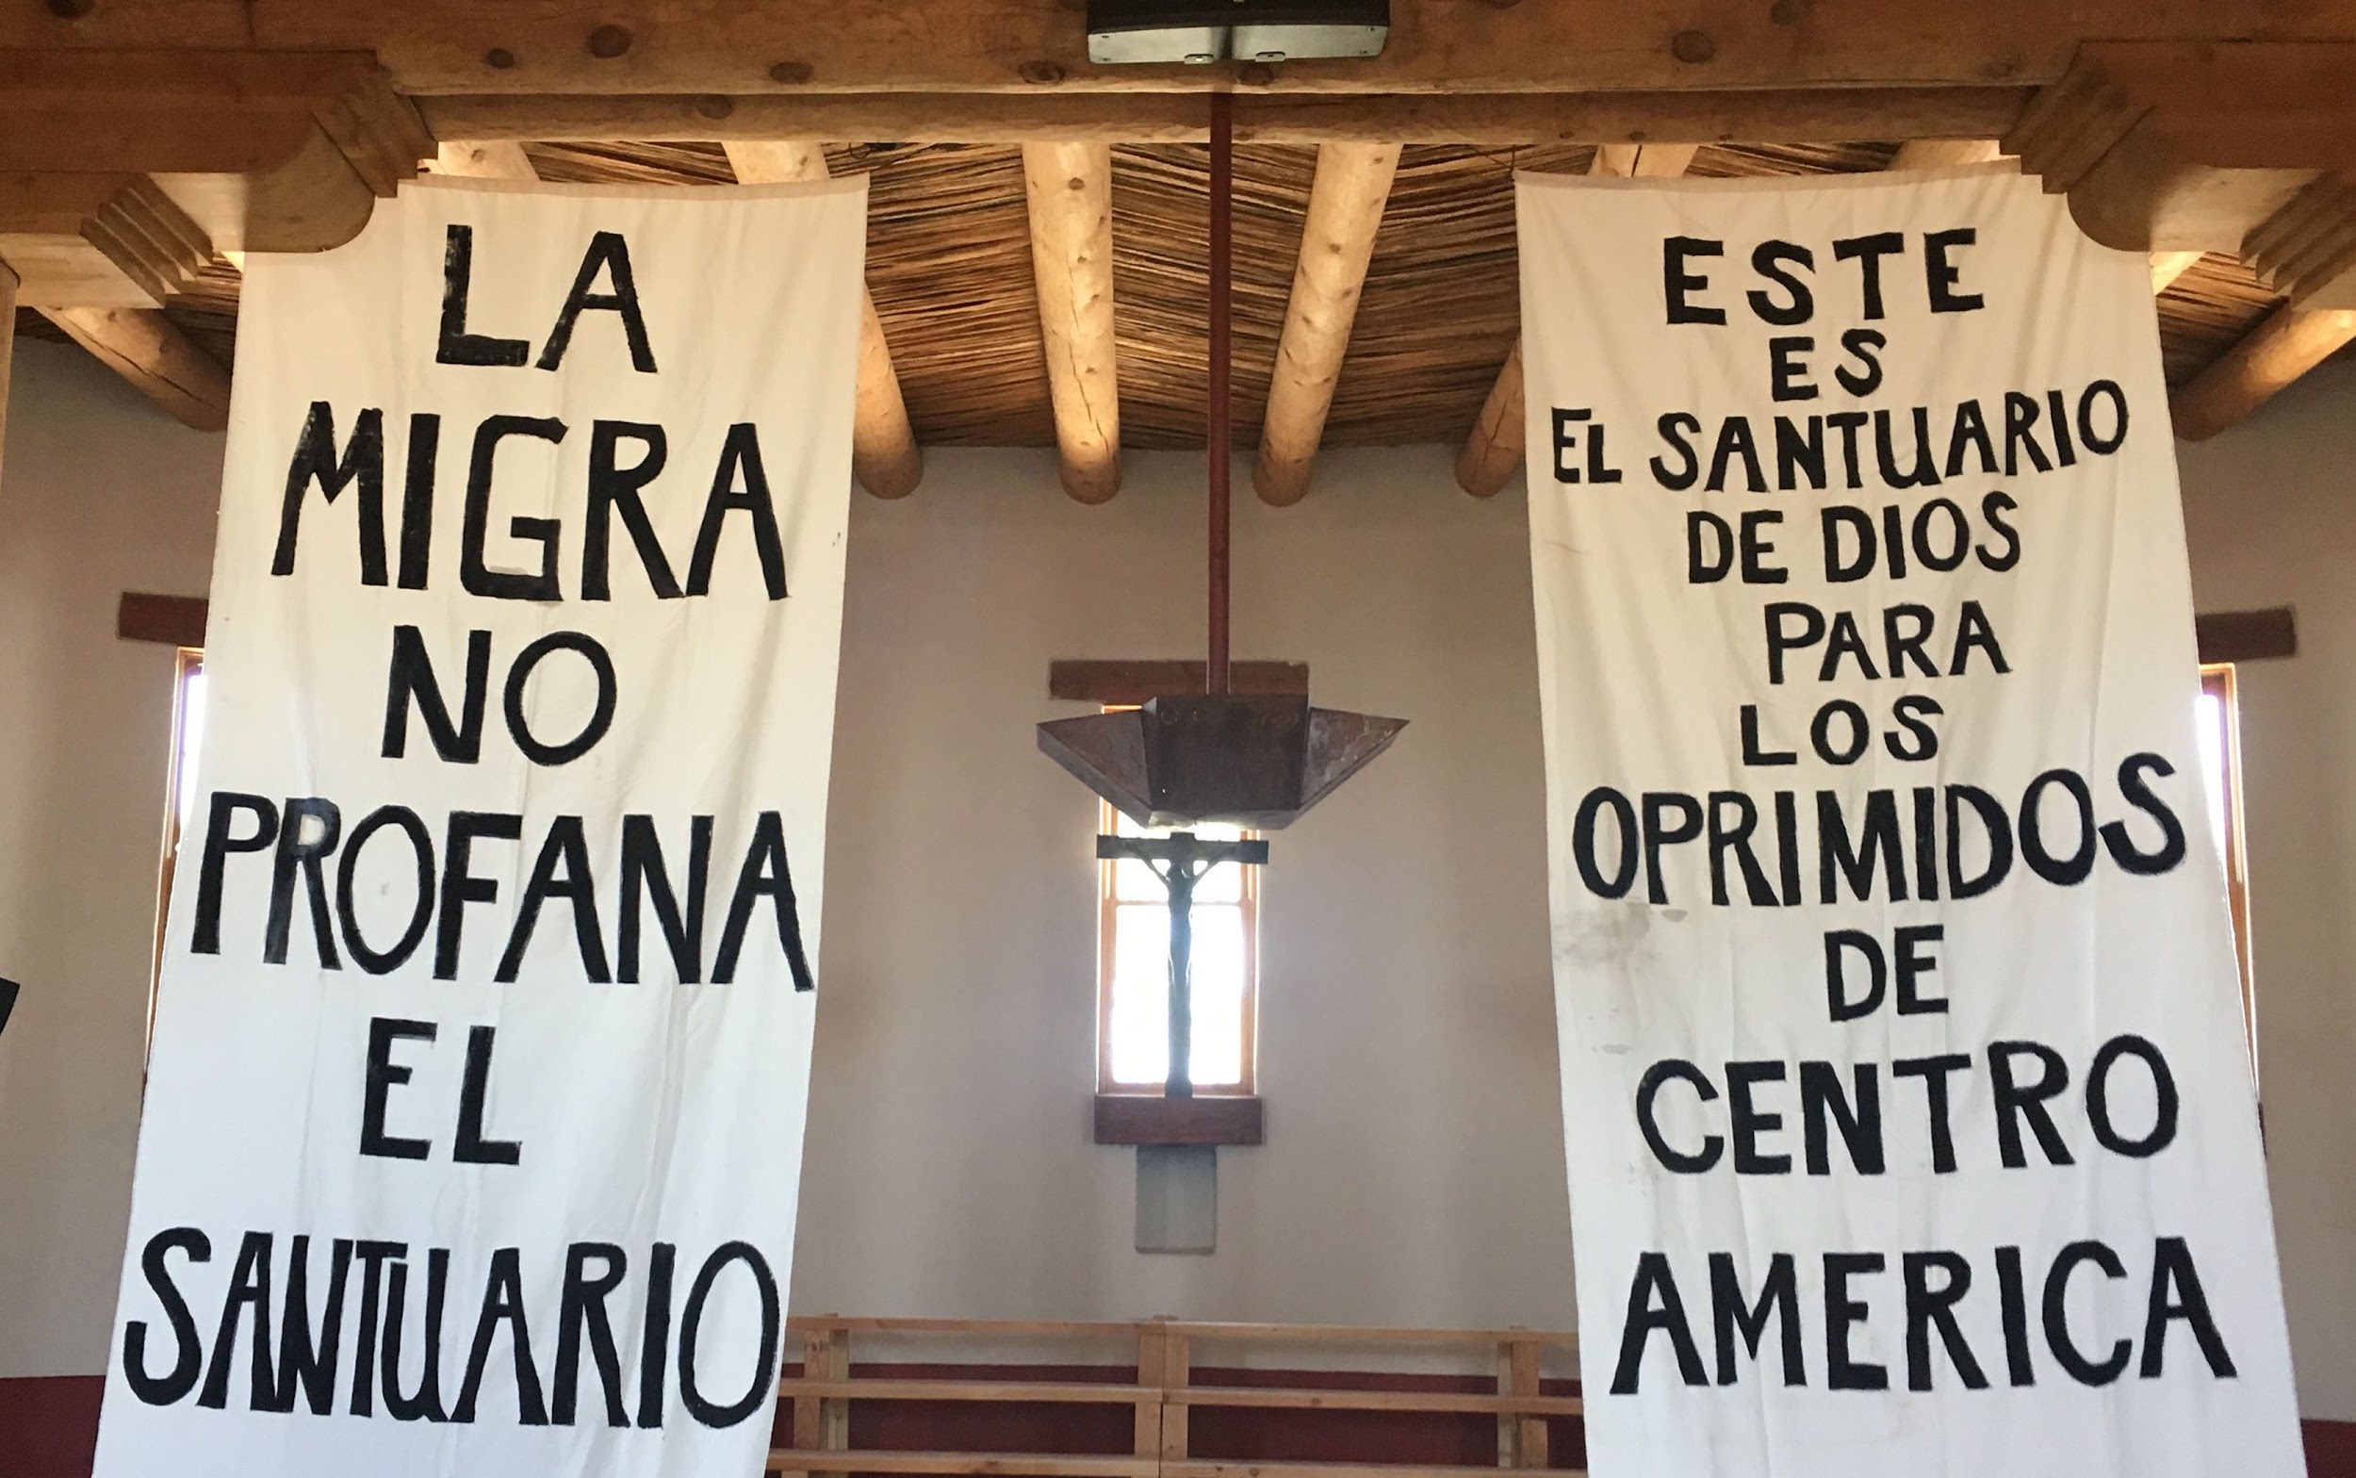
http://www.azarchivesonline.org/xtf/view?docId=ead/uoa/UAMS362.xml
A collection of papers detailing the trial in Tucson, Arizona of the founders of the Sanctuary Movement. The Sanctuary Movement involved churches allowing migrants to live in the sanctuaries to avoid arrest and deportation by immigration officials. The founders of Sanctuary Movement were put on trial for providing illegal aid to immigrants.

Slide 13
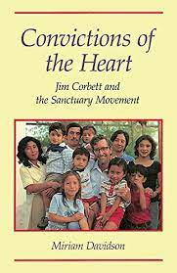
A book detailing the founding of the Sanctuary Movement in Tucson in the 1980s.

Slide 14
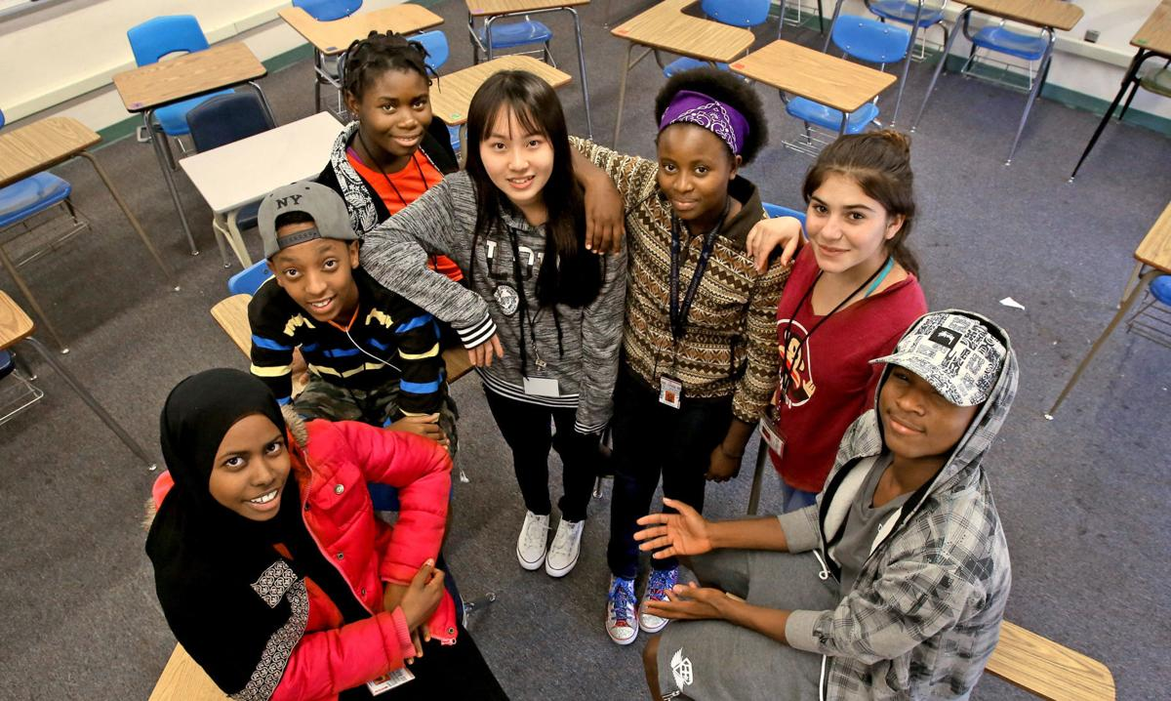
Through the modern United Nations refugee process people have been resettled to Tucson, Arizona since the 1980s.

Slide 15
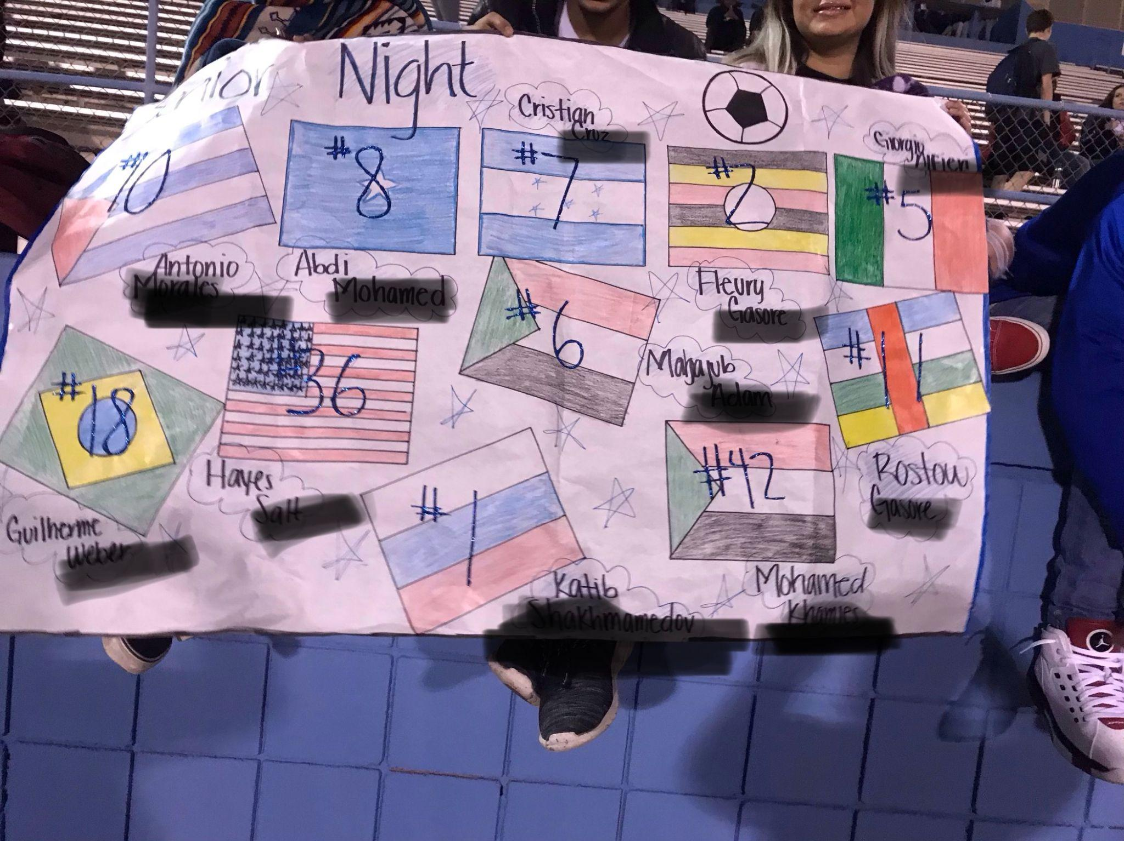
Arizona Refugee Resettlement Program. Arizona Refugee Resettlement Program | Arizona Department of Economic Security. (n.d.). https://des.az.gov/refugee-resettlement
https://des.az.gov/sites/default/files/Refugee_Arrivals_Report.pdf
A data table from the State of Arizona showing the countries of origin and numbers of refugees resettled in Arizona each year from 1981 to 2023.

Slide 16
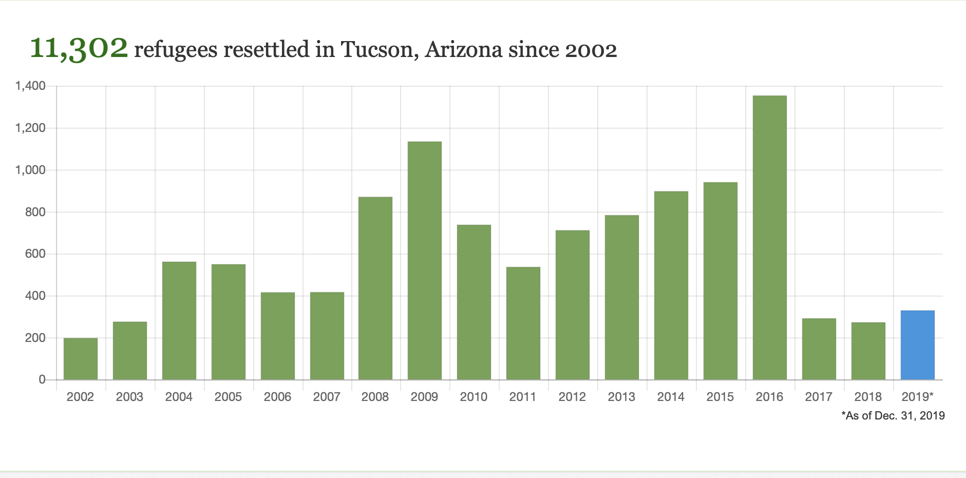
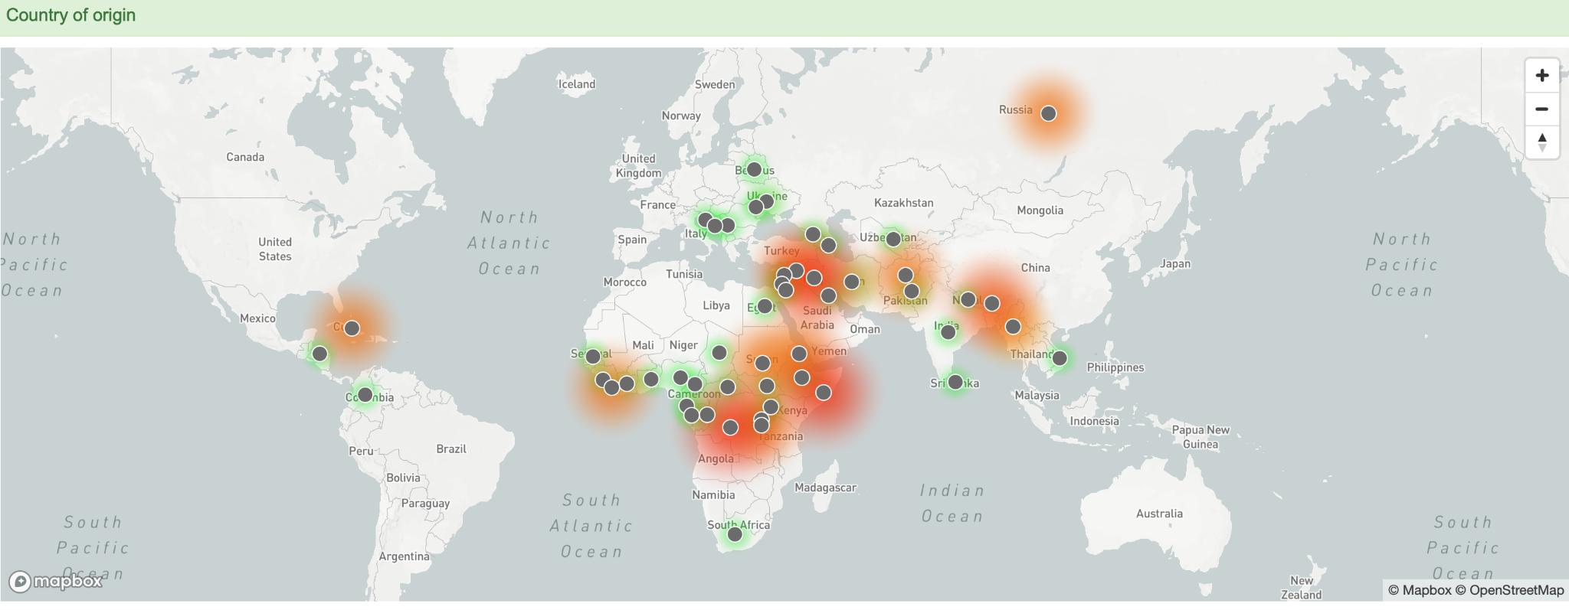
Refugees among us: Tucson, Arizona. Leader. https://data.news-leader.com/refugee/arizona-tucson/
A data table that shows refugee resettlement in Tucson, Arizona between 2002 and 2019. And a map showing the countries of origin of refugees relocated to Tucson.

Slide 17
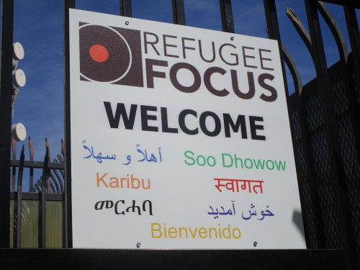
https://indearizona.com/helping-refugees-find-home-in-tucson/.
A news article detailing stories of refugees relocated to Tucson, Arizona.

Slide 18
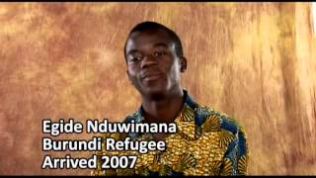
A video created by the Tucson Unified School District where young men who graduated from the school district tell about their lives after coming to Tucson, Arizona as refugees.

Slide 19
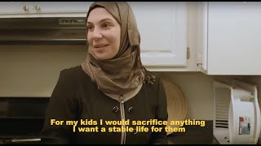
A video where a woman who came to Tucson, Arizona as a refugee tells about her life while showing how she bakes food that she will sell at a local market.

Slide 20

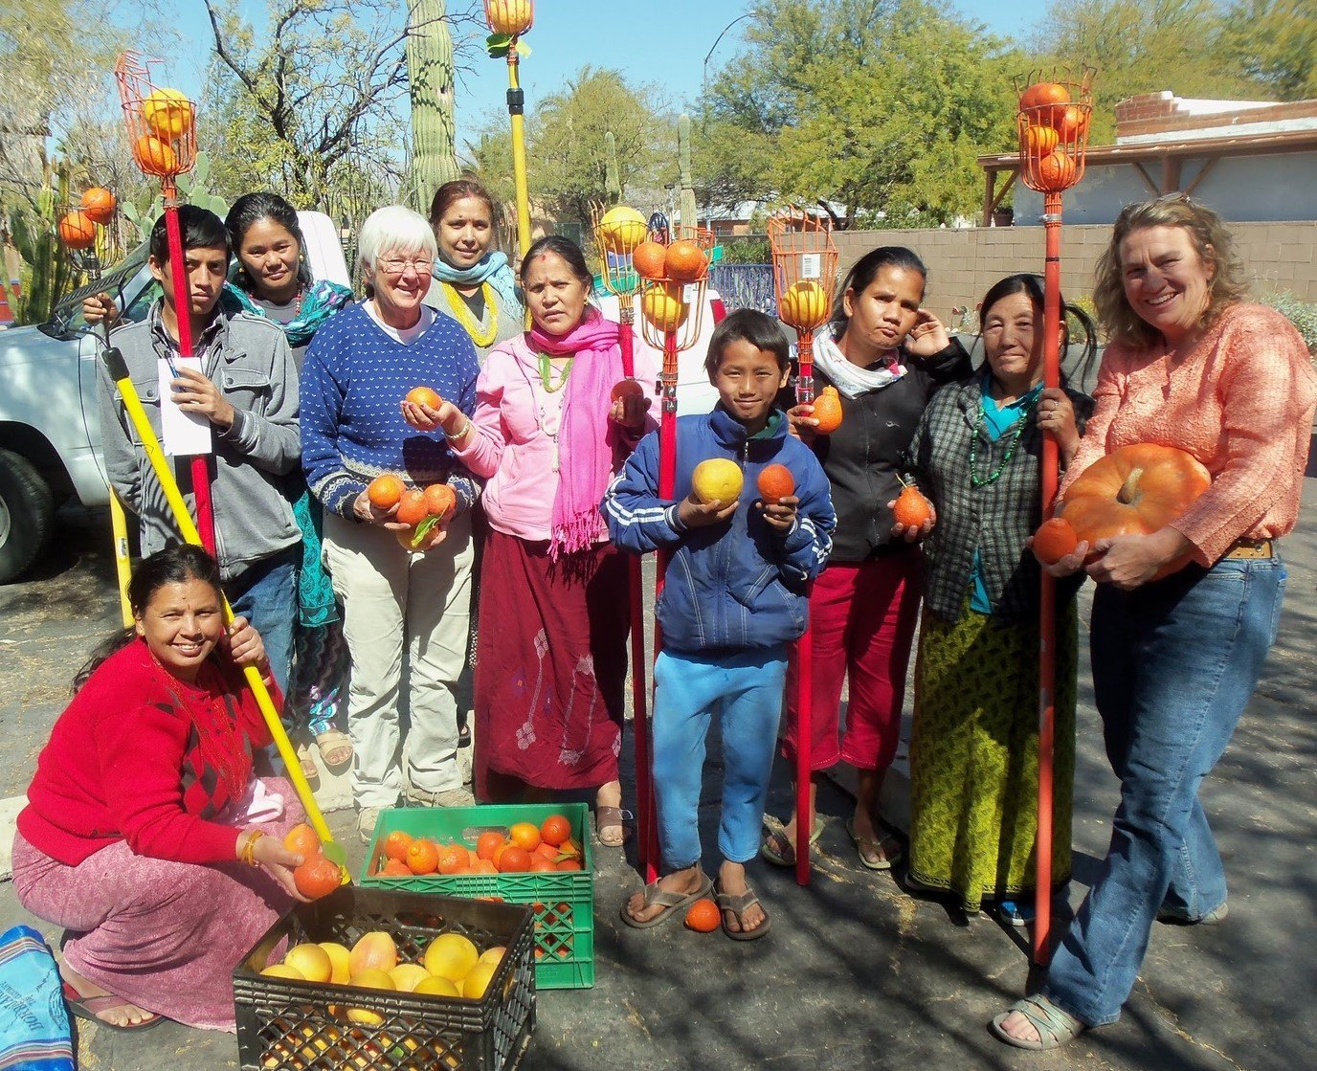
https://www.iskashitaa.org/
A website for an organization in Tucson, Arizona that helps refugees build sustainable lives by harvesting local fruit to make and sell goods.

Slide 21
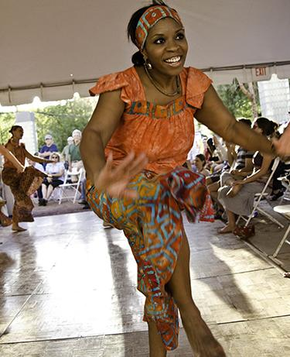
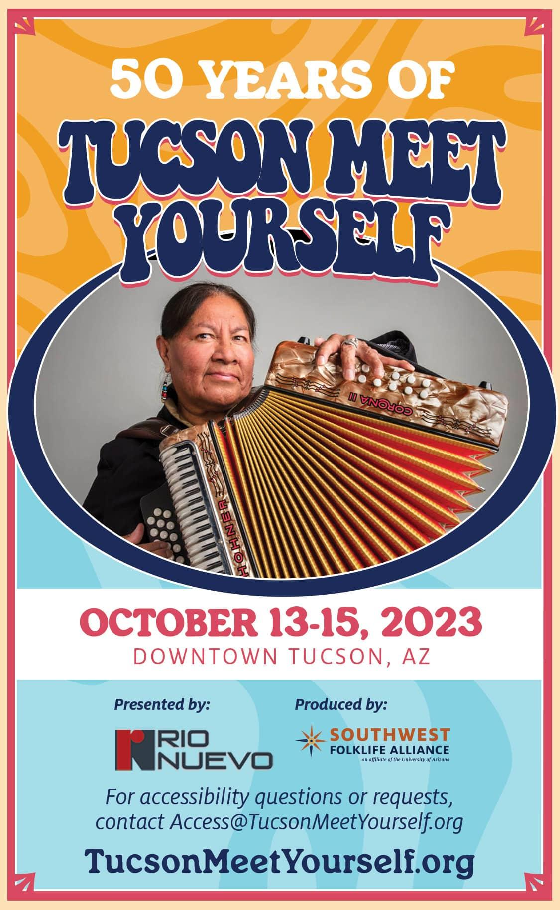
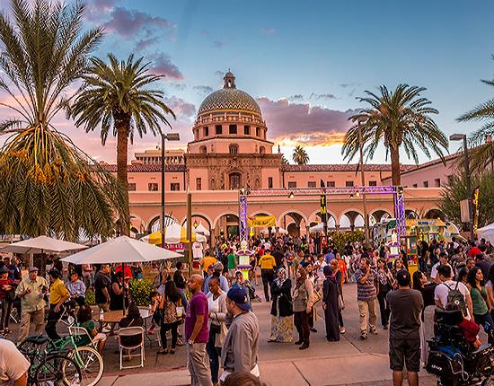
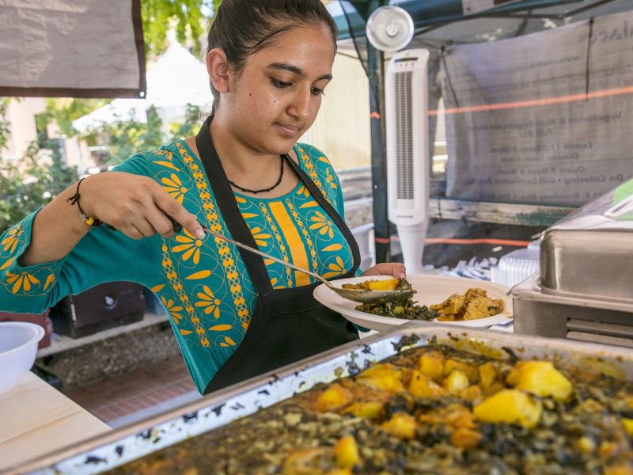
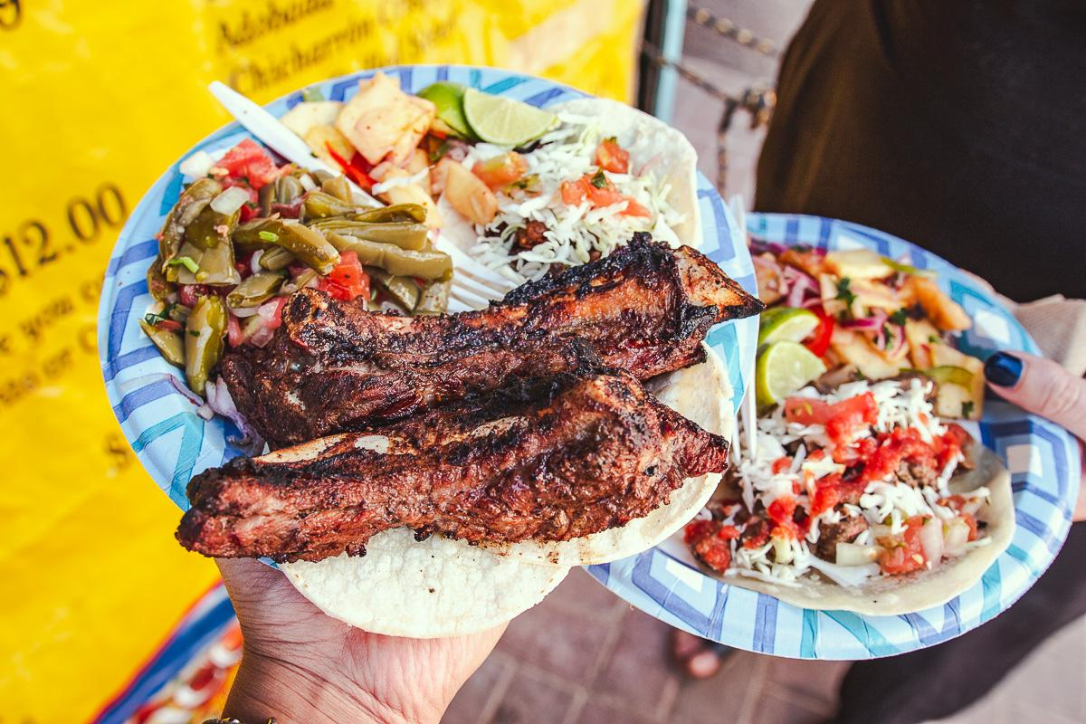
https://tucsonmeetyourself.org/
The website for the Tucson Meet Yourself Festival. The festival is held each year to celebrate the different cultural communities that call Tucson home. The festival includes all sorts of cultural expressions including music, arts, crafts and, most notably, food.

