Slide 1
YAQUI TRIBE
SUSANA PEDERSON AND ZULMA TOBOS

Slide 2
History of the Yaqui Tribe

Slide 3
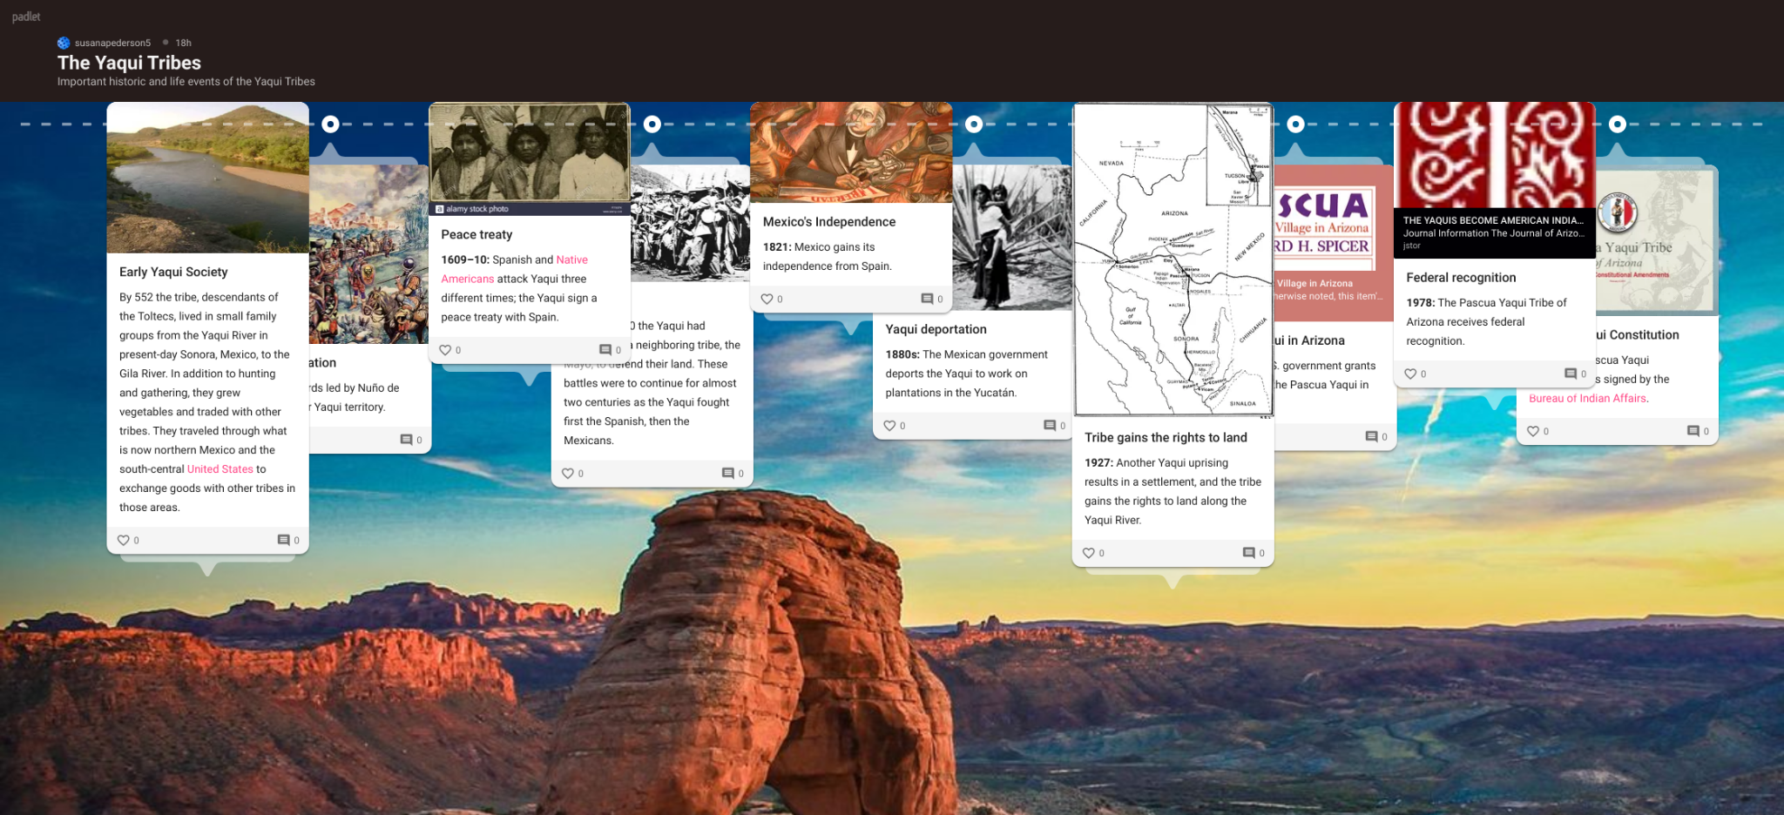
YAQUI TRIBES TIMELINE
padlet timeline

Slide 4
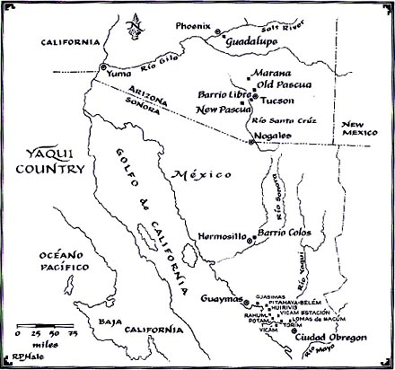
Map --
Yaqui Country

Slide 5
Archives/ Newspapers articles

Slide 6
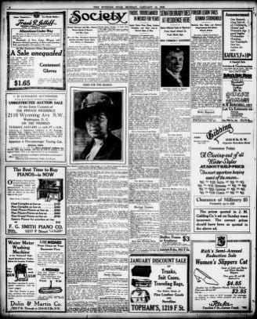
NEWSPAPER
Image 8 of Evening star (Washington, D.C.), January 14, 1918
... claimed by the Indians. The Yaqui tribes were originally agricultural people, with a bent...

Slide 7
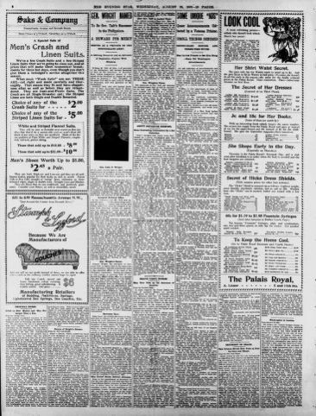
NEWSPAPER
Image 8 of Evening star (Washington, D.C.), August 26, 1903
... feminine members of the great Yaqui tribe in its rebellion against the authority of President...

Slide 8
Photos

Slide 9
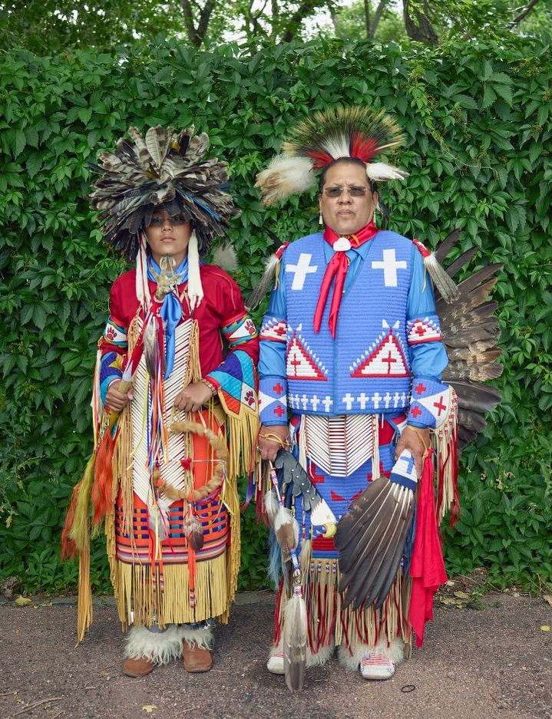
Rick Medina, right, a Yaqui Apache whose tribe is centered in Arizona, and his son, Miles Medina. They were among the participants at a Colorado Springs Native American Inter Tribal Powwow and festival in that central Colorado city.

Slide 10
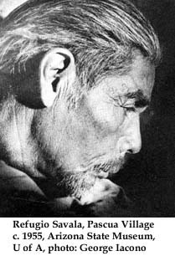
Refugio Savala is a Yaqui poet and translator. Born in Sonora, Mexico in 1904, he was brought by his parents into the United States during the height of the per­secution and deportation of Yaquis by the Mexican government, hence his name, Refugio -- refugee. As an adult Refugio Savala worked with a number of students of Yaqui culture, among them Edward Spicer and Muriel Painter. At Painter's encouragement he began to write. The three pieces we print here grew out of that association. "Growth: Merging of Labor and Love" is a portion of an autobiography Savala drafted in the 1950's and 60's. Recently edited by Kathleen Sands, it was published this year by the University of Arizona Press as The Autobiography of a Yaqui Poet "The Legend of Skeleton Mountain" and "The Singing Tree" are pieces of Savala's early work which are literary translations of stories from Yaqui oral tradition Both stories were published in the first issue of The Arizona Quarterly (Spring 1945). Mr. Savala resides in a nursing home in Tucson where he spends much of his time translating the Old Testament into Yaqui language.

Slide 11
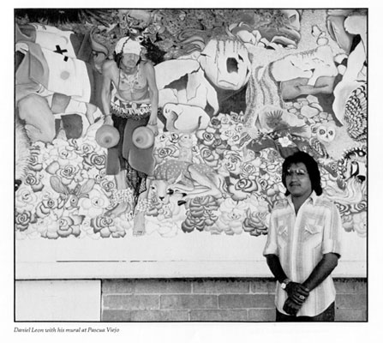
Daniel Leon
with his mural at Pascua Viejo

Slide 12
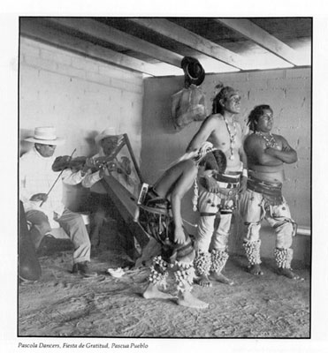
Pascola Dancers, Fiesta de Gratitud, Pascua Pueblo

Slide 13
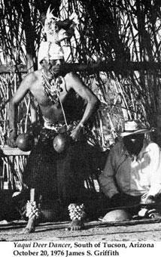
Yaqui Deer Dancer, South of Tucson, Arizona
October 20, 1976 James S. Griffith
Yaqui Deer Dancer, South of Tucson, Arizona
October 20, 1976 James S. Griffith

Slide 14
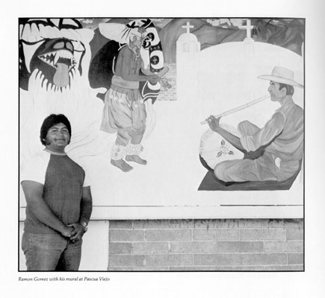
Ramon Gomez
with his mural at Pascua Viejo

Slide 15
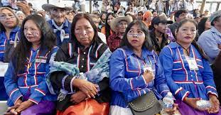
López Obrador, the current president of Mexico, apologizes to Yaqui tribe. August 6, 2020

Slide 16
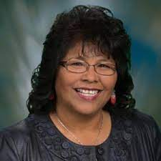
Arizona State Lagislature
Senate member
Sally Ann Gonzalez
District 3 Party Democrat

Slide 17
Documentaries

Slide 18
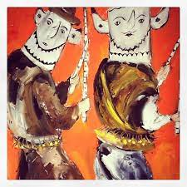
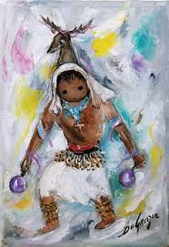
RITUALS AND CEREMONIES
Yaqui Easter by Ted DeGrazia

Slide 19
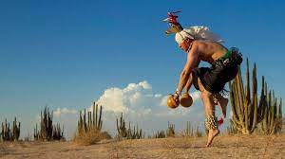
Native Myth: Yaqui Dance in Sonora, Mexico

Slide 20
Interview

Slide 21
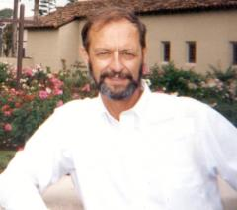
Dr. Denis Viri
Professor Emeritus at the Center for Indian Education at Arizona State University
Audio only/Interview with Dr. Viri

Slide 22
Children and Historical Books and Poems

Slide 23
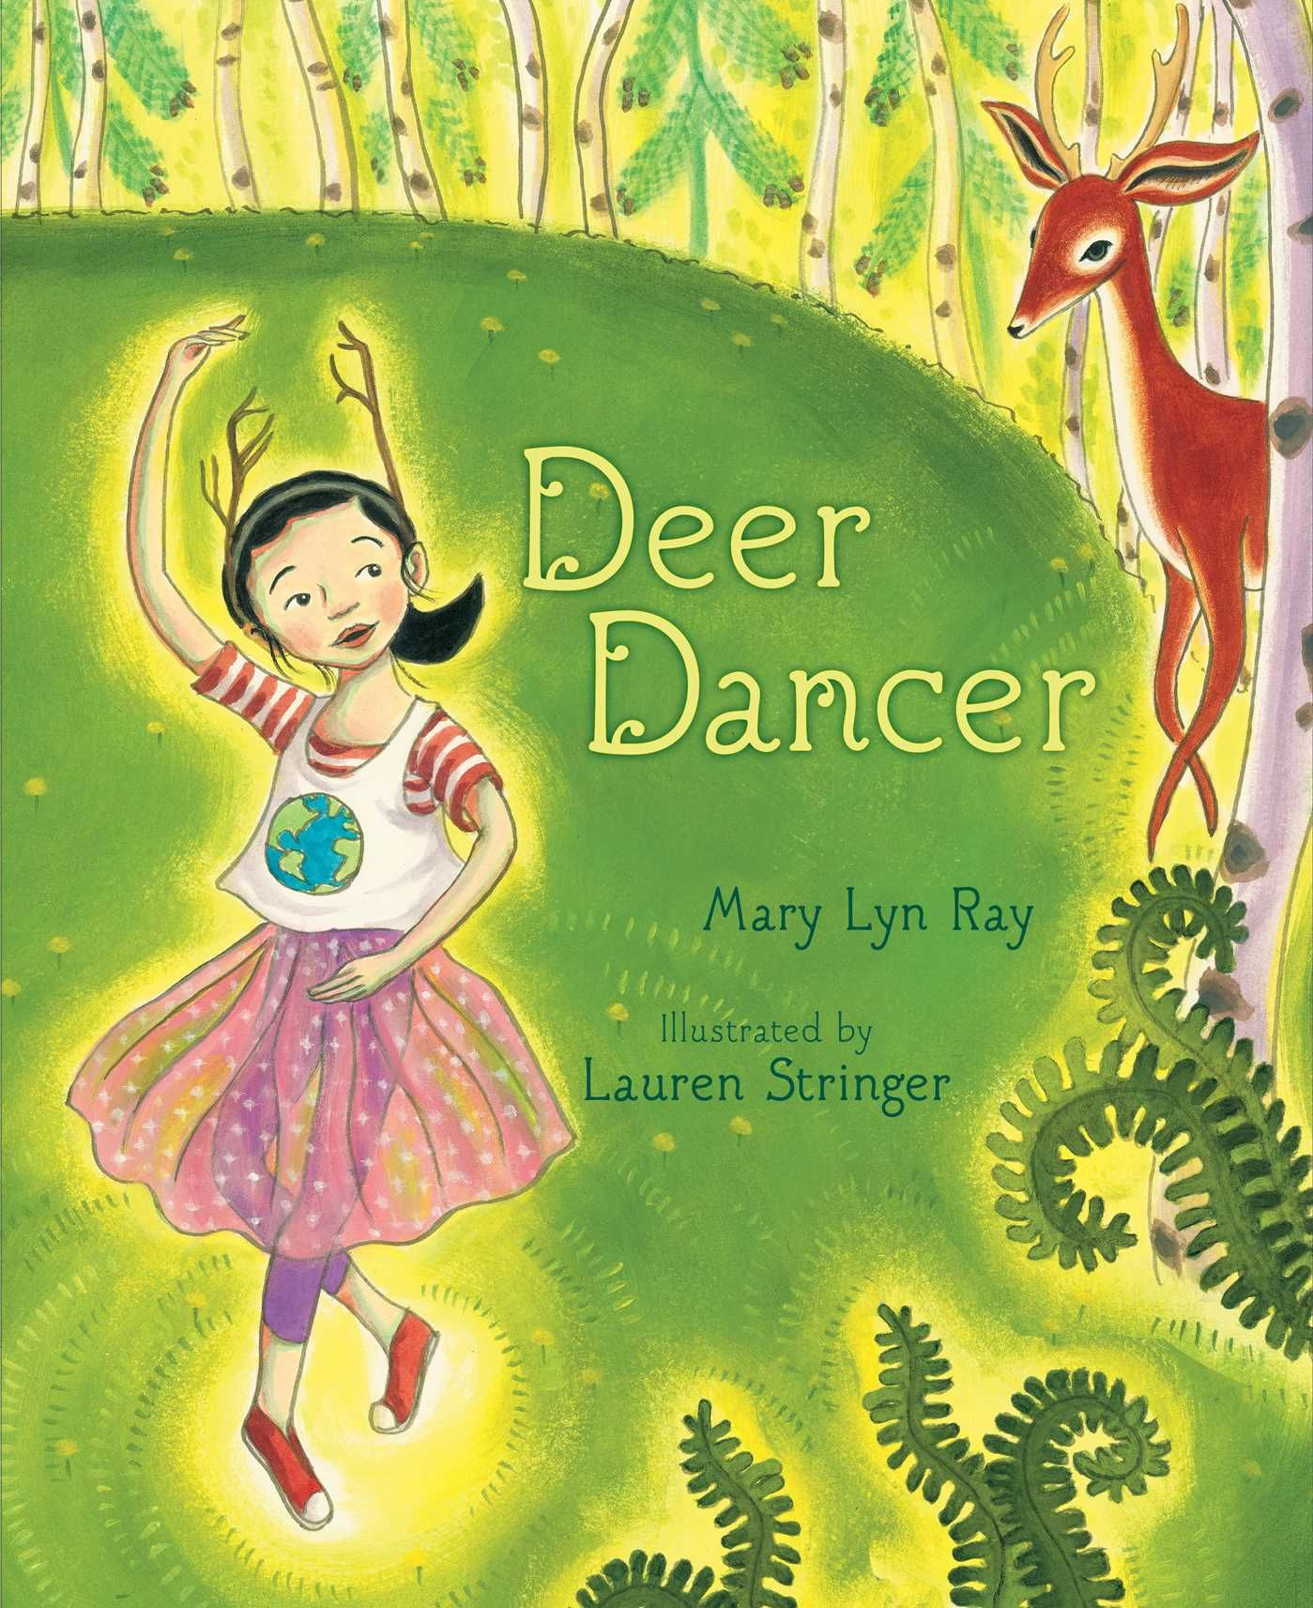
Deer Dancer
By Mary Lyn Ray
In this mesmerizing picture book from the author of the New York Times bestselling Stars, a young ballerina finds dancing inspiration in the natural world.
There’s a place I go that’s green and grass,
a place I thought that no one knew—
until the deer came.

Slide 24
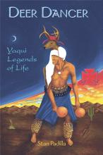
Deer Dancer
By Stan Padilla
Yaqui Legends of Life
From earliest times, the Yaqui people have had to overcome many oppressive and exploitative conditions to continue their own laws and customs. Many of their tribal stories reflect this struggle and are preserved in this collection of Yaqui legends and myths.

Slide 25
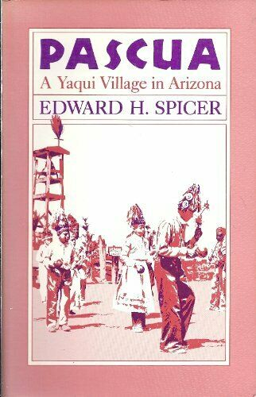
Pascua A Yaqui Village in Arizona
By Edward H. Spicer
A portrait of the Yaqui Indian village of Pascua, located on the outskirts of Tucson, Arizona, outlines the village's history, economics, customs of kinship, and complex religious ceremonial organization and practices.

Slide 26
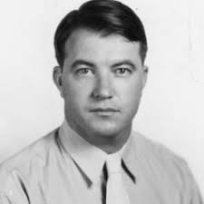
Cycles of Conquest
By Edward H Spicer
The Impact of Spain, Mexico, and the United States on the Indians of the Southwest, 1533–1960
Edward H. Spicer
Born: 11-29-1906
Died: 04-04-1983

Slide 27
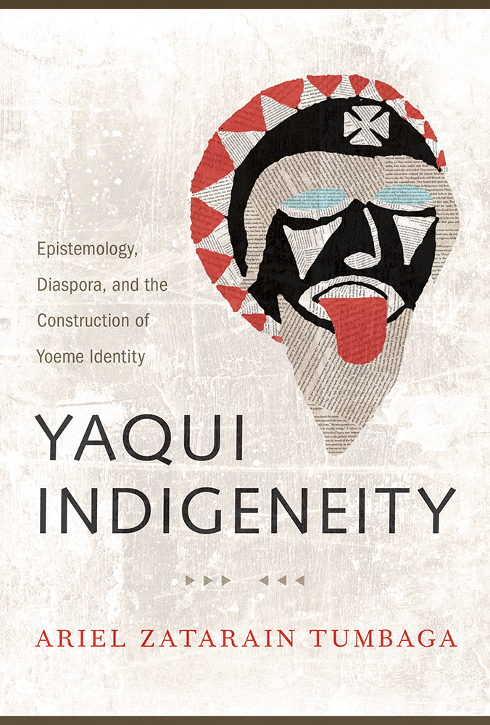
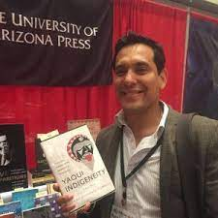
Yaqui Indigeneity
by Ariel Zatarain
Using indigenous forms of knowledge, Tumbaga shows the important and growing body of literary work on Yaqui culture and history that demonstrates the historical and contemporary importance of the Yaqui nation in Mexican and Chicana/o history, politics, and culture.
Born in Sonora, Mexico, Ariel Zatarain Tumbaga is an independent scholar of Mexican and Chicana/o Indigenous literature and culture.

Slide 28
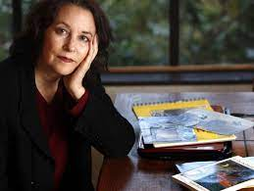
A POEM
Anita Endrezze reads and discusses Thirteen Ways of Looking at an Indian on June 29, 2020.
Thirteen Ways of Looking at an Indian / 13 Ways of Looking at an Indian
Anita Endrezze reads and discusses her poem "Thirteen Ways of Looking at an Indian" on June 29, 2020, from her home near Seattle, Washington. Endrezze is an artist and a writer. Her most recent book of poetry, Enigma, was published by Press 53 in 2019.
Anita is Yaqui, Pima, Maya as well as half European (Slovenian, German, and Italian).

Slide 29
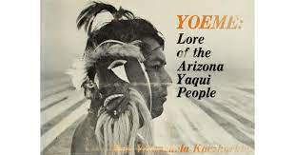
Yoeme: Lore of the Arizona Yaqui People
by Mini Valenzuela Kaczkurkin
It is probably the best source on contemporary Yaqui oral traditions.

Slide 30
Let's Make Thunder
Mini Valenzuela Kaczkurkin
"Let's make thunder,"
As the cloud makes thunder,
Say the Pascola Dancers.
Thunder brings the rain.
So we understand
What the Pascolas mean to do.
In imitation of rain,
They're going to shower
The spectators with bowls of water.
So we who know, walk away,
Before the Pascolas
Make thunder as the clouds make Thunder.
As printed in Larry Evers, ed. The South Corner of Time. Tucson, Ariz.: The University of Arizona Press, ©1980, p. 191-192.

