Slide 1


Yoeme
A Multi-Modal Exploration of the story of the Yoeme/Yaqui People in the Sonoran Desert

Slide 2
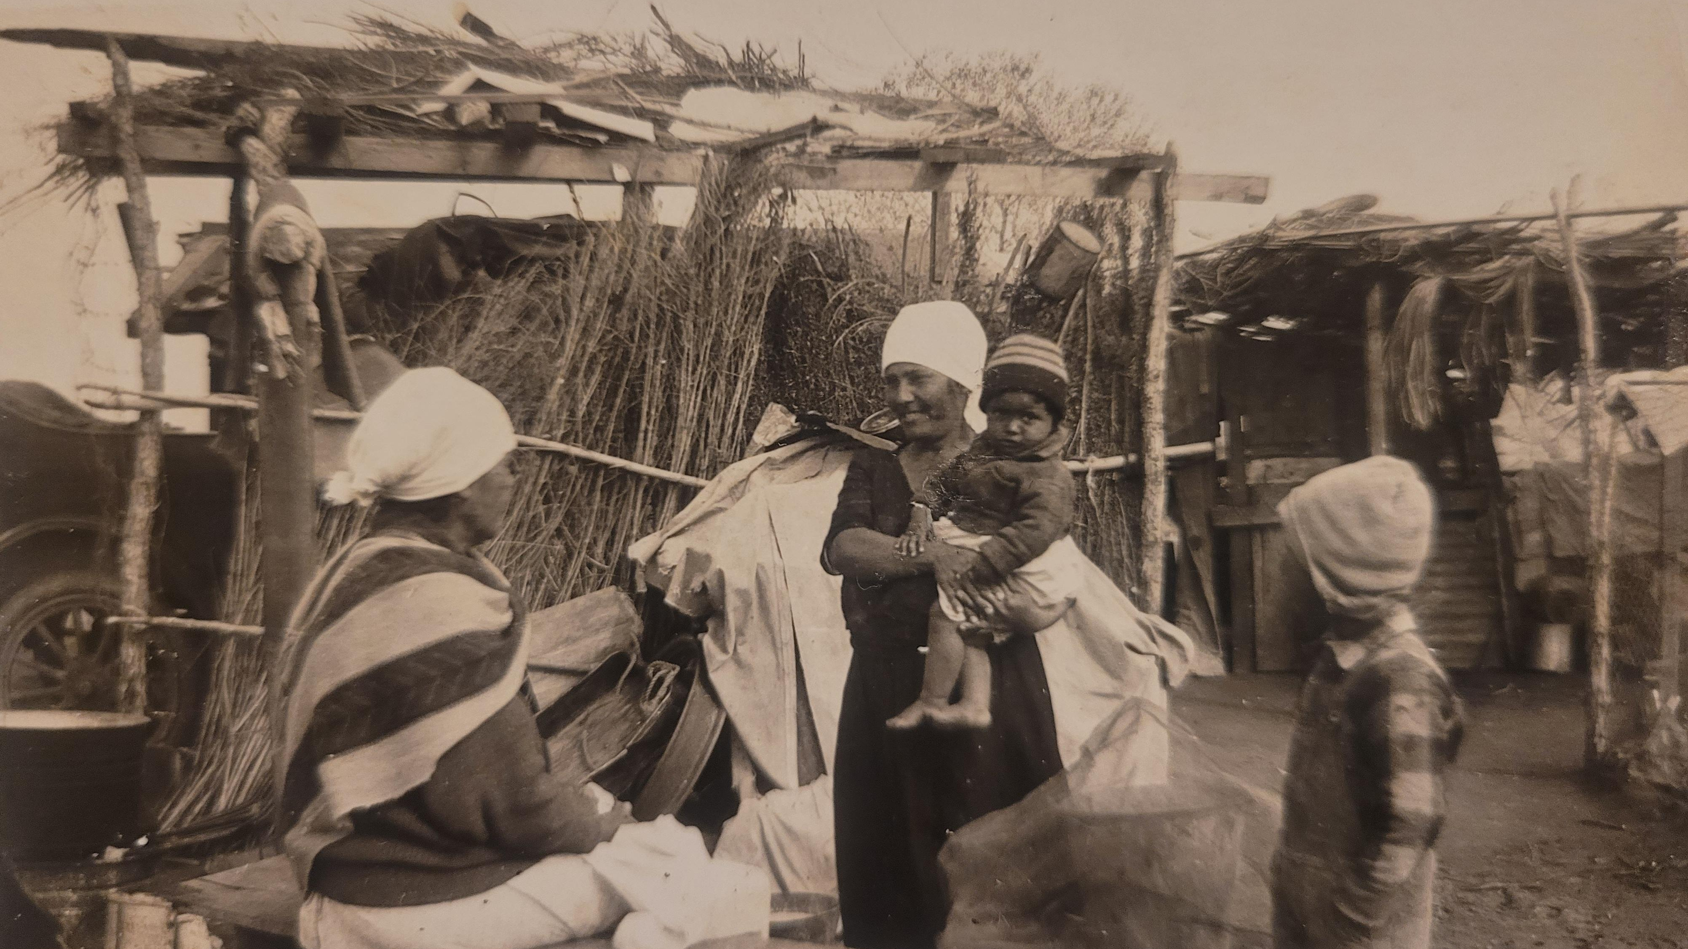
My Family
I couldn’t tell you who these people are in my photo album. This project is for others like me whose family’s traumatic history left holes in our stories. It’s a place where I can help fill those holes for myself and others. Perhaps also a place to start filling those empty parts

Slide 3

Reference materials
https://www.encyclopedia.com/history/latin-america-and-caribbean/mesoamerican-indigenous-peoples/yaqui
https://www.wikiwand.com/en/Yaqui
https://en.wikipedia.org/wiki/Yaqui
https://www.nps.gov/articles/yoeme.htm

Slide 4
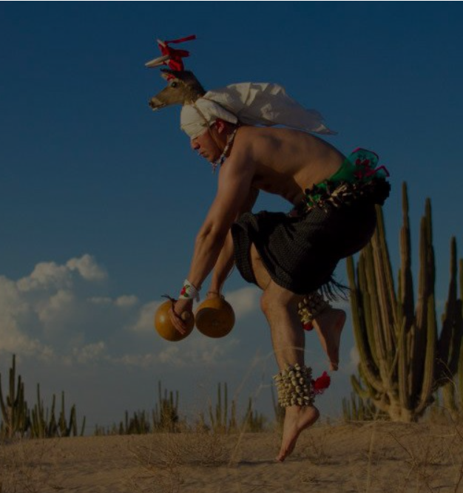
Videos- Yaqui Traditions
https://www.youtube.com/watch?v=doaFfzMbNeQ
https://www.youtube.com/watch?v=CzxIdFlurYQ Deer Dance
https://www.youtube.com/watch?v=ld4KQDPkGng Yaqui Fry Bread
https://www.youtube.com/watch?v=9Mavi3IdPUI University of Arizona Easter Dance
https://www.youtube.com/watch?v=gfAX1GEgkQc DeGrazia Video on Yaqui People

Slide 5
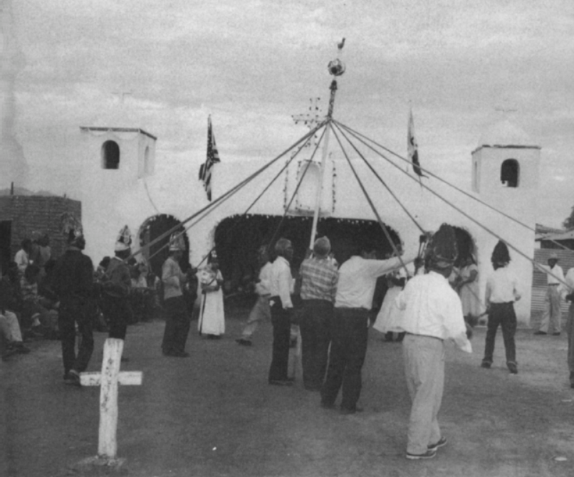
More Videos
https://www.youtube.com/watch?v=b4NzNWwXHFQ Yaqui recognition ceremony
https://www.youtube.com/watch?v=Pp67tHzxhu0 Mexican Documentary on Yaqui tribes
https://www.youtube.com/watch?v=L74qEvBq-PM Matachini Dance
https://www.youtube.com/watch?v=aSrki3TjqLE&list=RDL74qEvBq-PM&index=2 Matachini Dance
https://www.youtube.com/watch?v=kPKtKxpkh80 Matachinis dance videos
https://www.youtube.com/watch?v=4TJXAAYFMFs Yaqui Arts Festival
https://www.youtube.com/watch?v=UvV12OSe-eI 41st Tribal Recognition Ceremony Video

Slide 6
Videos Continued
Guadalupe, Three cultures https://www.youtube.com/watch?v=ezowzU3HIdk
Cocorit Museum of Yaqui History in Mexico https://www.youtube.com/watch?v=BuDIUZipQos
https://www.youtube.com/watch?v=-HBtlJ212qs Yaqui Culture preservation video
https://www.youtube.com/watch?v=0qHDlACgglo Yaqui paper flower making video
https://www.youtube.com/watch?v=WBIdZwgypTA Mexican Documentary on Yaqui history.
https://www.youtube.com/watch?v=X5Zs8Gyu6V8
Yaqui Blessing video

Slide 7
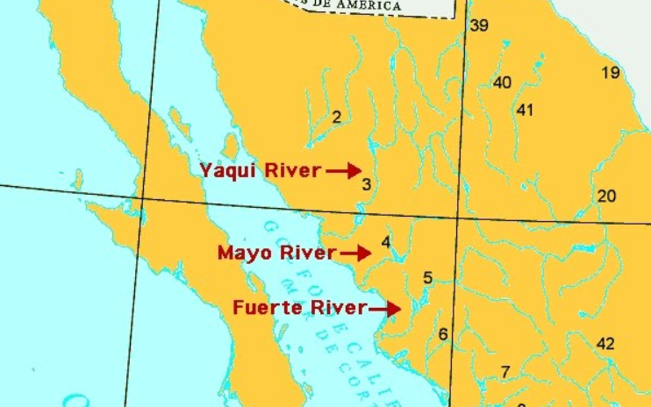
Maps and Timelines
https://native-land.ca/maps/territories/yaqui/
http://www.watersecuritynetwork.org/wp-content/uploads/2015/03/deGrenade_Yaqui_Map.jpg
https://guides.loc.gov/chronicling-america-yaqui War timeline
https://yaquitribetexas.com/history
https://native-land.ca/

Slide 8
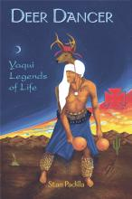
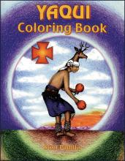
Books for children
Yaqui Legends of Life
From earliest times, the Yaqui people have had to overcome many oppressive and exploitative conditions to continue their own laws and customs. Many of their tribal stories reflect this struggle and are preserved in this collection of Yaqui legends and myths
Yaqui Coloring book
A coloring book of drawings to help children learn about Yaqui tribal culture of the Southwest. Includes dancers, animals, food plants, sacred symbols and more from this ancient culture

Slide 9
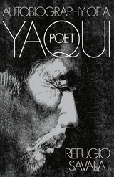
Literature
Autobiography of a Yaqui Poet
Refugio Savala; Edited by Kathleen M. Sands
University of Arizona Press, 1980
Library of Congress F1221.Y3S28 | Dewey Decimal 970.00497
This is the major literary achievement of a sensitive, gifted man. The author is a Yaqui Indian, a railroad gandy dancer who sees beauty in iron spikes and rail clamps as well as in twilight-purple mountains and glossy-leafed cottonwood trees. In the seventy years following his flight from the Yaqui-Mexican wars in Sonora, Savala became a talented poet and loving recorder of his people's cultural heritage. A large sampling of his original works appears in the interpretations section of this book. Together with the beautifully written autobiography, they offer a unique view of Arizona Yaqui culture and history, railroading in the American West, and the personal and artistic growth of a Native American man of letters.

Slide 10
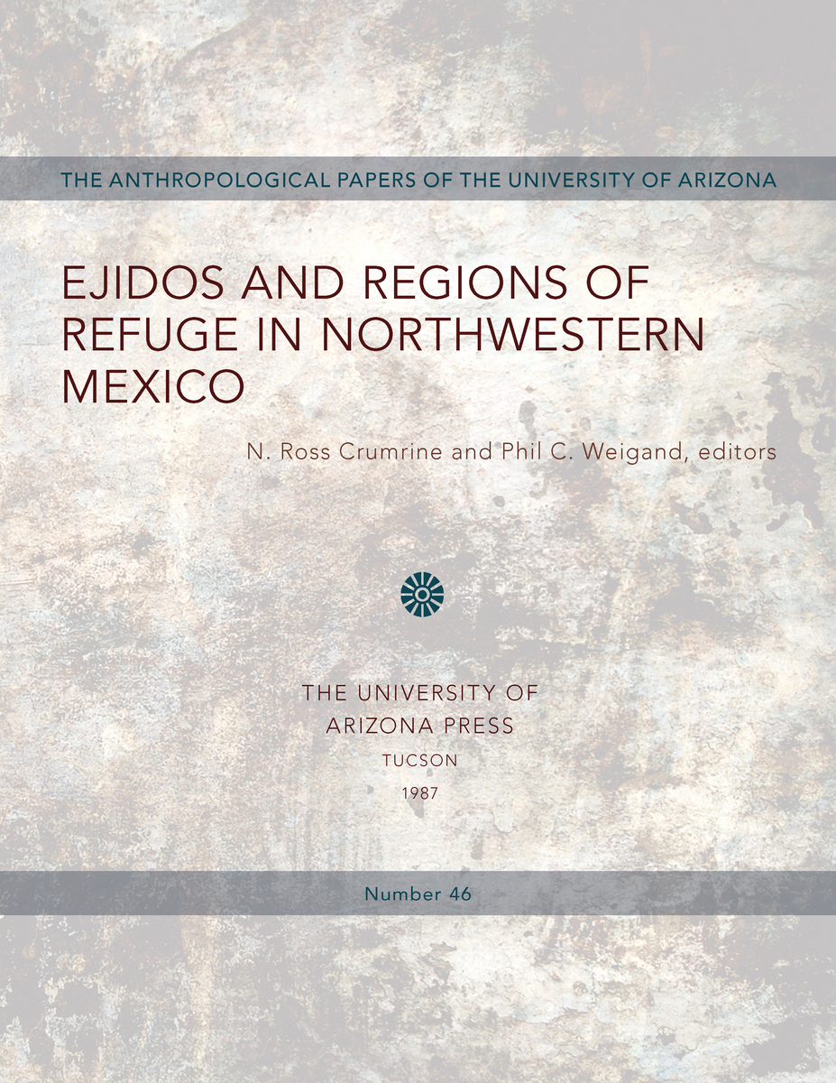
Literature
The ten essays in this volume present case studies of different cultural groups in northwestern Mexico, analyzed through the concepts of enclaves and regions of refugee initially proposed by Edward Spicer and Gonzalo Aguirre Beltran.

Slide 11
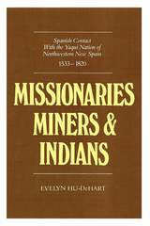
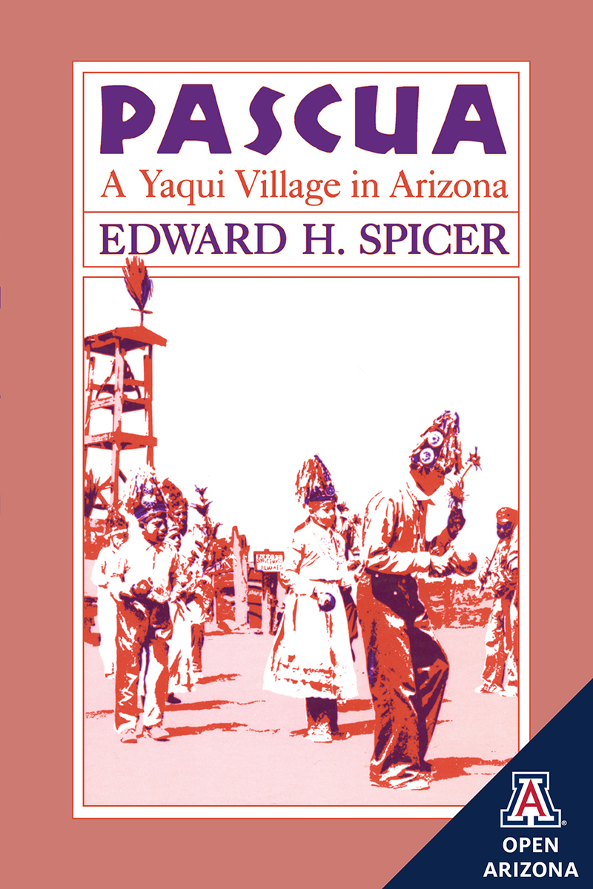
Literature
ABOUT THIS BOOK
The Yaqui of Mexico were early converts to Christianity in New Spain. Yet they came to be regarded with hostility by the newly emerging Mexican government. Many Yaquis fled Mexico in the early twentieth century and established a settlement in Arizona where they resumed a peaceful existence centered around their ceremonial calendar.
Edward Spicer devoted most of his professional career to the study of the Yaquis and came to be regarded as a leading authority on that tribe. At the inception of his forty years of research stands Pascua, a firsthand description of daily village life.
The Yaqui Indians managed to avoid assimilation during the Spanish colonization of Mexico. Even when mining interests sought to wrest Yaqui labor from the control of the Jesuits who had organized Indian society into an agricultural system, the Yaqui themselves sought primarily to ensure their continuing existence as a people.
More than a tale of Yaqui Indian resistance, Missionaries, Miners, and Indians documents the history of the Jesuit missions during a period of encroaching secularization. The Yaqui rebellion of 1740, analyzed here in detail, enabled the Yaqui to work for the mines without repudiating the missions; however, the erosion of the mission system ultimately led to the Jesuits’ expulsion from New Spain in 1767, and through their own perseverance, the Yaqui were able to bring their culture intact into the nineteenth century.

Slide 12
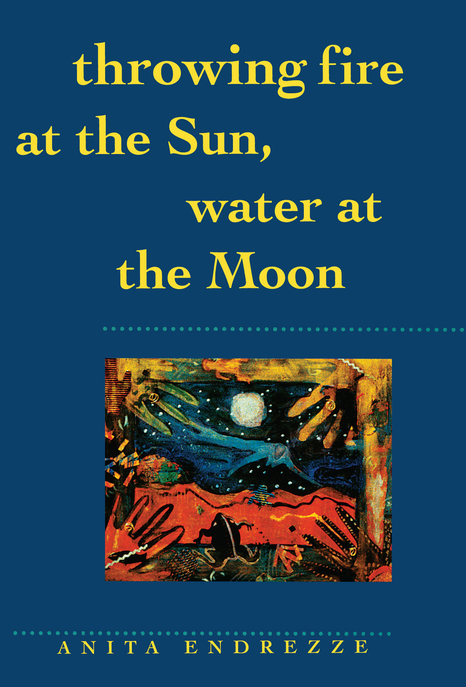
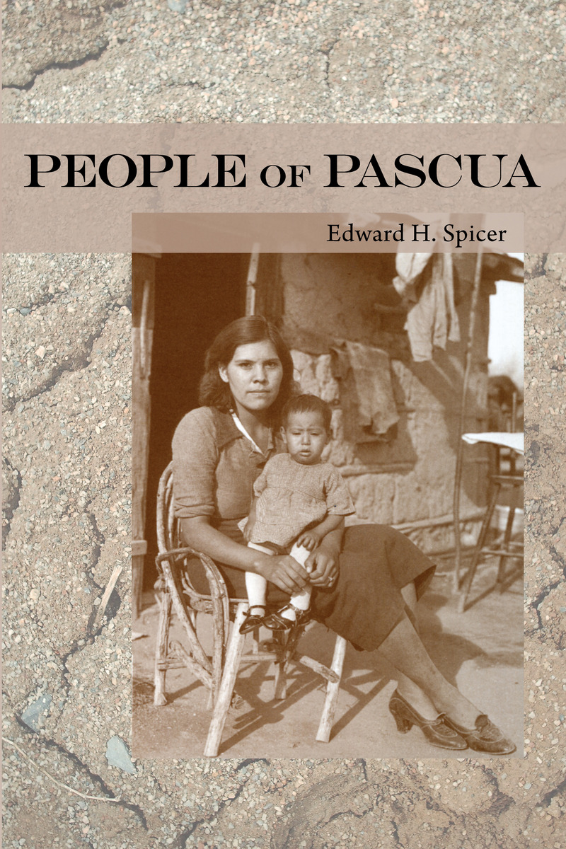
Literature
ABOUT THIS BOOK
“[People of Pascua] sketches the history and culture of the Tucson area Yaqui and contains case studies of a number of the informants. What constituted ‘Yaquiness’ in Pascua was mainly a common language, a shared historical tradition, and an aberrant form of Catholic Christianity laced with Yaqui concepts. This clearly and concisely written book is very important in its own terms both as an early example of the use of life histories in ethnology and as a significant contribution to Yaqui studies.”—Choice
ABOUT THIS BOOK
Perhaps you know them for their deer dances or for their rich Easter ceremonies, or perhaps only from the writings of anthropologists or of Carlos Castaneda. But now you can come to know the Yaqui Indians in a whole new way. Anita Endrezze, born in California of a Yaqui father and a European mother, has written a multilayered work that interweaves personal, mythical, and historical views of the Yaqui people.
Throwing Fire at the Sun, Water at the Moon is a blend of ancient myths, poetry, journal extracts, short stories, and essays that tell her people's story from the early 1500s to the present, and her family's story over the past five generations. Reproductions of Endrezze's paintings add an additional dimension to her story and illuminate it with striking visual imagery. Endrezze has combed history and legend to gather stories of her immediate family and her mythical ancient family, the two converging in the spirit of storytelling. She tells Aztec and Yaqui creation stories, tales of witches and seductresses, with recurring motifs from both Yaqui and Chicano culture. She shows how Christianity has deeply infused Yaqui beliefs, sharing poems about the Flood and stories of a Yaqui Jesus. She re-creates the coming of the Spaniards through the works of such historical personages as Andrés Pérez de Ribas. And finally she tells of those individuals who carry the Yaqui spirit into the present day. People like the Esperanza sisters, her grandmothers, and others balance characters like Coyote Woman and the Virgin of Guadalupe to show that Yaqui women are especially important as carriers of their culture.
Greater than the sum of its parts, Endrezze's work is a new kind of family history that features a startling use of language to invoke a people and their past--a time capsule with a female soul. Written to enable her to understand more about her ancestors and to pass this understanding on to her own children, Throwing Fire at the Sun, Water at the Moon helps us gain insight not only into Yaqui culture but into ourselves as well.

Slide 13
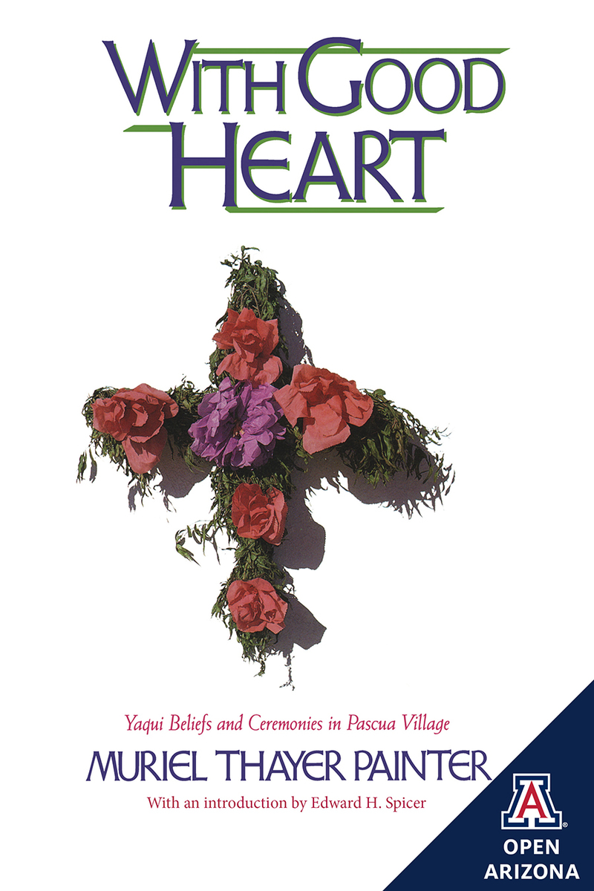
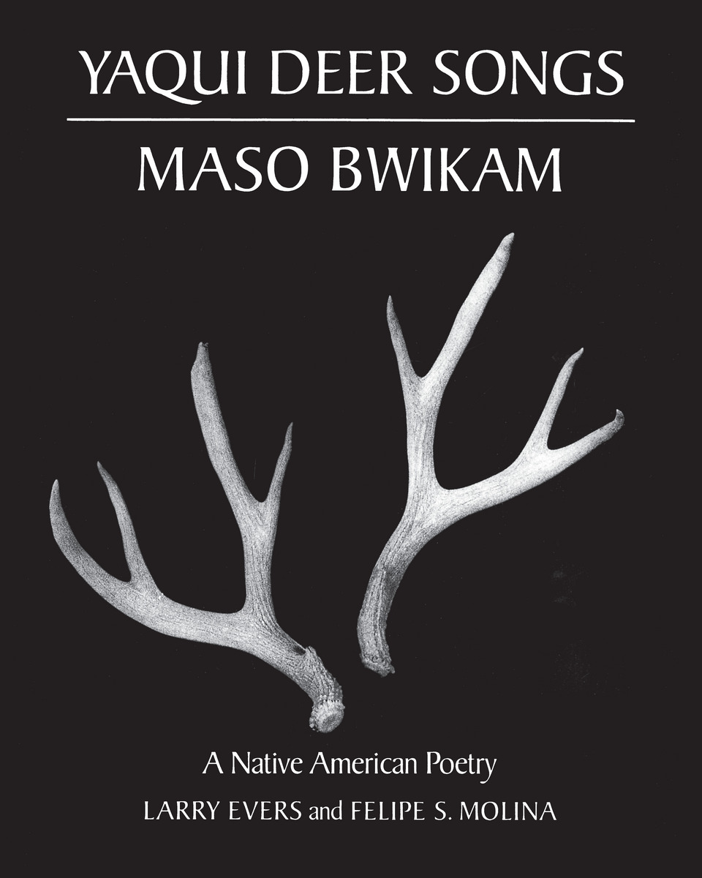
Literature
ABOUT THIS BOOK
Muriel Painter's account of Yaqui beliefs and ceremonies is based on her firsthand observations over the course of four decades. By the time Painter died in 1974, she was as familiar with Yaqui culture as on outsider could be and left behind the manuscript from which this volume arose. It was reviewed before the original publication in 1986 by a Yaqui committee and edited for publication by Edward Spicer.
Yaqui regard song as a kind of lingua franca of the intelligent universe. It is through song that experience with other living things is made intelligible and accessible to the human community. Deer songs often take the form of dialogues in which the deer and others in the wilderness world speak with one another or with the deer singers themselves. It is in this way, according to one deer singer, that “the wilderness world listens to itself even today.”
In this book authentic ceremonial songs, transcribed in both Yaqui and English, are the center of a fascinating discussion of the Deer Song tradition in Yaqui culture. Yaqui Deer Songs/Maso Bwikam thus enables non-Yaquis to hear these dialogues with the wilderness world for the first time

Slide 14
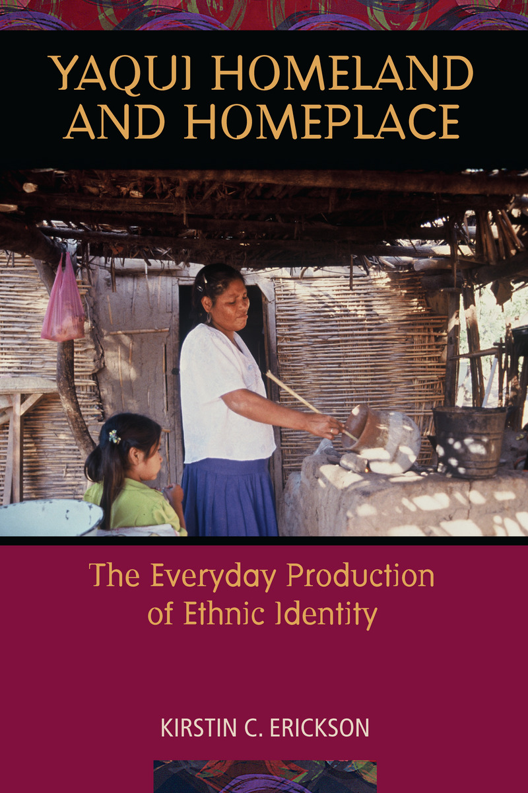
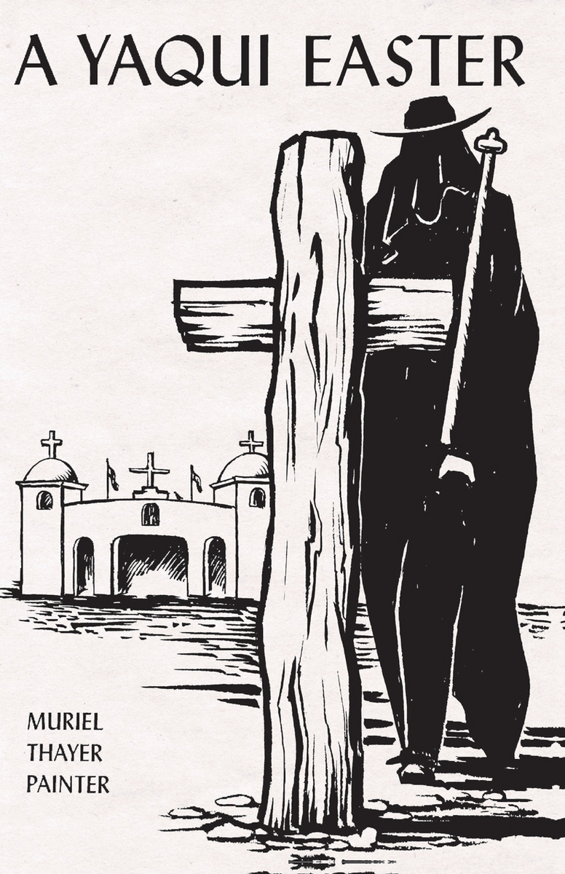
Literature
The Yaqui Indian Easter Ceremony--from the initial events of Ash Wednesday through the final "Circle" on Easter Sunday--briefly described and interpreted by a long-time student of the tribe.
In this illuminating book, anthropologist Kirstin Erickson explains how members of the Yaqui tribe, an indigenous group in northern Mexico, construct, negotiate, and continually reimagine their ethnic identity. She examines two interconnected dimensions of the Yaqui ethnic imagination: the simultaneous processes of place making and identification, and the inseparability of ethnicity from female-identified spaces, roles, and practices.
Yaquis live in a portion of their ancestral homeland in Sonora, about 250 miles south of the Arizona border. A long history of displacement and ethnic struggle continues to shape the Yaqui sense of self, as Erickson discovered during the sixteen months that she lived in Potam, one of the eight historic Yaqui pueblos. She found that themes of identity frequently arise in the stories that Yaquis tell and that geography and location—space and place—figure prominently in their narratives.
Revisiting Edward Spicer’s groundbreaking anthropological study of the Yaquis of Potam pueblo undertaken more than sixty years ago, Erickson pays particular attention to the “cultural work” performed by Yaqui women today. She shows that by reaffirming their gendered identities and creating and occupying female-gendered spaces such as kitchens, household altars, and domestic ceremonial spaces, women constitute Yaqui ethnicity in ways that are as significant as actions taken by males in tribal leadership and public ceremony.
This absorbing study contributes new empirical knowledge about a Native American community as it adds to the growing anthropology of space/place and gender. By inviting readers into the homes and patios where Yaqui women discuss their lives, it offers a highly personalized account of how they construct—and reconstruct—their identity.

Slide 15
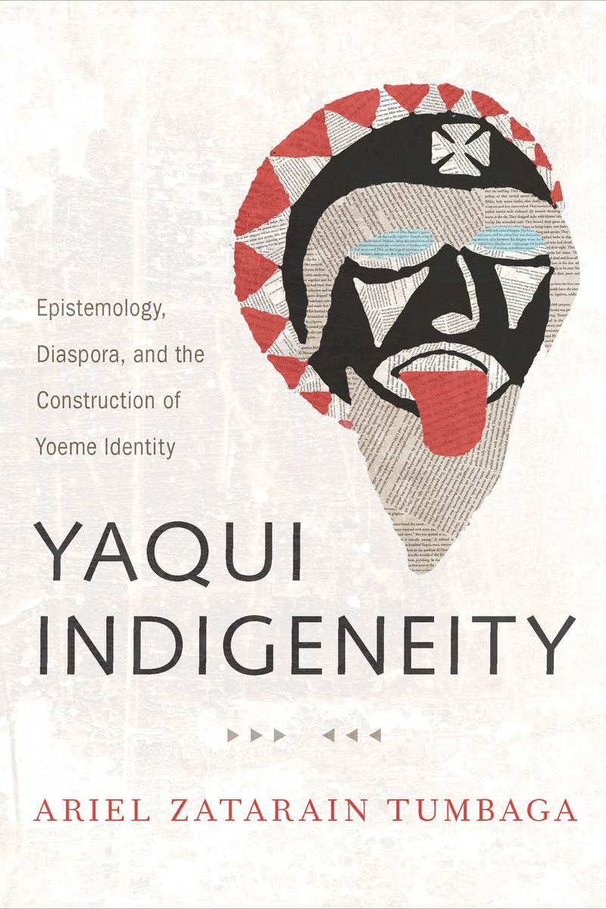
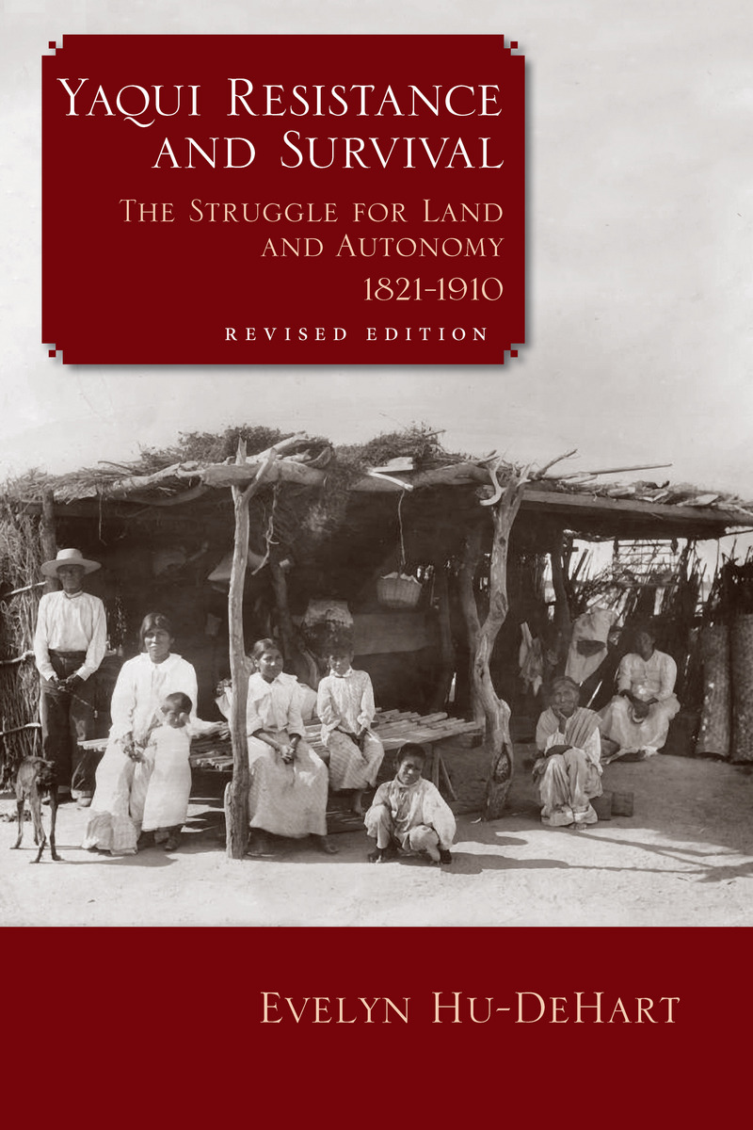
Literature
Evelyn Hu-DeHart brings into focus the Yaqui in the nineteenth century, as the newly independent Mexico lurched through immense economic and governmental transformations, wars, insurgencies, and changing political alliances. This history includes Yaqui efforts to establish a native republic independent of Mexico, their resistance against government efforts to reduce their communal land to individual holdings, the value of their labor to mining and agricultural companies in northwest Mexico, their several revolts and guerrilla actions, the massive deportation of Yaquis from Sonora to Yucatán, the flight of some Yaquis across the U.S. border to Arizona, and their role in the 1910 Mexican Revolution.
In this revised edition of her groundbreaking work, Hu-DeHart reviews and reflects on the growth in scholarship about the Yaqui, including advances in theoretical frameworks and methodologies on borderlands, transnationalism, diaspora, and collective memory that are especially relevant to their history.
The Yaqui warrior is a persistent trope of the Mexican nation. But using fresh eyes to examine Yoeme indigeneity constructs, appropriations, and efforts at reclamation in twentieth- and twenty-first-century Mexican and Chicana/o literature provides important and vivid new opportunities for understanding. In Yaqui Indigeneity, Ariel Zatarain Tumbaga offers an interdisciplinary approach to examining representations of the transborder Yaqui nation as interpreted through the Mexican and Chicana/o imaginary.
Tumbaga examines colonial documents and nineteenth-century political literature that produce a Yaqui warrior mystique and reexamines the Mexican Revolution through indigenous culture. He delves into literary depictions of Yaqui battalions by writers like Martín Luis Guzmán and Carlos Fuentes and concludes that they conceal Yaqui politics and stigmatize Yaqui warriorhood, as well as misrepresent frequently performed deer dances as isolated exotic events.
Yaqui Indigeneity draws attention to a community of Chicana/o writers of Yaqui descent: Chicano-Yaqui authors such as Luis Valdez, Alma Luz Villanueva, Miguel Méndez, Alfredo Véa Jr., and Michael Nava, who possess a diaspora-based indigenous identity. Their writings rebut prior colonial and Mexican depictions of Yaquis—in particular, Véa’s La Maravilla exemplifies the new literary tradition that looks to indigenous oral tradition, religion, and history to address questions of cultural memory and immigration.
Using indigenous forms of knowledge, Tumbaga shows the important and growing body of literary work on Yaqui culture and history that demonstrates the historical and contemporary importance of the Yaqui nation in Mexican and Chicana/o history, politics, and culture.

Slide 16
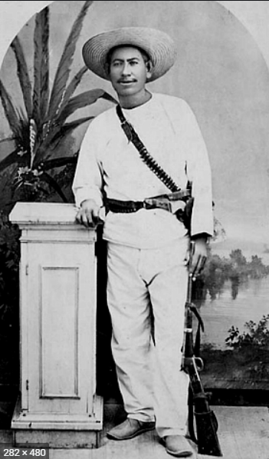
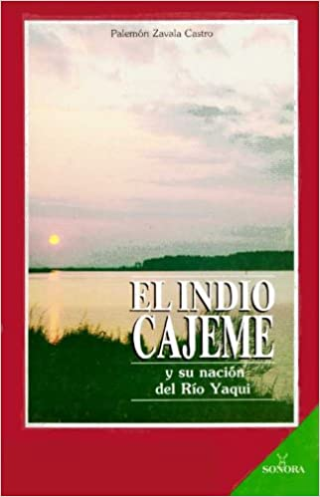
Cajeme-Hero of the Yoeme people
https://www.jstor.org/stable/41695415?seq=1#metadata_info_tab_contents
Scholarly Article about Cajeme aka Jose Maria Leyva
https://www.youtube.com/watch?v=daJDmLhOeXs
https://mexicounexplained.com/cajeme-yaqui-indian-republic/
The son of a revolutionary military man, "In the soldier's backpack" was almost born (as another descendant of the same lineage put it) in one of the many Obregonist troop trips to the nation's capital. Thus, he was born in the Federal District in 1922; but his mother, dona Maria Luisa Castro de Zavala, opposes his civil registry in that place and registers it, taking advantage of his trip to Bacum, Sonora, one of the coronaries of the Yaqui Valley.
His childhood was spent on board trains and ships on trips motivated by military reasons and in contact and dealing with Yaqui soldiers and children.
This was followed by his work "Perfiles de Sonora", a dramatic window that shows the history of the revolution in Sonora, intertwined with the biography of his father, General Marcelo Zavala y Cota, whose clean military career develops, not only in the dusty plains and frozen Sonoran mountains, but throughout the national territory at the command of Yaqui troops.

Slide 17
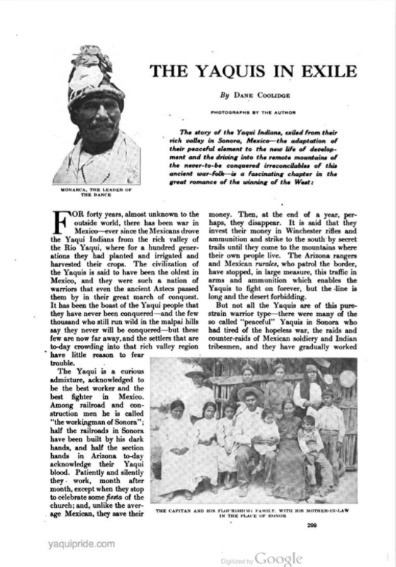
Articles
Collection of historically relevant media

Slide 18
Media/articles continued
http://yaquipride.com/pdf/articles/190909_SUNSET-YAQUI-IN-EXILEx.pdf
https://www.otago.ac.nz/english-linguistics/english/lowry/content/08_literature/08_pages/barbarous.html
https://www.onlytribal.com/yaqui-tribe.asp
https://www.nytimes.com/1885/07/09/archives/cajeme-the-yaqui-chief-career-of-the-sonora-outlaw-who-defies-the.html
https://cdnc.ucr.edu/?a=d&d=SFC18990809.2.39&e=-------en--20--1--txt-txIN--------1
https://chroniclingamerica.loc.gov/lccn/sn84031081/1906-03-29/ed-1/seq-7/
https://cdnc.ucr.edu/?a=d&d=SFC19090207.2.199.9&e=-------en--20--1--txt-txIN--------1
https://apnews.com/article/business-ff873a43313a6d3b9446cd420499548c
https://azmemory.azlibrary.gov/digital/collection/eltucsonense/id/4246/
https://azcapitoltimes.com/news/2018/05/14/thamar-richey-and-her-yaqui-students-2/
https://www.washingtonpost.com/outlook/2021/06/27/deadly-battle-over-control-yaqui-river-will-affect-us-all/
https://www.nytimes.com/1886/05/10/archives/the-yaqui-war-in-mexico.html
https://indigenousmexico.org/sonora/watching-the-yaquis-from-los-angeles-1894-1937-enduring-resistance-in-the-face-of-extermination/?print=print

Slide 19
Scholarly Article
https://www.jstor.org/stable/41696297?read-now=1&refreqid=excelsior%3A2dfb4c20d16d29420e9915e72a454fa2&seq=12#page_scan_tab_contents
https://digitalcommons.unl.edu/cgi/viewcontent.cgi?article=1024&context=historydiss

Slide 20
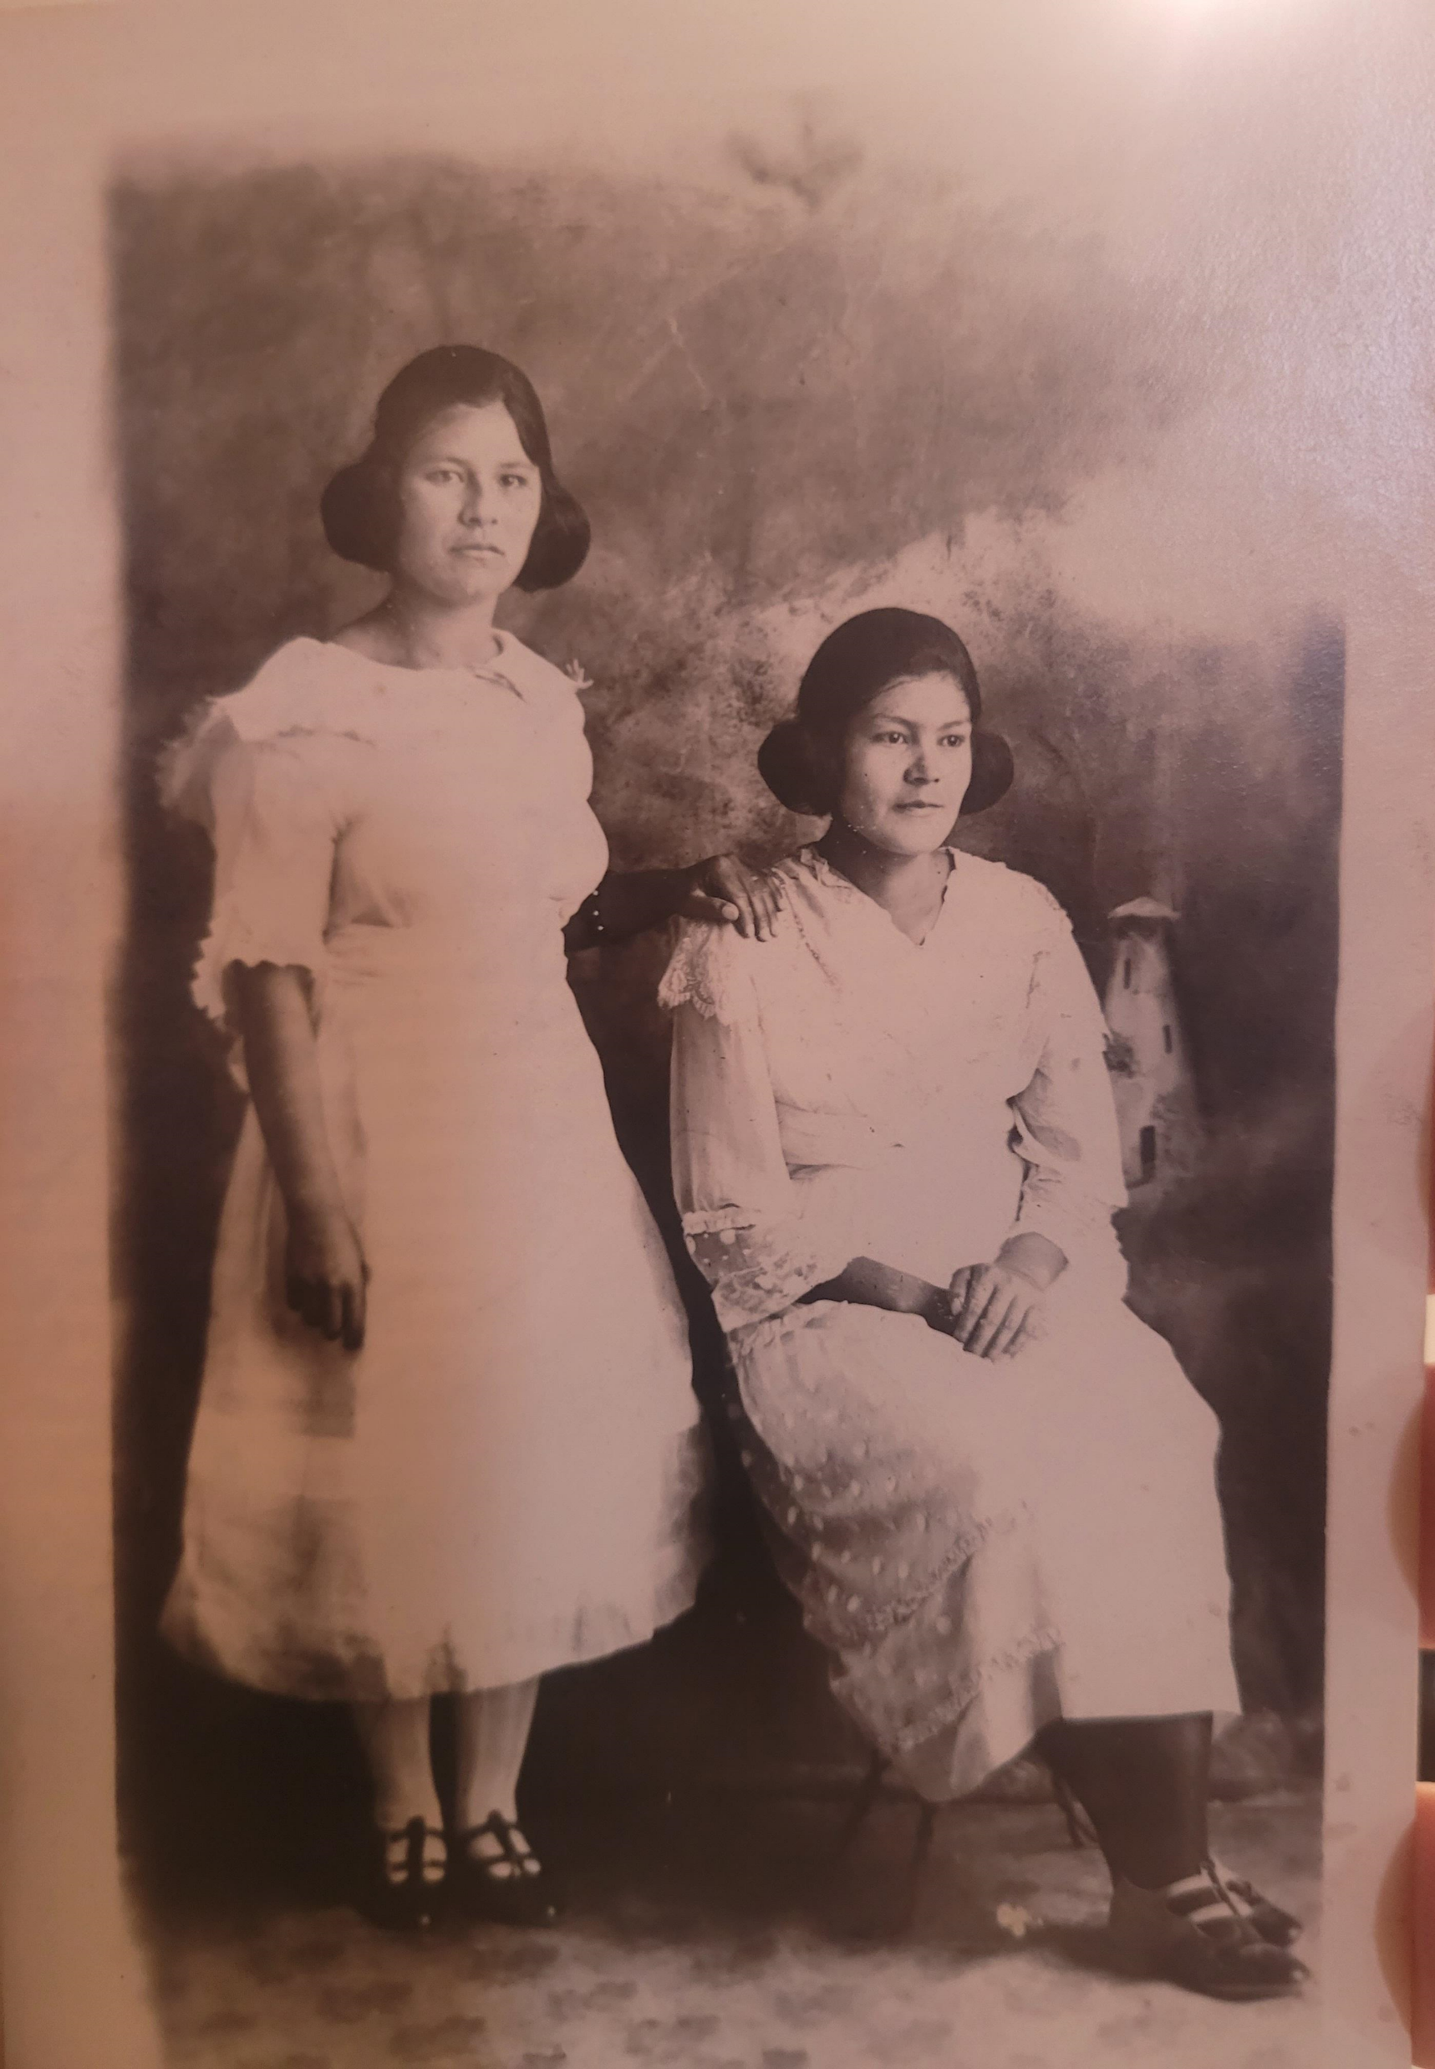
There is a need…
The information obtained in these slides is abundant, for adults. What about the younger community who is not submerged in the culture filled with oral traditions and culture?
I was one of those children and there is little to no children’s literature or access to for children of a young age.
Additionally, this is a living project. For me, I will use this information to learn more about my Yaqui family history, culture and maybe even perhaps, create a children’s book about my journey, the stories and more. This has inspired me.
Thank you,
Patricia Palomera- Granddaughter of Yoeme Migrant tribe members Mercedes Villaescusa ( pictured on the left) and Teodoro Mendoza

